Slide 1


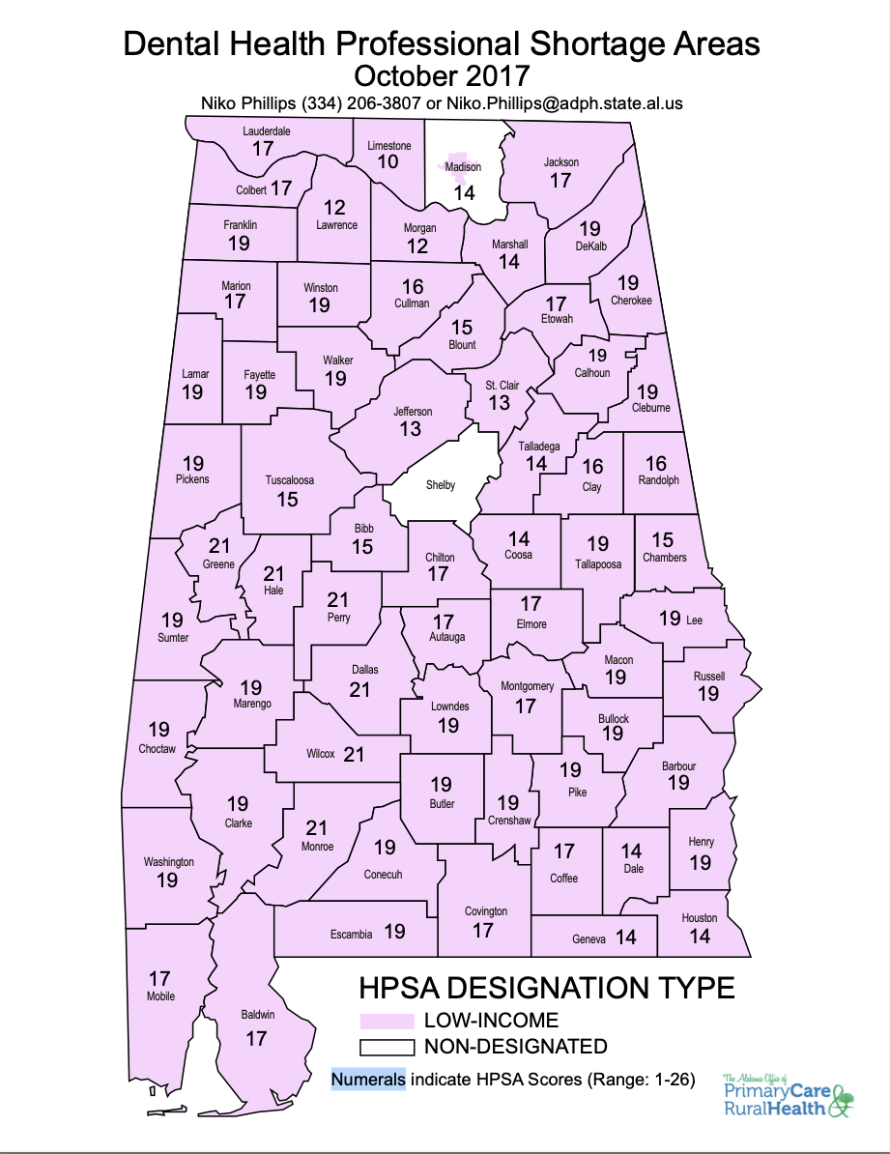


Pathway to Oral Health: Development of
The Rural Dental Scholars Program
Drake Lavender, MD, Holly McCaleb, MD, Susan Guin, MSN, FNP, Antonio Gardner, Ph. D., Carly Timmons Mckenzie, Ph.D.
The University of Alabama/UAB School of Dentistry
Introduction
Alabama’s Dentist Shortage
Introduction
Results
The Rural Medical Scholars Program at The University of Alabama is a selective medical school admissions program to the UAB Heersink School of Medicine for students from rural Alabama who have a stated desire to practice primary care in rural Alabama.
Developed in 1996, it is one of a group of rural pathway programs at The University of Alabama that start in high school and continue into residency.
Given the success of the RMSP, in 2022 a collaborative effort began between The University of Alabama College of Community Health Sciences and The UAB School of Dentistry to develop a similar pathway into dental school for rural students.
Consequently, the Rural Dental Scholars was developed to address the shortage of rural dentists in Alabama.
4 students entered the initial cohort of Rural Dental Scholars and are currently completing their Master’s degree in Rural Community Health.
There are 2 male and 2 female students.
All students are performing at high academic levels, and expected to matriculate into UAB School of Dentistry in Summer 2024.
5 students have applied to, interviewed for, and been accepted into RDS for the upcoming cycle.
Future Research
Short-term and long-term evaluation of RDS practicing dentistry in rural Alabama.
Development of high school and college pipelines for rural dentistry.
Comparison of RDS to general admits in site selection for rural practice sites.
Background
There is a severe shortage of dentists is Alabama, particularly in rural areas.
66 of 67 Alabama counties are designated as Dental Health Professional Shortage Areas with an estimated 511 dentists needed in HPSA areas to resolve the shortage.
Lack of preventative dental services are associated with poor outcomes.
Rural residents are less likely to have received preventative dental care than their urban counterparts.
Despite efforts such as recruitment of rural students, rural rotations, and loan repayment programs specific to those who enter practice in a rural area, the UAB School of Dentistry has found that few graduates enter rural practice.
Methods/Design
Admission requirements include:
  GPA 3.3 (BCPM 3.0)
  DAT 17
  Must have lived in rural AL for 8 years or graduated from a rural high school
Master’s year curriculum includes:
  12 credit hours of graduate level Biology/Chemistry
  Health Policy and Planning
  Rural Environmental and Occupational Health
  Community Clinical Process – lectures from dental practitioners, dental shadowing, and a community health assessment of their home community
  Clinical Correlations – correlation of science curriculum into clinical cases, study skills, test taking strategies, time management and wellness activities
Students also participate in community engagement activities and advocacy events (Alabama Dental Association annual meeting, National Rural Health Association Health Policy Institute)
Alabama Department of Public Health. Dental Health Professional Shortage Areas. https://www.alabamapublichealth.gov/ruralhealth/assets/dentalhpsamap-oct2017.pdf; accessed 1/29/24
Luo H, Wu Q, Bell RA, Wright W, et al. Rural-Urban Differences in Dental Service Utilization and Dental Service Procedures Received Among US Adults: Results From the 2016 Medical Expenditure Panel Survey. J Rural Health. 2021 Jun;37(3):655-666.
Bibliography

