Slide 1

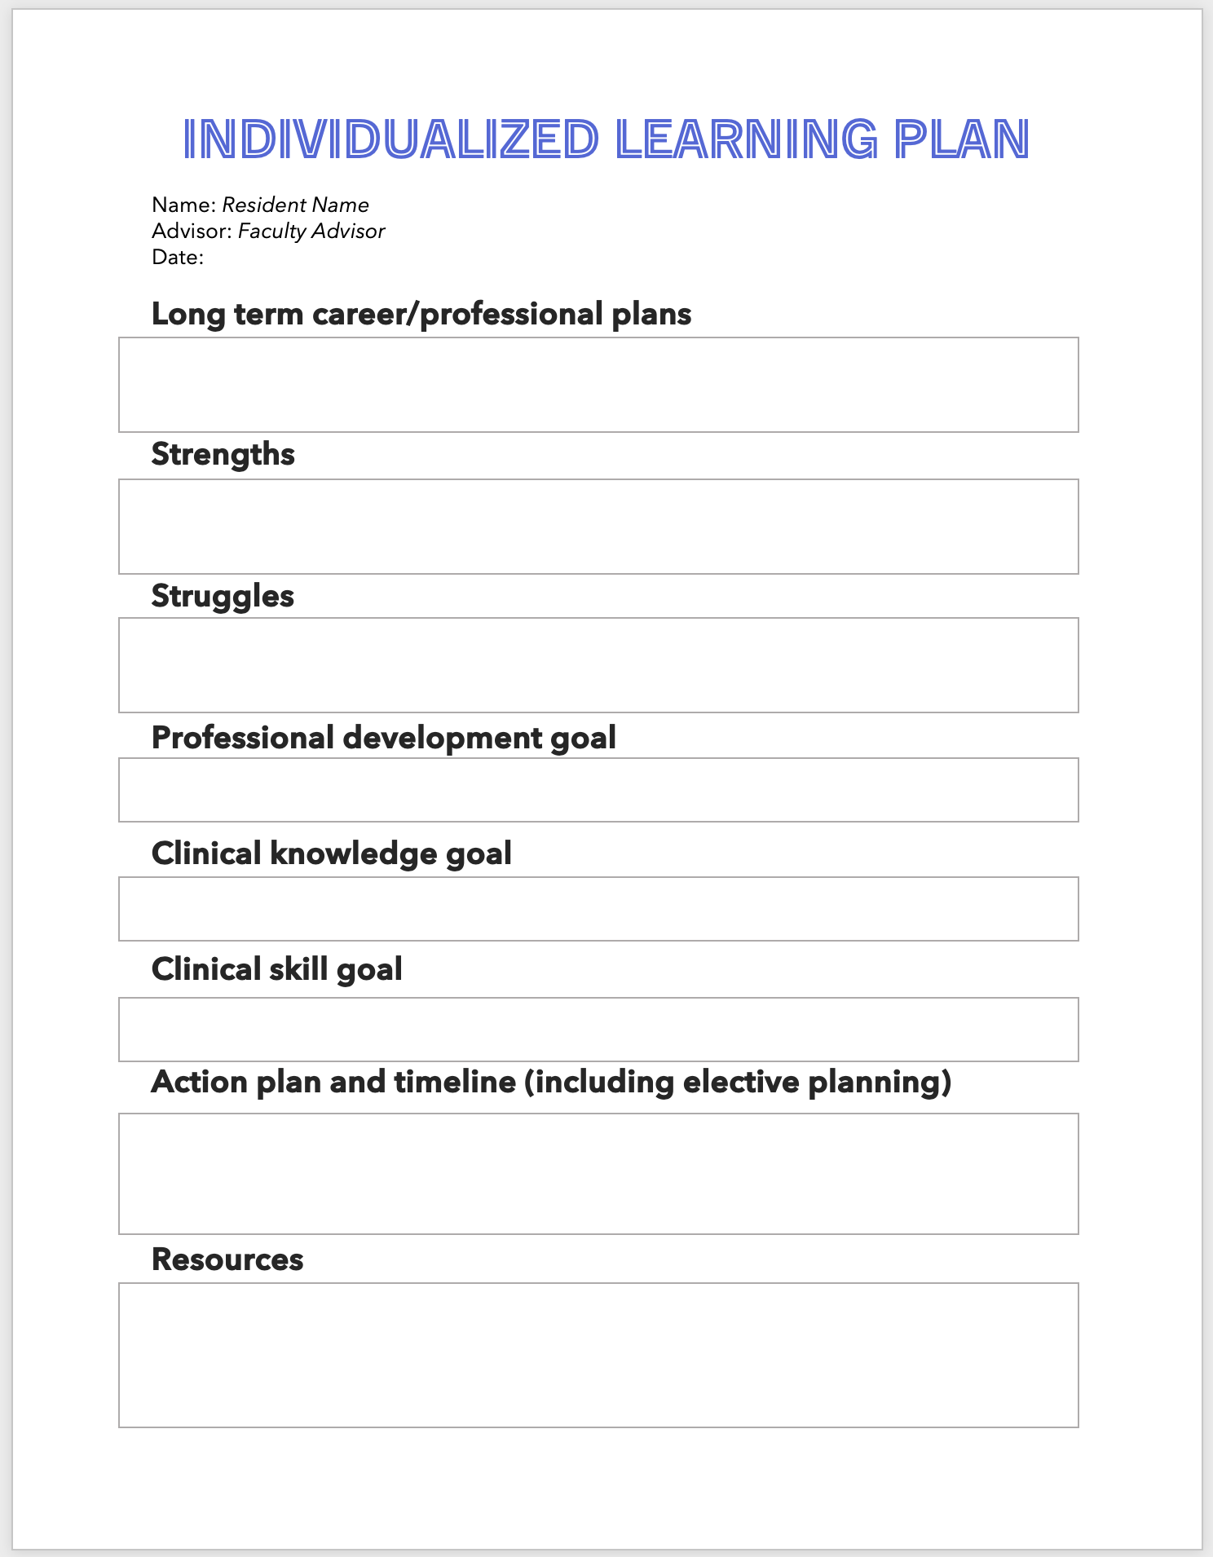
leveraging Individualized learning plans to optimize resident education
Alexa Namba, DO, MPH,
Eric Buenviaje, MD, FAAFP
Duke Rural Family Medicine Residency Program,
Department of Family Medicine and Community Health
METHODS
The implementation of ILPs have provided a framework to optimize personalized resident education, while enhancing collaboration with faculty advisors.
We created an ILP template utilizing Microsoft Word (Fig. 1) and reviewed expectations during a resident-faculty shared meeting
Residents and faculty advisors began creating, revising, and reviewing ILPs every 6 months
ILPs were posted to each resident’s channel on Microsoft Teams, so residents, faculty and leadership could monitor individual goals and progress
INTRODUCTION
Individualized learning plans (ILPs) provide a framework for residents to reflect on their learning and training needs to adequately prepare for their future career aspirations.¹ ILPs allow learners to take an active role in shaping their residency education and customizing their training through intentional reflection practices and longitudinal I-SMART goals.² When crafted appropriately, ILPs can provide structure to residents’ self-directed learning and increase learner motivation.^{3, 4} Prior evaluation of ILPs in pediatric residency programs has demonstrated the most effective components of successful ILPs were the creation of measurable goals and systems to monitor resident progress.⁵
Historically, we utilized ILPs for struggling residents to provide structure for their remediation plans. To better align with ACGME program requirements⁶, we adapted our template to be applicable to all residents.
FIGURE 1
RESULTS
100% of residents (N=5) implemented the ILP process including posting revisions every 6 months. This has led to better understanding of each resident’s career aspirations among residency leadership and faculty, as well more defined short terms goals for each resident. For PGY2s and PGY3s, elective planning has been more intentional and occurred earlier in the year.
Pre-work completed by the resident ahead of advising meeting
CONCLUSIONS
ILPs have allowed residents to play a more active role in shaping their own residency education and strengthened collaboration with their faculty advisors and program leadership.
Objectives
REFERENCES
Build an easy-to-use ILP template that can be regularly revised, monitored, and archived for future reference
Cultivate residents’ self-directed learning strategies including personal reflection, goal setting, and professional adaptability
Foster collaboration between faculty and their advisees to customize residency education
Fulfill ACGME requirements⁶ related to ILPs:
  IV.C.3.u).(2), IV.C.3.u).(3), IV.C.3.u).(3), V.A.1.d).(2), V.A.1.d).(5), V.A.1.d).(6), V.A.1.d).(6).(b),
ACGME. Executive summary: individualized learning plans. https://www.acgme.org/globalassets/pdfs/milestones/guidebooks/individual-learning-plans.pdf
Wheat S, Cole S. Individualized Learning Plans: Who, What, When, Where, Why, and How?. Ann Fam Med. 2023;21(6):560-562. doi:10.1370/afm.3062
Stuart E, Sectish TC, Huffman LC. Are residents ready for self directed learning? A pilot program of individualized learning plans in continuity clinic. Ambul Pediatr. 2005;5:298-301.
Chan SW, Chien WT. Implementing contract learning in a clinical context: report on a study. J Adv Nurs. 2000;31(2):298-305.
Li ST, Tancredi DJ, Co JP, West DC. Factors associated with successful self-directed learning using individualized learning plans during pediatric residency. Acad Pediatr. 2010;10(2):124-130. doi:10.1016/j.acap.2009.12.007
ACGME. ACGME Program Requirements for Graduate Medical Education in Family Medicine. https://www.acgme.org/globalassets/pfassets/programrequirements/120_familymedicine_2024.pdf
Completed by resident & faculty advisor during meeting
Completed by faculty advisor following meeting

