Slide 1
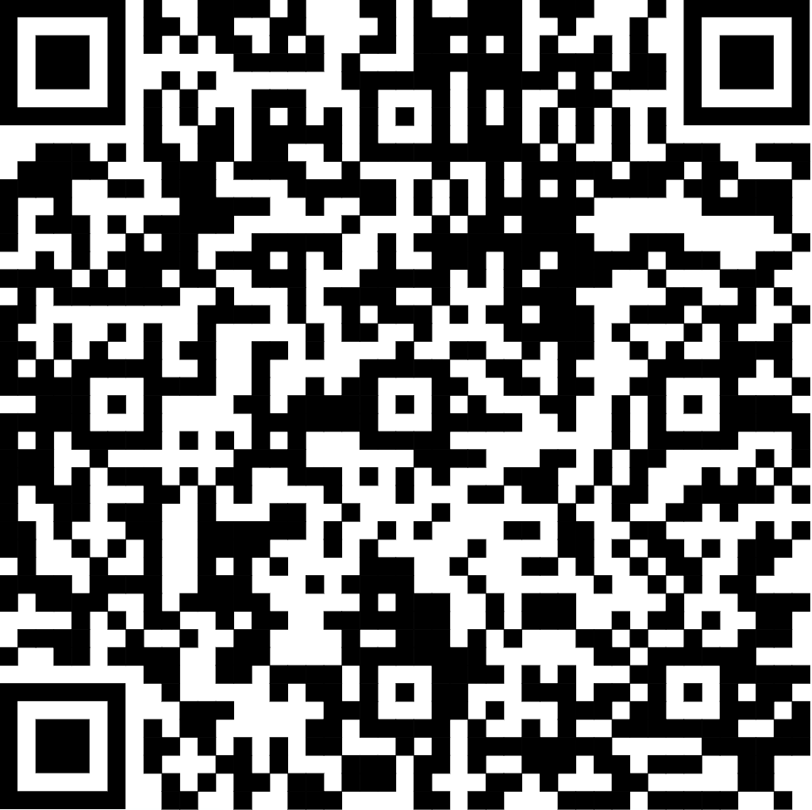
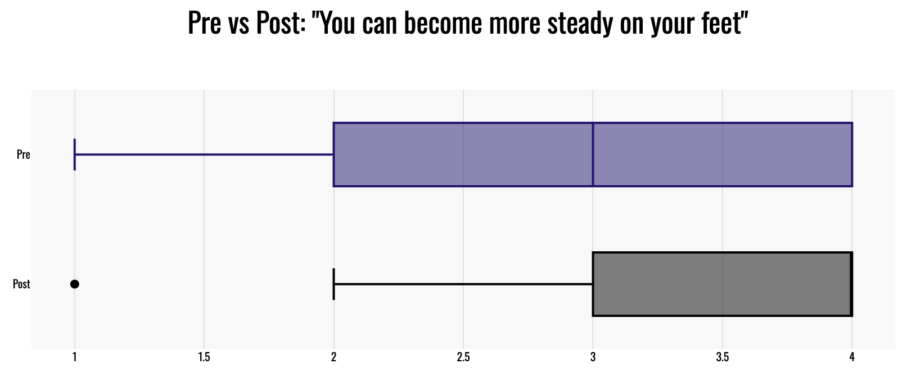
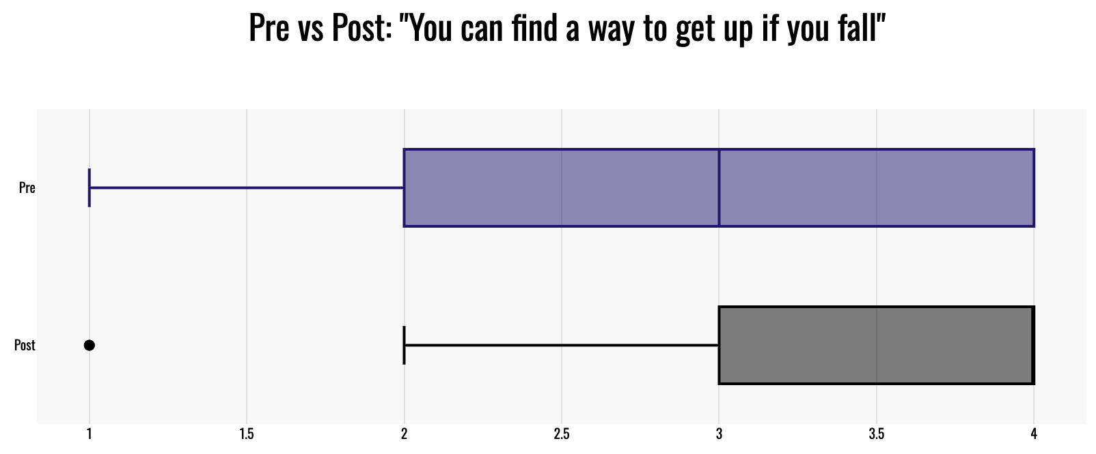
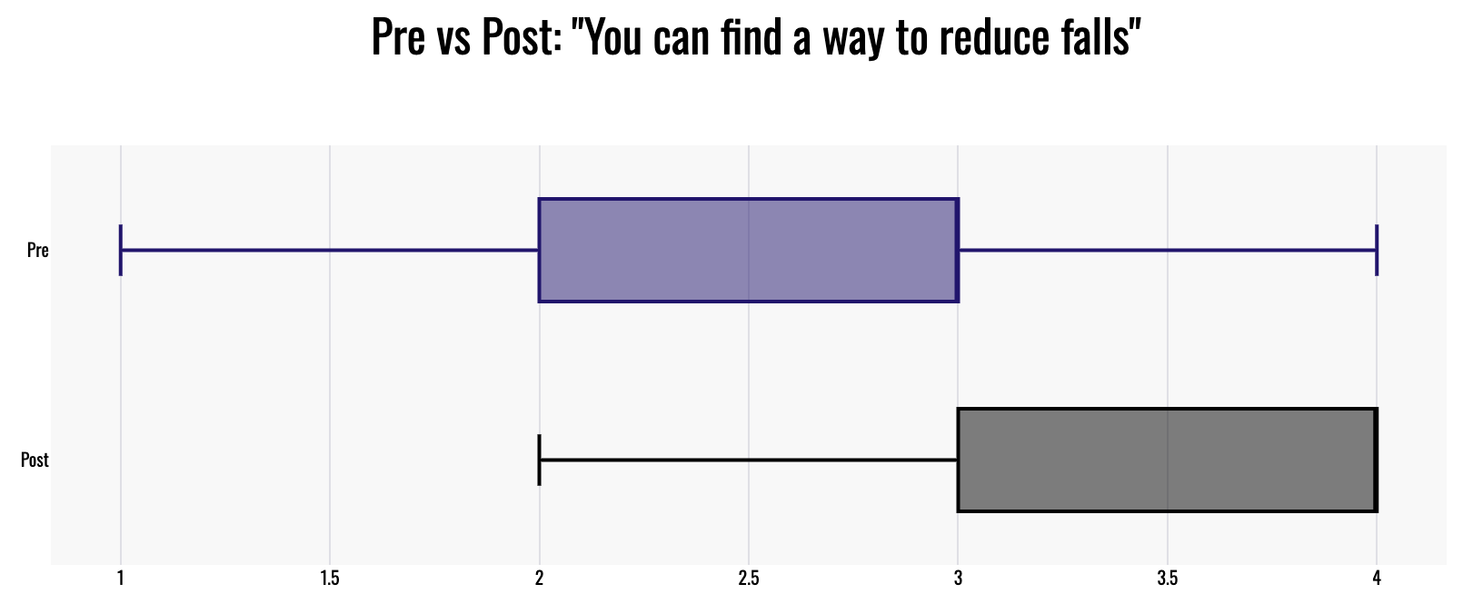
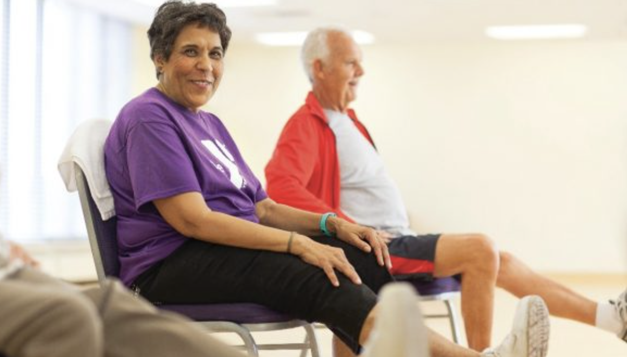
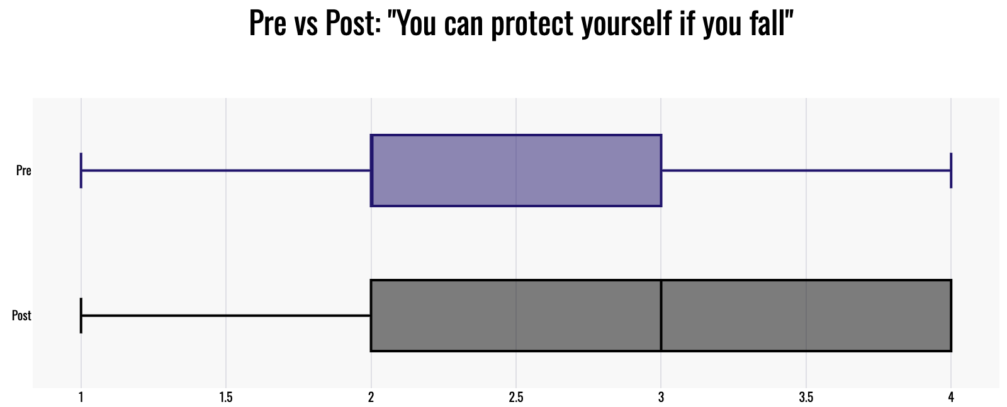
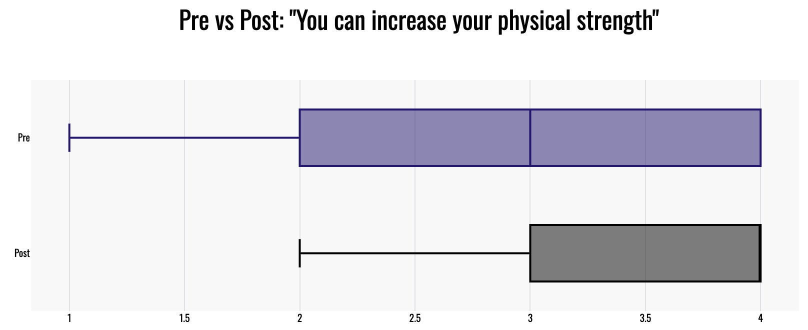
Evaluating A Matter of Balance Series for Fall Prevention in Rural Texas: Findings and Implications
Bergen Lemack¹, Sara Murphy¹, Jennifer Severance¹, Andrew B. Crocker^{2,3}
¹ University of North Texas Health Science Center – Center for Older Adults, ²Texas A&M AgriLife Extension Service – Family & Community Health, ³Texas Tech University – School of Veterinary Medicine
BACKGROUND
RESULTS
You can become steadier on your feet
Falls among older adults, a public health issue affecting one-fourth of adults aged 65 and older annually, presents significant risks in the United States, notably in Texas where they remain a leading cause of unintentional injury death, particularly in rural areas. These incidents not only threaten physical health but also reduce confidence and overall well-being.
The COVID-19 pandemic exacerbated challenges for rural healthcare systems in the U.S., especially in Texas. In 2020, Texas witnessed a surge in rural hospital closures, the highest number in over a decade nationwide. Additionally, the scarcity of healthcare professionals, including primary care physicians and registered nurses, intensifies the healthcare crisis, with a shocking 82% of Texas counties designated as primary care shortage areas.
In response to these challenges, the A Matter of Balance series emerges as a promising solution to a large problem. Focused on enhancing participant well-being, the program targets key aspects including confidence, physical activity, and awareness.
The study revealed significant enhancements in participants' well-being following engagement in the A Matter of Balance series. Statistical analyses indicated notable improvements across various aspects of fall prevention knowledge and physical capabilities. Participants demonstrated increased knowledge about fall prevention strategies (p < .001), improved ability to protect themselves during falls (p < .001), enhanced physical strength (p < .001), steadier balance (p < .001), and better fall recovery skills (p < .001).
Pre
Post
1 1.5 2 2.5 3 3.5 4
CONCLUSIONS
You can find a way to get up if you fall
Pre
Post
A Matter of Balance series has proven to be a successful intervention for enhancing the well-being of rural Texas participants. By instilling confidence, alleviating concerns, and promoting physical activity, the program effectively addresses the prevalent challenges associated with falls among older adults. As one participant noted, "I am more assured to look forward & not down as I walk." The significant improvements observed in participants' well-being underscore the program's efficacy in empowering individuals to take proactive measures against falls.
Moving forward, sustained efforts to expand access to and participation in the A Matter of Balance series are crucial for promoting healthy aging and mitigating the burden of fall-related injuries in rural communities. As another participant emphasized, "I understand better what moves strengthen what parts of the body." By prioritizing the spread of evidence-based interventions like the A Matter of Balance series, we can effectively address the challenges of falls among older adults, ultimately contributing to healthier and safer rural communities.
1 1.5 2 2.5 3 3.5 4
You can find a way to reduce falls
Pre
Post
1 1.5 2 2.5 3 3.5 4
You can protect yourself if you fall
METHODS
Pre
Post
In 2023, a secondary analysis of 164 surveys from participants of the A Matter of Balance series was conducted. The intervention involved eight 2-hour sessions led by Agrilife's certified educators, focusing on behavioral modification strategies. Participants, predominantly female (90.1%), aged 35 to 96 (average age: 75.88), completed surveys before and after the series. These surveys assessed fall prevention knowledge, protective techniques, and confidence levels, rated on a scale from 1 (not sure at all) to 4 (absolutely sure). A paired t-test compared pre- and post-intervention scores to measure changes in knowledge and well-being, aiming to enhance fall prevention understanding, improve physical capabilities, and boost confidence in managing fall-related situations.
1 1.5 2 2.5 3 3.5 4
REFERENCES
You can increase your physical strength
Centers for Disease Control and Prevention. (n.d.). Keep on Your Feet—Preventing Older Adult Falls. Retrieved from https://www.cdc.gov/steadi/index.html
Texas Department of State Health Services. (n.d.). Injury Prevention. Retrieved from https://www.dshs.texas.gov/injury-prevention
APM Research Lab. (n.d.). Rural health and hospitals: A focus on Texas. Retrieved from https://www.apmresearchlab.org/rural-hospital-closures
Pre
Post
1 1.5 2 2.5 3 3.5 4

