Slide 1
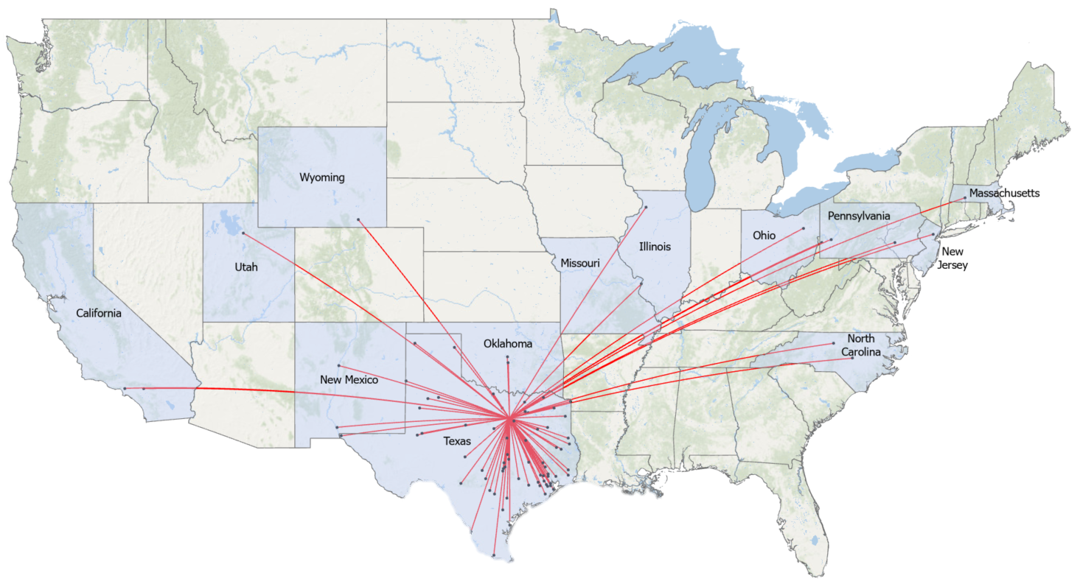
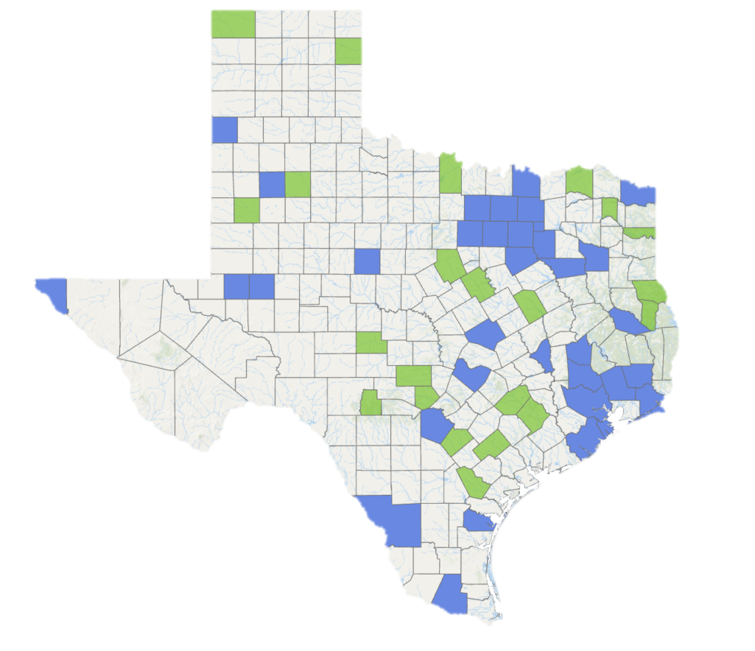
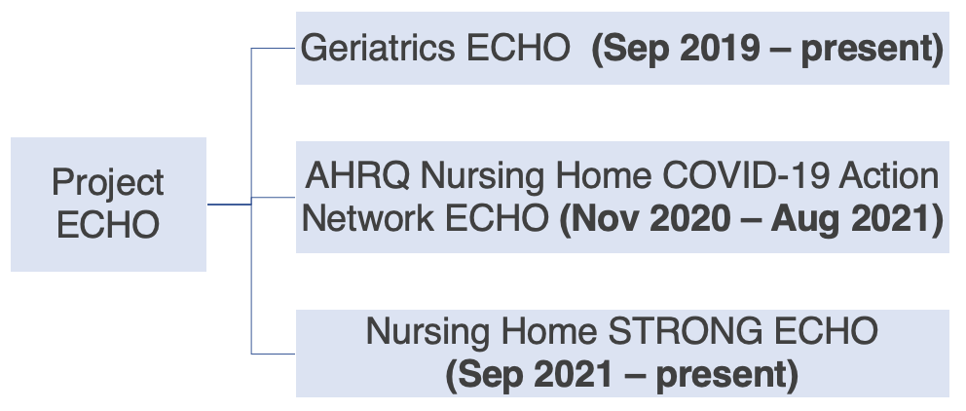
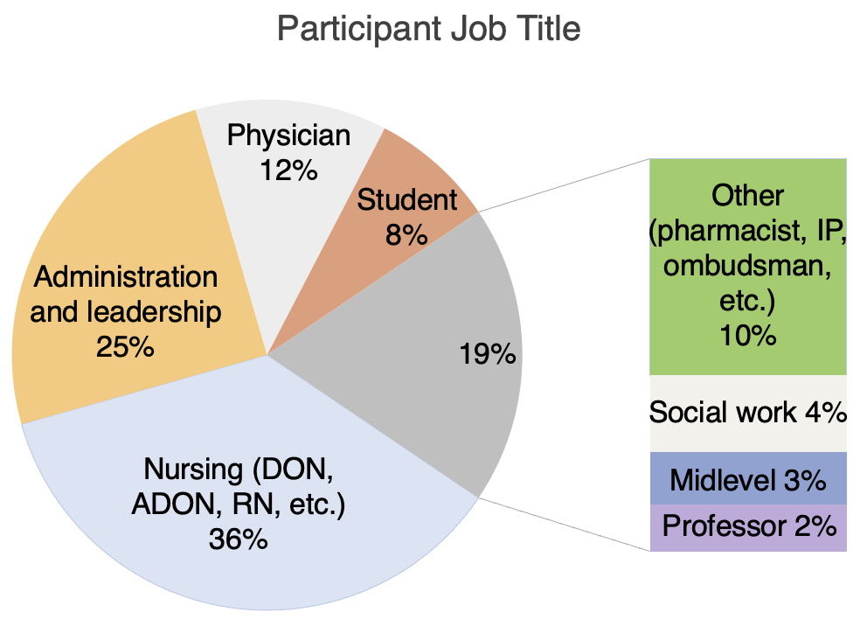
Evaluating the Rural Impact of Project ECHO
Sara Murphy, PhD, Matthew Biggerstaff, OMS-III, Sarah Ross, DO, Susanna Luk-Jones, MS, Jennifer Severance, PhD
BACKGROUND
RESULTS
CONCLUSIONS
The number of adults over 65 is projected to increase from 54.1 million in 2019 to 80.8 million in 2040, representing the fastest growing segment of the US population.¹ This growth is expected to place further strain on a geriatric workforce that has been disproportionately impacted by COVID-19 and is already facing numerous staffing shortages.² Expanding geriatric education and training for health professionals caring for older adults could better prepare the healthcare system to address these challenges. The ECHO (Extension for Community Healthcare Outcomes) project at the UNTHSC Center for Older Adults aims to fulfill this need using interactive videoconferencing sessions that connect interprofessional teams of geriatric specialists with healthcare teams caring for older adults, particularly those in rural or underserved communities.
Participant Locations from 159 ECHO Sessions (Sep 2019 – Sep 2022)
Utilization of the Project ECHO model has allowed the UNTHSC Center for Older Adults to disseminate expert knowledge in geriatric care to a widespread geographic distribution in Texas and its surrounding regions, including rural regions. This ECHO project offers an innovative communication channel that uses interdisciplinary teamwork to provide healthcare professionals with tools to address a variety of health concerns affecting the mind, body, and spirit in the geriatric population.
A
FUTURE DIRECTION
Future ECHO lines at the UNTHSC Center for Older Adults will focus on broadening the scope of geriatric educational material. In addition, efforts are being made to expand the outreach of project ECHO through social media marketing and mailing campaigns, particularly targeting facilities in states immediately surrounding Texas.
RESEARCH QUESTION
Legend
Reached by Project ECHO
Not reached by Project ECHO
Location of participant(s)
Can the Project ECHO model be applied to geriatric workforce education and training to reach a broad audience in Texas and the surrounding regions?
Figure 1: Map depicting the “hub and spokes” pattern of geographic locations, including 14 states, reached by UNTHSC Project ECHO from September 2019 through September 2022. Not included in this map but participating in the ECHO project include Alaska, Myanmar, and Nepal.
METHODS
ACKNOWLEDGEMENTS
Three platforms were offered:
Weekly, bi-weekly, or monthly ECHO sessions were broadcasted remotely via Zoom from UNTHSC. Sessions included expert-led didactics and interactive discussions across a variety of geriatric topics, from COVID-19 infection prevention to burnout among nursing home staff. The target audience primarily included staff and leadership at long-term care facilities and primary care providers in Texas and the surrounding regions.
This project is supported by the Health Resources and Services Administration (HRSA) of the U.S. Department of Health and Human Services (HHS) as part of a Geriatrics Workforce Enhancement Program under grant number UTQHP28735. The North Texas Regional Institutional Review Board approved the study as meeting criteria for exempt status.
SOURCES
1. Projected future growth of older population. (2022, May 4). Administration for Community Living. https://acl.gov/aging-and-disability-in-america/data-and-research/projected-future-growth-older-population
2. Xu, H., Intrator, O., & Bowblis, J. R. (2020). Shortages of Staff in Nursing Homes During the COVID-19 Pandemic: What are the Driving Factors?. Journal of the American Medical Directors Association, 21(10), 1371–1377. https://doi.org/10.1016/j.jamda.2020.08.002
3. Rural Texas counties. (n.d.). Texas Commission on the Arts. https://www.arts.texas.gov/initiatives/rural-initiatives/rural-texas-counties/
NP or PA
Legend
Rural county
Nonrural county
Figure 2: Breakdown from the 354 of 437 unique participants that reported job titles.
DON: director of nursing, ADON: assistant director of nursing, IP: infection preventionist, NP: nurse practitioner, PA: physician assistant.
Figure 3: Map demonstrating the counties in Texas reached by the UNTHSC Project ECHO lines, divided into rural and nonrural. Of the 58 unique Texas counties with ECHO participants, 22 (37.9%) were considered rural^{.3}
Notes:
Hybrid Model

