Slide 1
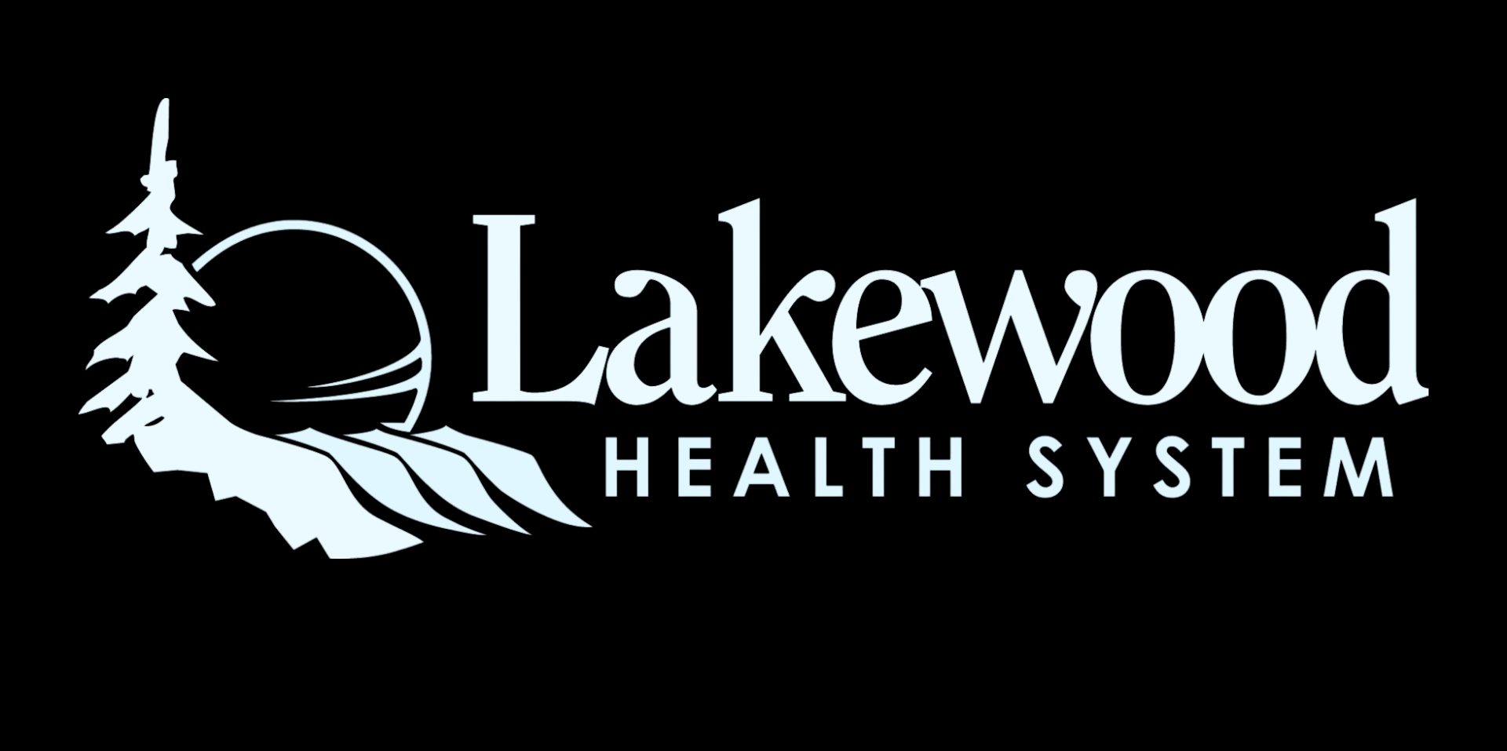
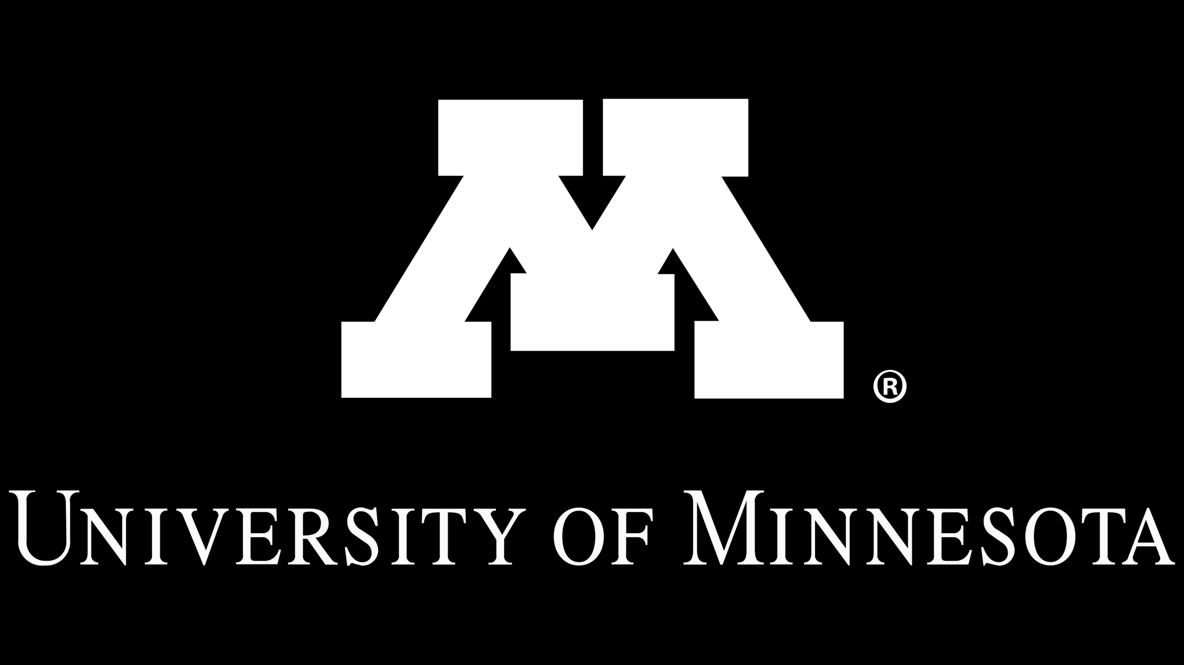
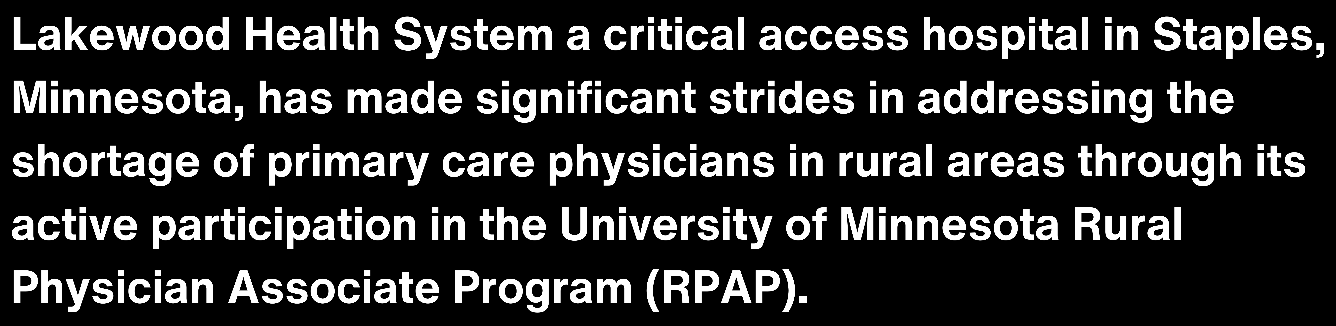
NURTURING PRIMARY CARE IN RURAL AMERICA:
Insights from Lakewood Health System's Rural Physician Associate Program (RPAP) Success
Aidan Swenson, University of Minnesota Twin Cities
What is RPAP?
The Rural Physician Associate Program (RPAP) is a nine-month, community- based educational
experience for University of
This program is a key factor in training primary care physicians at Lakewood, with 83% of their family medicine doctors being former RPAP students.
Minnesota third-year medical students who live and train in rural communities across Minnesota and western Wisconsin. RPAP students experience hands-on learning as they care for patients of all ages.
RPAP was founded in 1971 to increase the number of primary care physicians in rural Minnesota and now has 1,600+ alumni.
83%
41
To date, Lakewood has hosted 41 RPAP students, and notably, 11 of these students have chosen to continue their careers at Lakewood Health System.
Each year, the program brings two third-year medical students to Lakewood for a nine-month period, which forms a major part of their third-year medical education.
Lakewood Primary Service Area
28,000
14
10
Culture of Teaching: Lakewood's commitment to educating future physicians ensures a steady influx of trained professionals dedicated to rural healthcare. The culture of teaching is a differentiator for rural healthcare workforce recruiting.
Family Medicine MDs
Family Medicine APPs

