Slide 1
RTT Collaborative
Navigating the Website

Slide 2
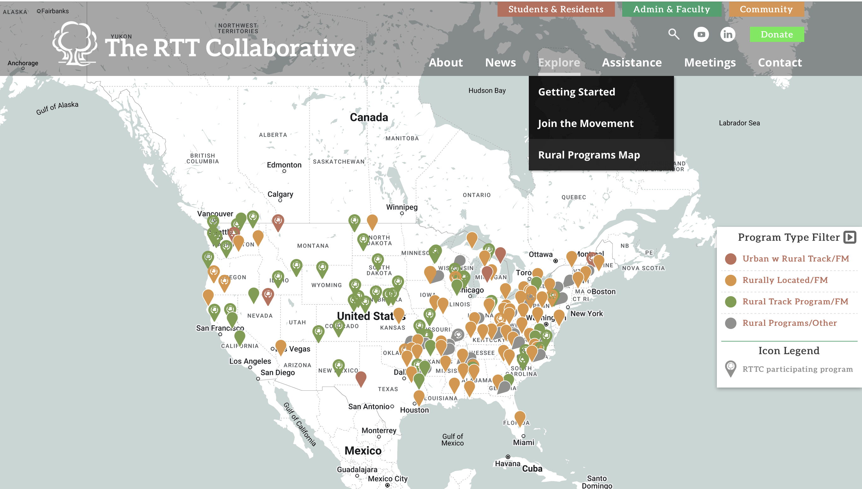
Explore > Rural Program Map https://rttcollaborative.net/rural-programs/residency-map/

Slide 3
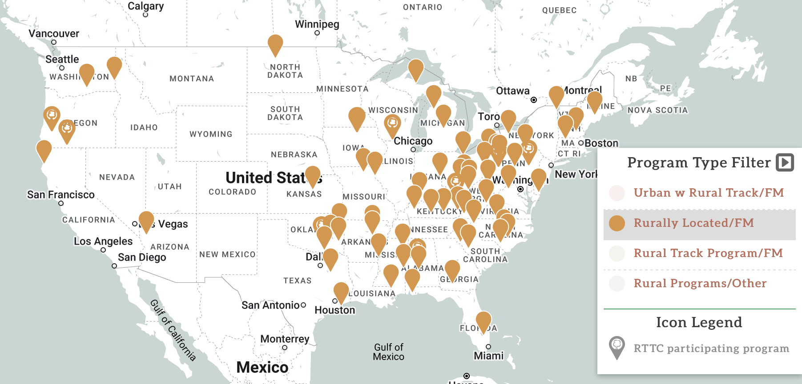
Rurally Located

Slide 4
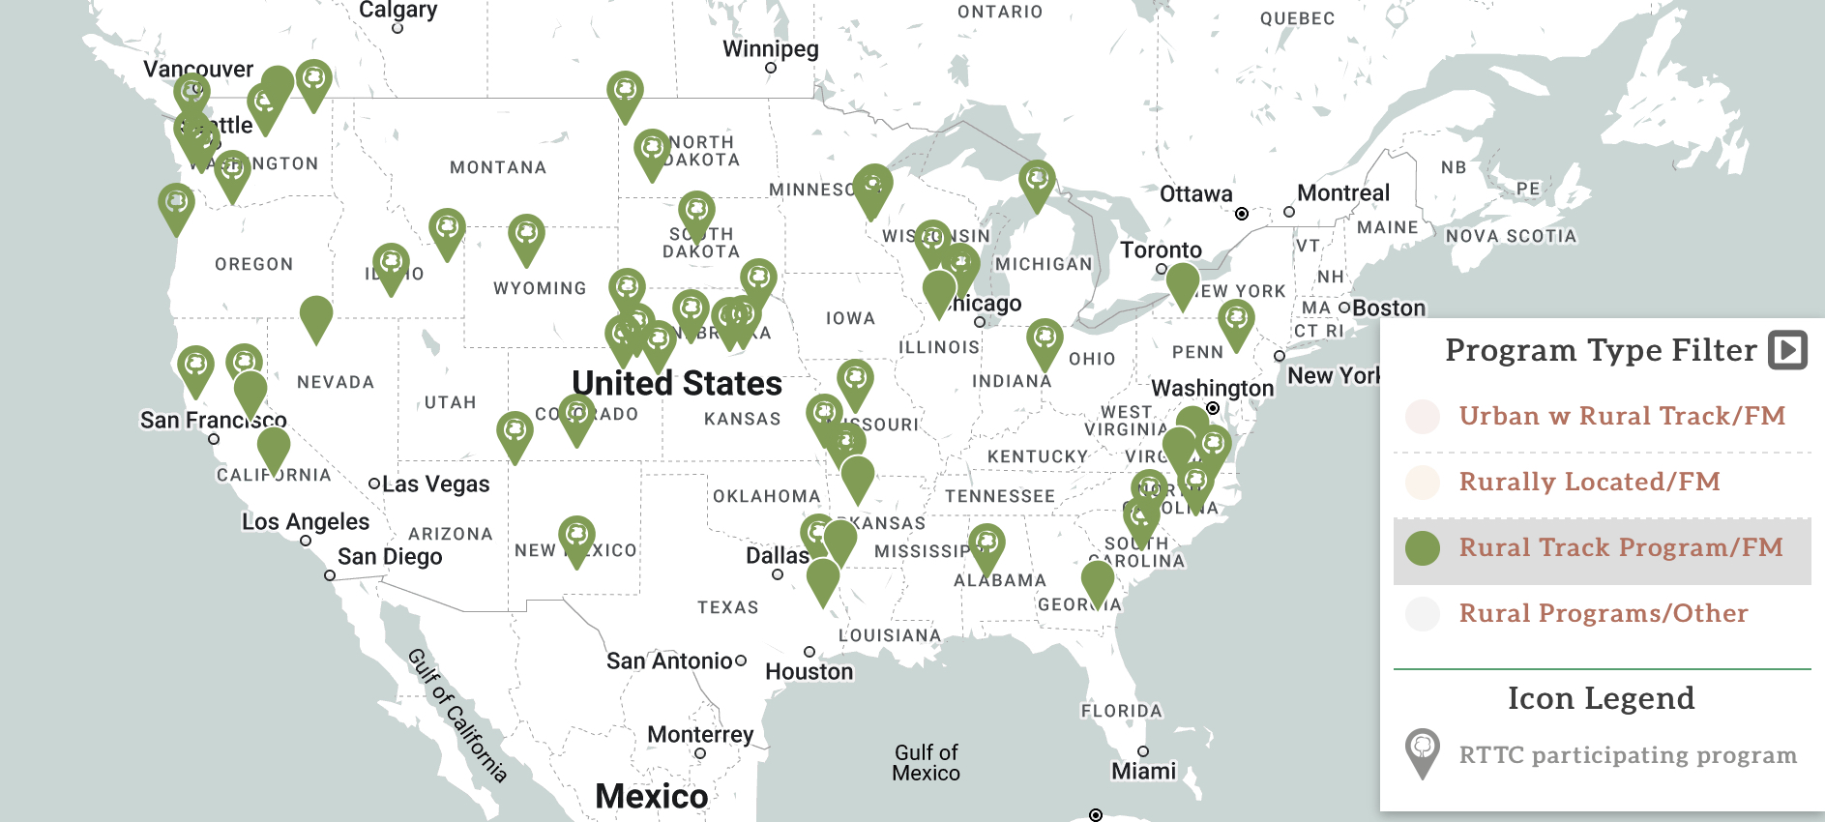
Rural Track Program (RTP)

Slide 5
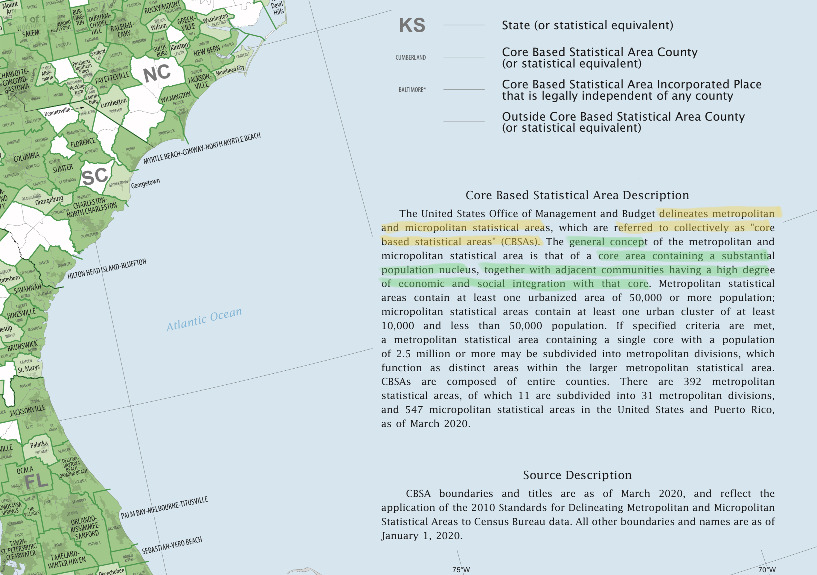
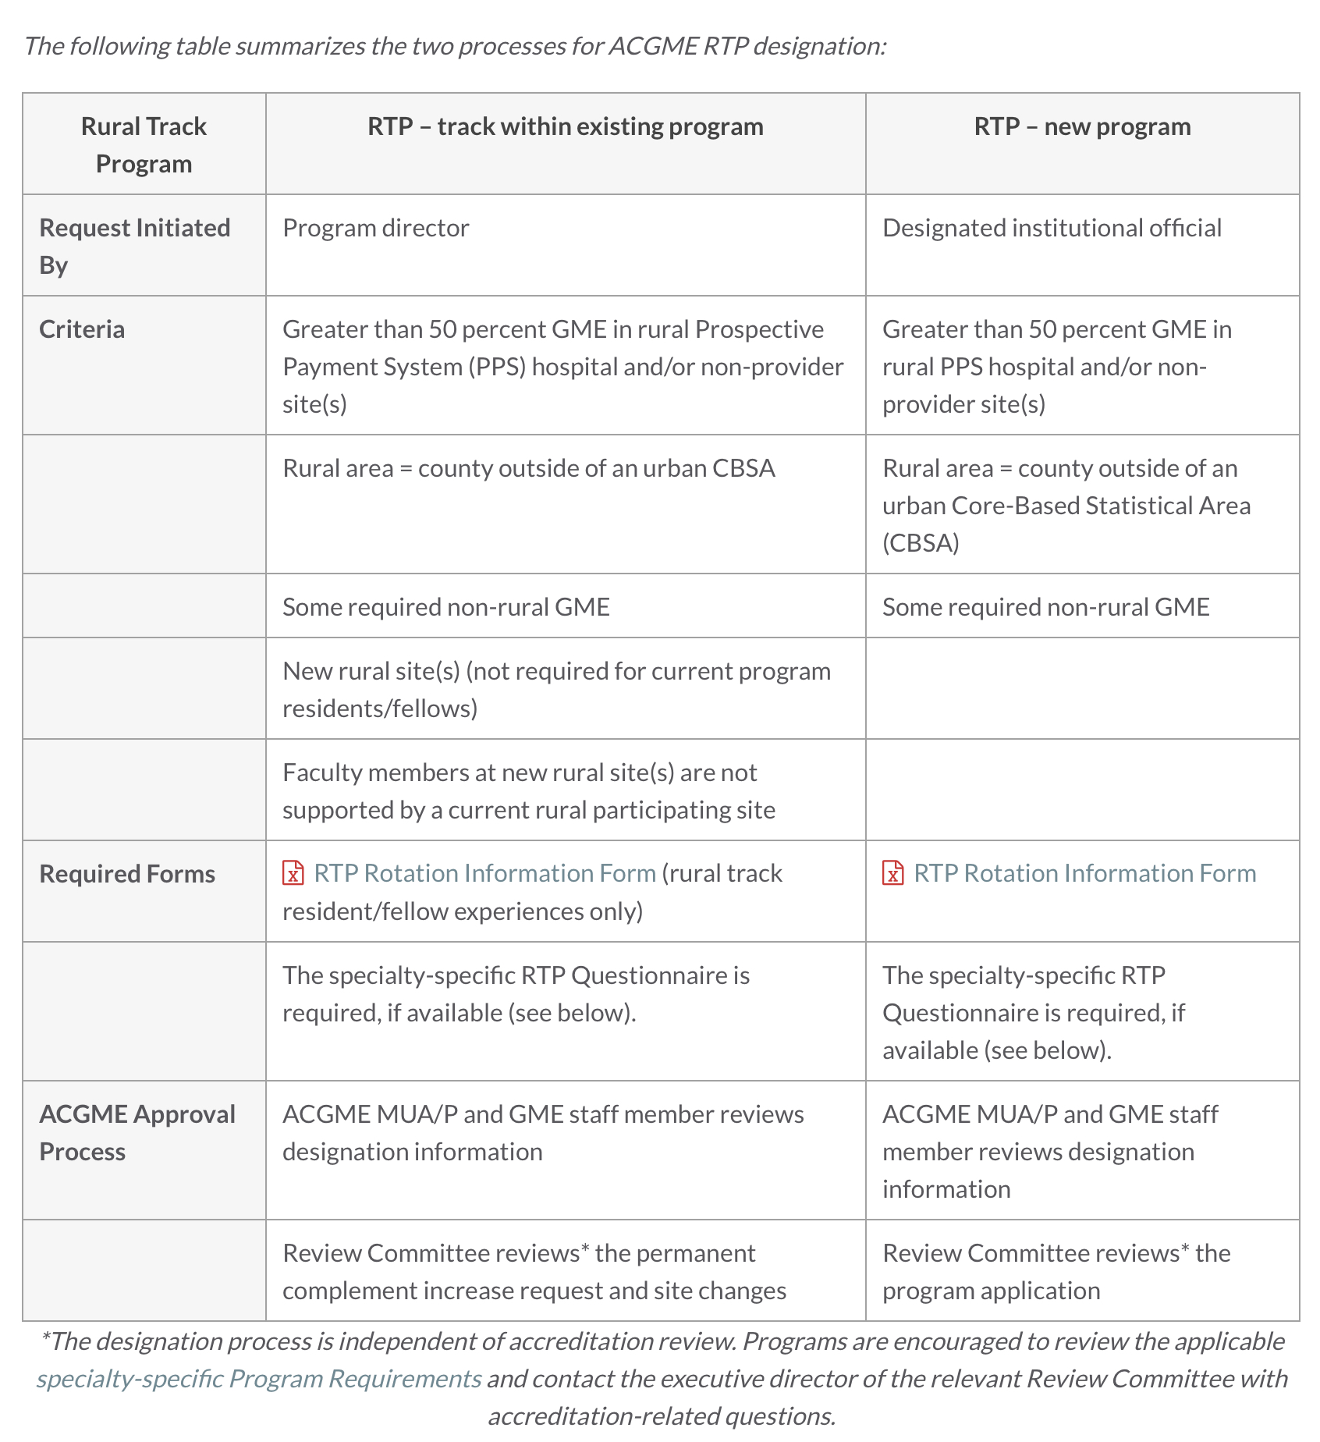
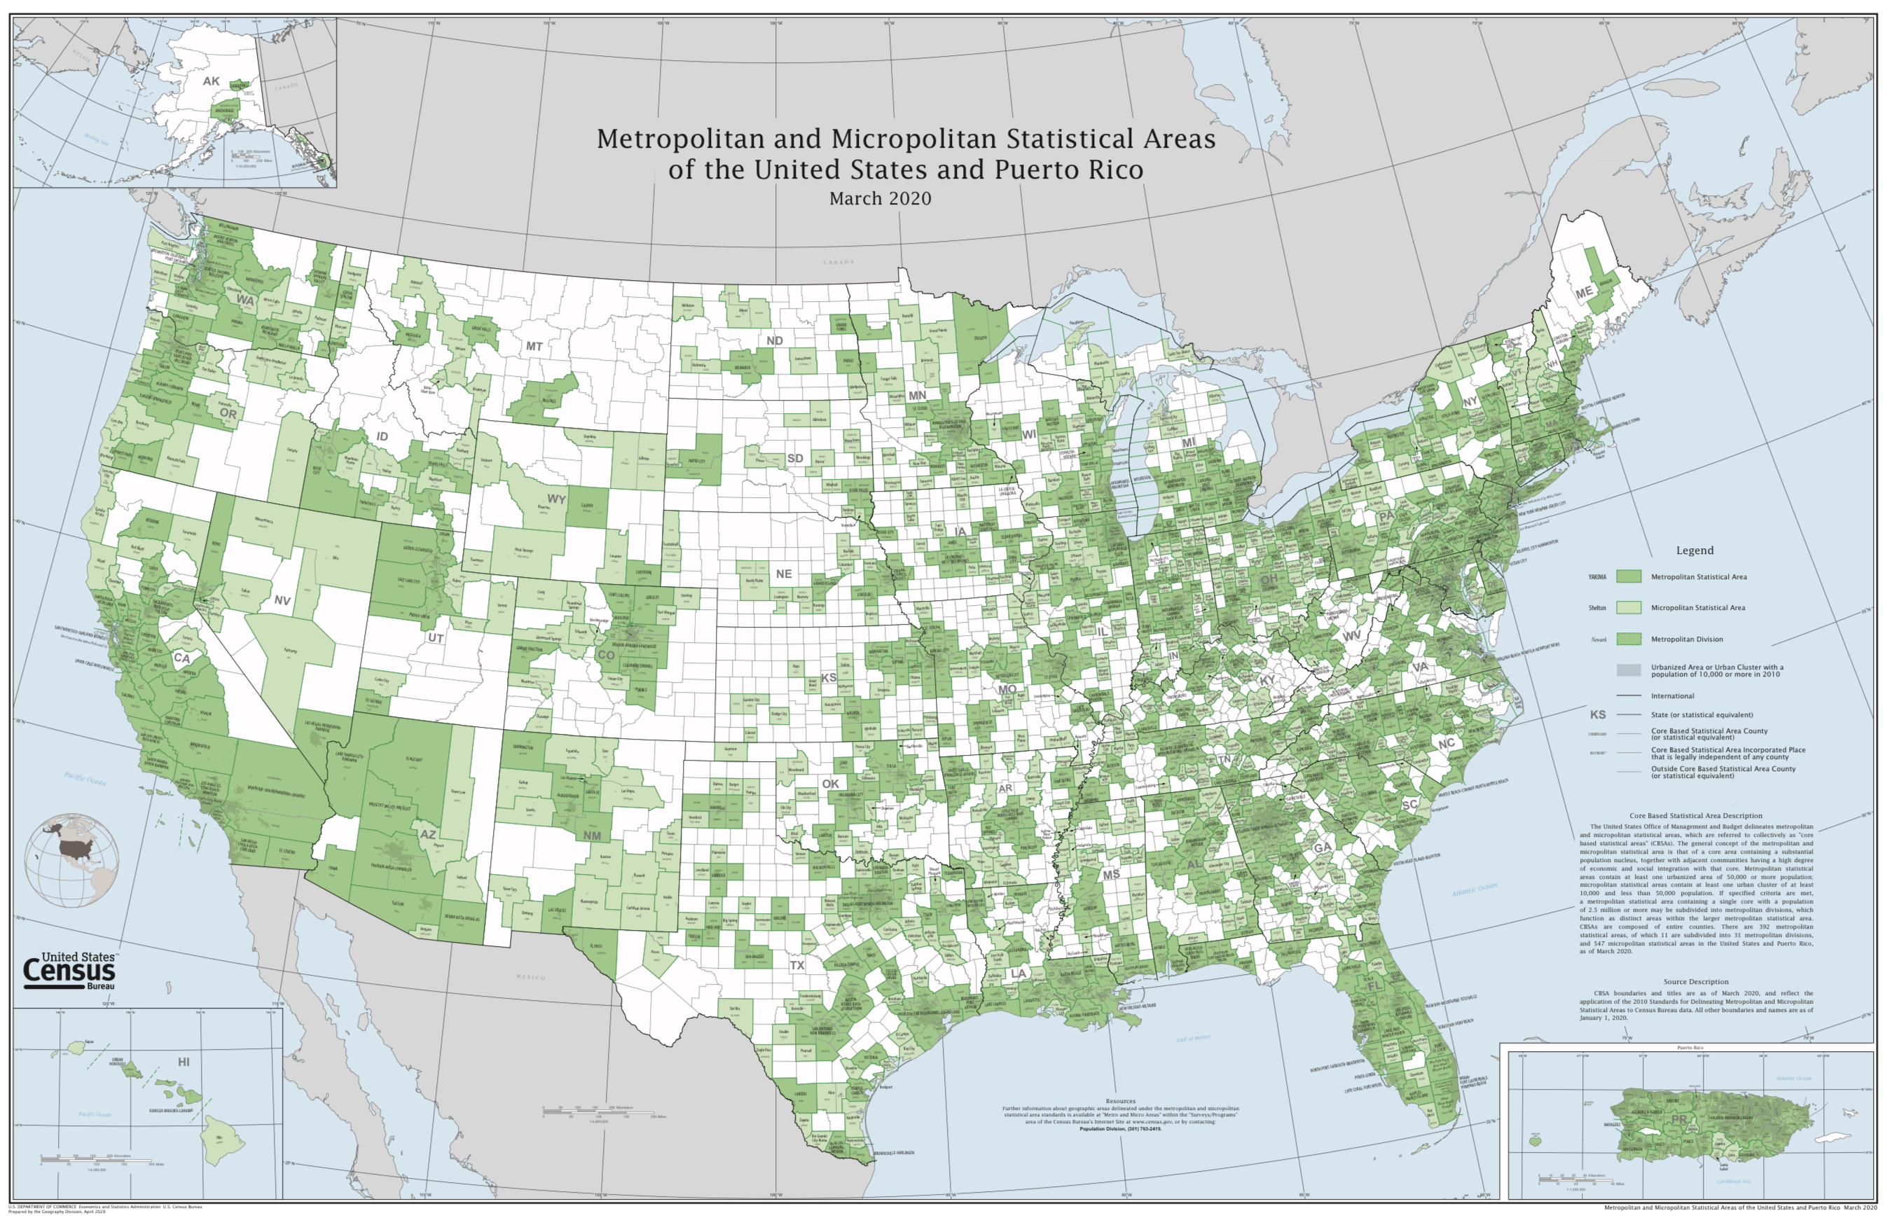

Slide 6
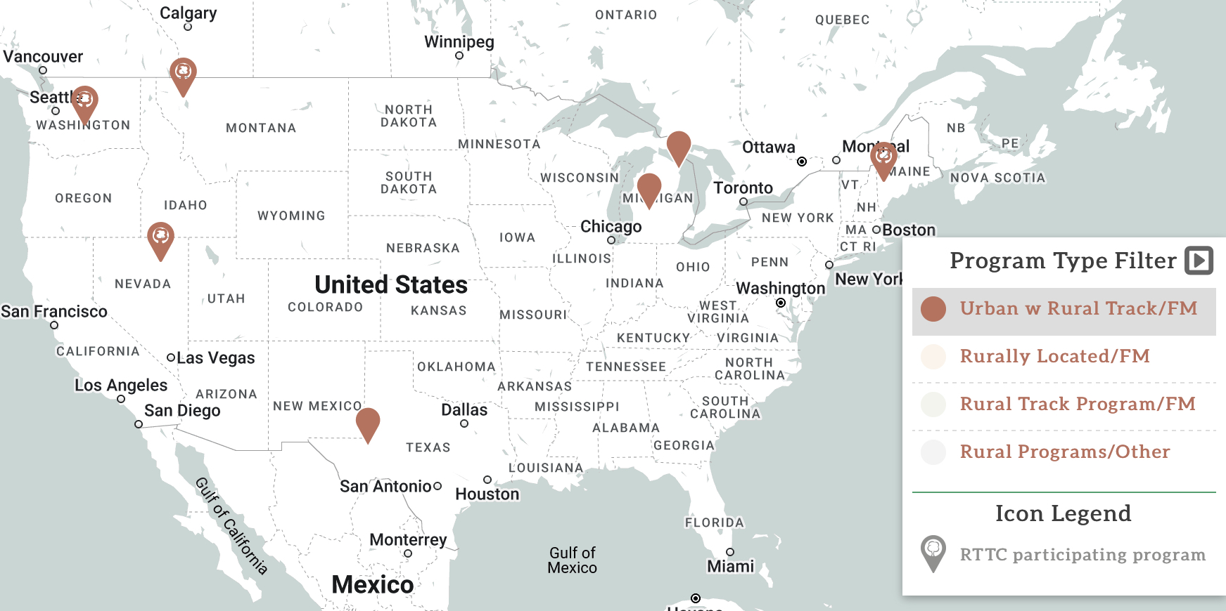
Urban with Rural Track

Slide 7
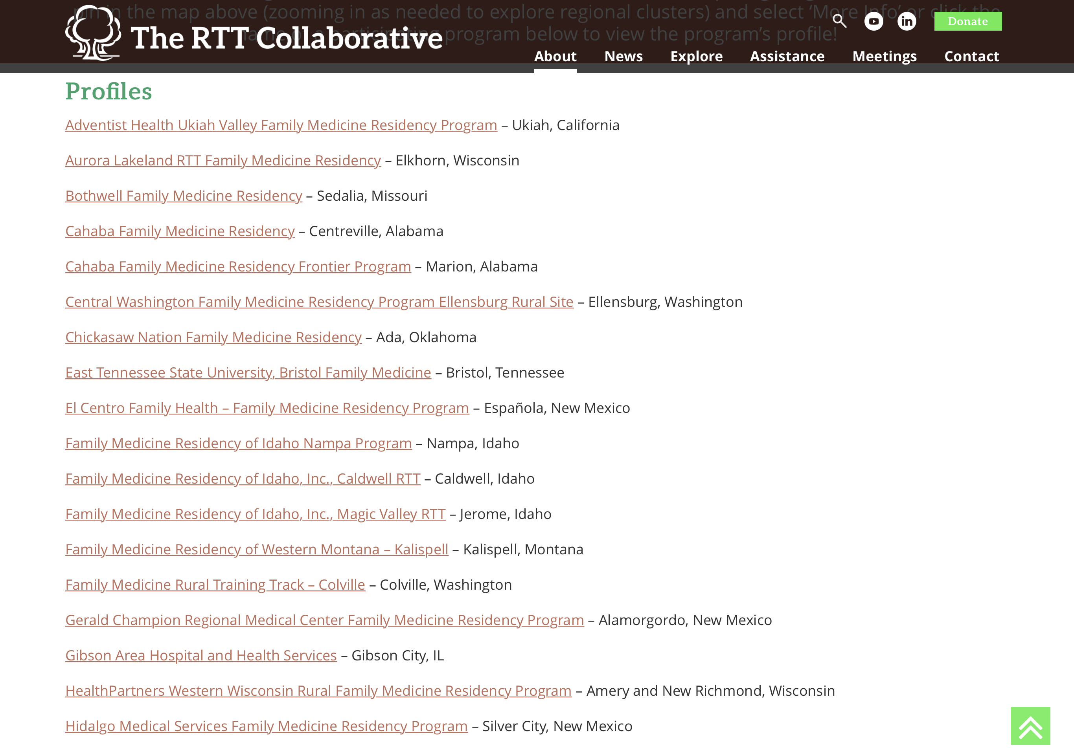
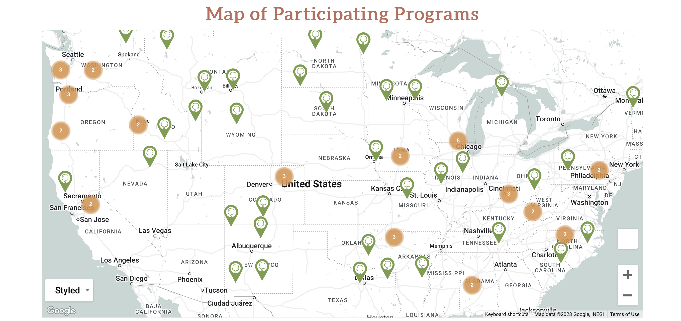
https://rttcollaborative.net/rttc-participating-programs/

Slide 8
Explore > Rural Program Map https://rttcollaborative.net/rural-programs/residency-map/

Slide 9
