Slide 1
Building a Trauma Training Track for a Rural Residency
Joel Klas, MD
Logan Smestad, MD

Slide 2
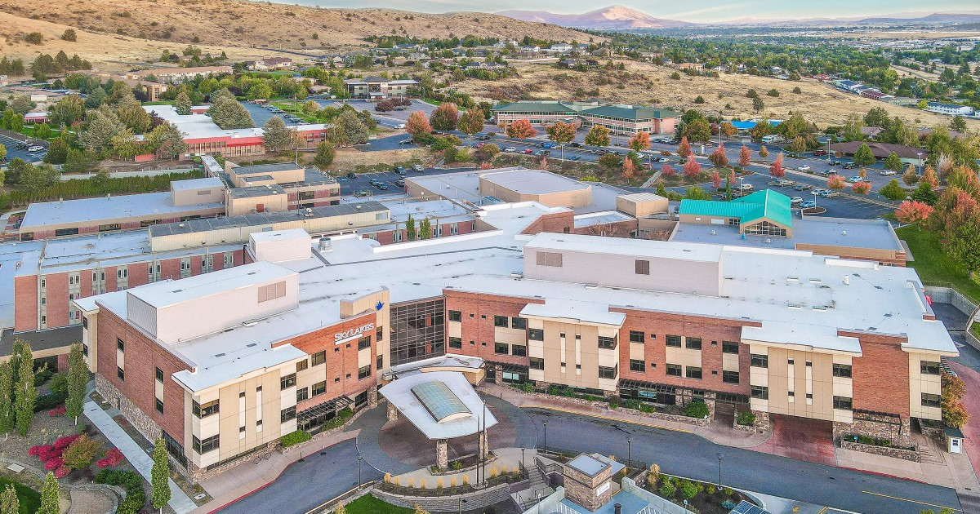
Disclosures
Disclosure(s) We have no actual or potential conflict of interest in relation to this program or presentation

Slide 3
The Why

Slide 4
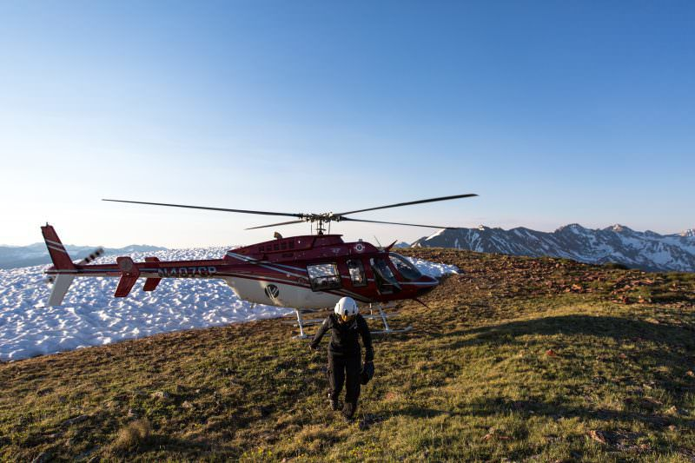
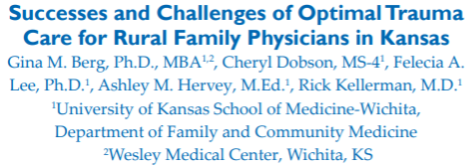
Rural trauma care disparities
Mortality due to traumatic injury increases inversely with population density
Causes:
Increased prehospital transport times
Limited hospital resources for
Staffing
Surgical care
Imaging
Varying experience with trauma stabilization
Notes:
Nearly 1/6th of residents live in a rural area; with greater than 47.6 million Americans living greater than 1 hour away from a level I or II trauma center

Slide 5
Rural access to Level 1 or 2 Trauma Centers
Notes:
Greater than 47.6 million Americans living greater than 1 hour away from a level I or II trauma center
How do we improve trauma stabilization training for those physicians who practice in rural settings; which are invariably Family Medicine Physicians

Slide 6
Boarded Emergency Physicians
Non boarded + Boarded Emergency Physicians
Notes:
This is a graph from the emergency physician workforce produced in 2020:
It demonstrates that nonboarded significantly increase physician density most dramatically in rural locations
Non- emergency medicine board certified were family medicine (33%), internal medicine (24%), or surgery (12%)
Family medicine (31%) and internal medicine (23%) were the most common backgrounds for non-emergency medicine–trained/emergency medicine board certified emergency physicians, and most (75%) graduated from residency greater than or equal to 20 years ago.
Rural emergency physicians were much less likely than urban emergency physicians to have emergency medicine training (31% versus 57%), emergency medicine board certified (43% versus 59%), and to have graduated in the past 5 years (8% versus 19%).
February 2, 2022 at 10:47 PM

Slide 7
Workforce Shortage of Emergency Care in Rural Areas
"as newly trained emergency physicians predominate in more urban practice environments, large expanses of rural areas in the United States, which already are understaffed, will likely experience further critical shortages"
Notes:
Continuing data from the national study of the emergency physician work force. This was the second evaluation the first being performed in 2008.
1) Urban population have much higher Emergency physician Density (both EM boarded and total physicians) compared to rural location (MORE THEN DOUBLE the density)
2)Over the past 12 years-rural locations have been losing physicians at a rate greater then replacement
3) Rural locations are expected to continue losing physicians at an increasing rate due to retirement
physicians in large and small rural EDs are older (median age 58 and 62 years, respectively) and nearing the US retirement age. This finding is more pronounced than what we reported about in 2008, in which the median age was 54 and 56 years
2) Rural Locations are losing physician and are expected to continue losing physicians
------------
we identified a decrease in emergency physicians in rural areas since our 2008 report.2 Per 100,000 US population in 2020, we found a decline for both large rural (–0.4) and small rural (–3.7) emergency physician densities. In 2008, we reported that 7.6% and 3.3% of emergency physicians practice in large and small rural areas, respectively; in 2020, the corresponding values were 5.6% and 2.5%
physicians in large and small rural EDs are older (median age 58 and 62 years, respectively) and nearing the US retirement age. This finding is more pronounced than what we reported about in 2008, in which the median age was 54 and 56 years, respectively
physicians in large and small rural EDs are older (median age 58 and 62 years, respectively) and nearing the US retirement age. This finding is more pronounced than what we reported about in 2008, in which the median age was 54 and 56 years, respectively

Slide 8
70% of residents reported that of all aspects of emergency care, they were least comfortable managing traumas
63% of rural residents desired more trauma focused training
Notes:
This is the only data that exists discussing family medicine graduate comfort with trauma care after residency. In fact I have only been able to find one published paper. From 2000
Background: no published data describe how they perceive their preparation for emergency practice. We surveyed graduates of Colorado family practice residencies concerning their emergency medicine practice, their comfort working in emergency departments, and their perceived preparation for practicing emergency medicine.
Methods: May 1998 we mailed a IS-item questionnaire to all 1997 graduates of Colorado family practice residencies. We chose a I-year postresidency interval because we expected that respondents' recall of residency training would be high and the potential confounding of practice experience (as opposed to residency training) would be less. Seventy recent graduates of Colorado residencies were surveyed regarding their location, work in emergency departments, contact with emergency medical services (EMS) personnel, and perceptions about their emergency medical training

Slide 9
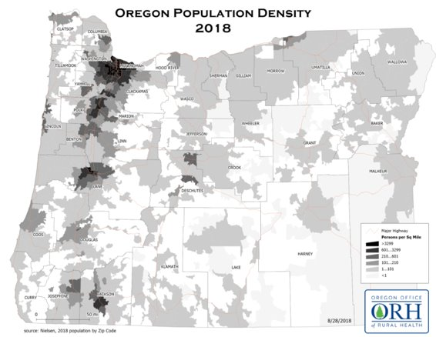
Why the Trauma Track was Started
Graduating residents desire for further experience in trauma stabilizations to prepare for future practices
Infrequency and unpredictable nature of traumas
Trauma system limited resident involvement
Perception of importance of training for family medicine residents
Residency duties in other patient care areas

Slide 10
The How

Slide 11
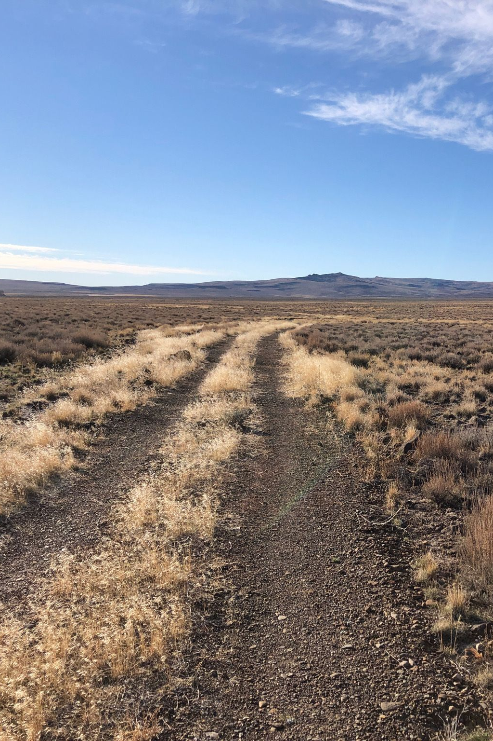
Creating a Trauma Track Roadmap
Needs assessment
Creating a vision
Curriculum development
Building partnership
Creating a resident trauma position
Logistics
Implementation
Notes:
Translating the needs assessment in a tangilbe plan

Slide 12
Needs Assessment
Resident interest - are these skills they need and want?
Are residents willing to perform extra work to obtain these skills?
What training are they currently getting in this area?
Do residents have ATLS certification?
Do they have an active clinical role in current trauma cases?
How many trauma cases has a typical resident been involved in?

Slide 13
Creating a Vision
Creating an understanding of need
How to match the needs assessment to the current system's framework?
Early involvement of multidisciplinary team members, building a foundation
"Selling it"
Notes:
How do we match what we have identified in our needs assessment to the requirements and current framework that exist already in the hospital?
-Communicating this need to distinct members of the trauma team. We have specific residents that will work in these rural locations and they have no formal trauma training.
-
Communicated: We would like to include residents in trauma stabilization in the ER.
How to involve everyone else in that vision and convince that it is a good idea?
How to get buy in from the hospital, those with financial ties/limitations?
-how to convince that it is worth it? That there will be benefits that come from it, apart from just resident education. Might be for the program (in terms of recruiting), for the hospital (not sure how), the trauma program (can advertise they focus on education), or the rural communities.
Our Needs assessment
-There was large interest from 3 invested residents for increased trauma specific training
-no consistent trauma leadership role
-few trauma cases-structure that actually excluded residents from trauma cases.
-rare trauma stabilization
-no organized method for atls certification –some would get in third year using CME.
-no method to inform residents of trauma cases
Ways we communicated this vision:
We communicated specific resident needs (Nick to here, Charlie to here...)
Regional Need: Rural Oregon hospitals have a direct need for rural emergency coverage

Slide 14
Curriculum Development
Available to second and third year residents
Requires ATLS certification prior to initiation of track
Trauma team participation
Residents lead trauma stabilization under the guided supervision of ED/surgical physicians
Trauma residents receive trauma pages while on specific rotations or on days where they sign up for call
Only one resident will be allowed at a trauma at a time
Quarterly Trauma Committee meeting participation
Additional ED exposure: One month of elective time in the ED
Notes:
Who is able to perform this- second and third year residents
What is required: ATLS certification
What systems do we build into this to make this possible:

Slide 16
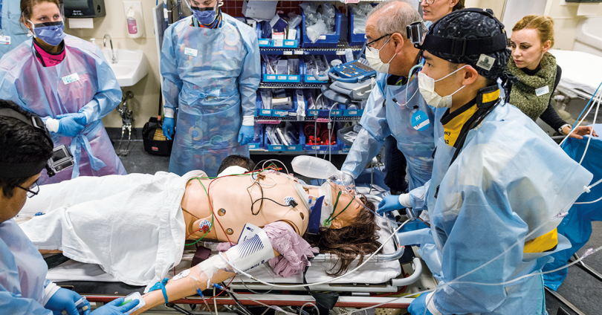
Creating a Position: The trauma resident
Notes:
For Our Track:
1) Trauma Resident: Having a formal position was key to having a role on the team and aleviating fears of nursing/trauma managers. Avoid confusion.
2) Leadership position: Team lead in an supervised role
A) trauma surgeon or emergency physician was always present
B)These attendings always supervised the residents actions, stabilization, and procedures--> it was important though that the resident be seen in a leadership position so that they would understand how to lead these teams.
C) Resident's primary role is to perform the primary and secondary survey.
D) Resident is able to give verbal orders, direct the flow of the trauma stabilization. Perform key procedures.
E) Has the responsibility to report when he arrived (hopefully prior to patient arrival) or inform nurses/secretary of his arrival.

Slide 17
Logistics
Malpractice: Gained approval from hospital for resident and supervising physician coverage
Paging System: Created a paging system to contact resident physicians
Scheduling: Incorporated resident schedules into a trauma calendar. Duty hours
Data: Resident participation recorded by trauma committee including number of traumas, procedures
Research: Retroactive survey of trauma residents and non-trauma residents, Resident trauma competency
Teamwork: Minimized resident impact on metrics (time to CT, transfer, admission)
Notes:
Logisitics is often working through people's concerns and creating efficient systems that do not overburden other groups.
Risk management may need to be involved
Not screwing up trauma team's timing, metrics
Work hours

Slide 18
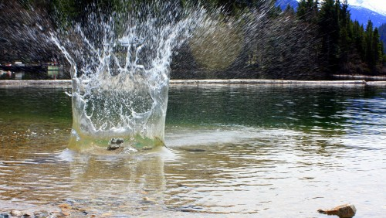
The Impact and Outcomes

Slide 19
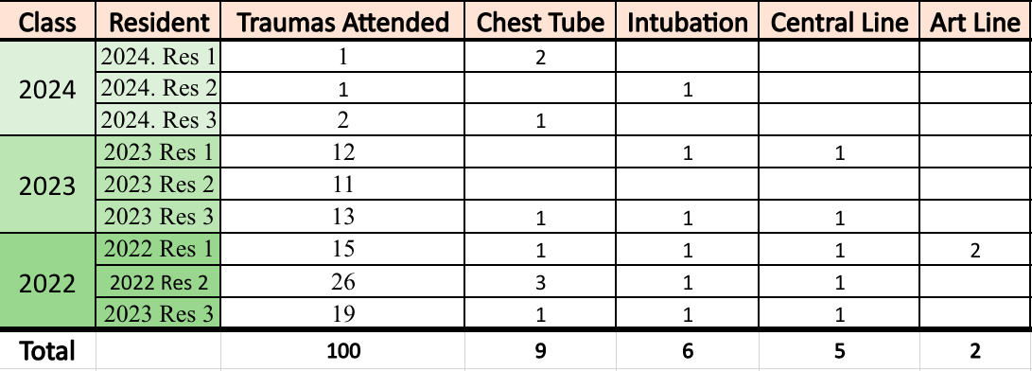
September 2020-Dec 2022

Slide 20
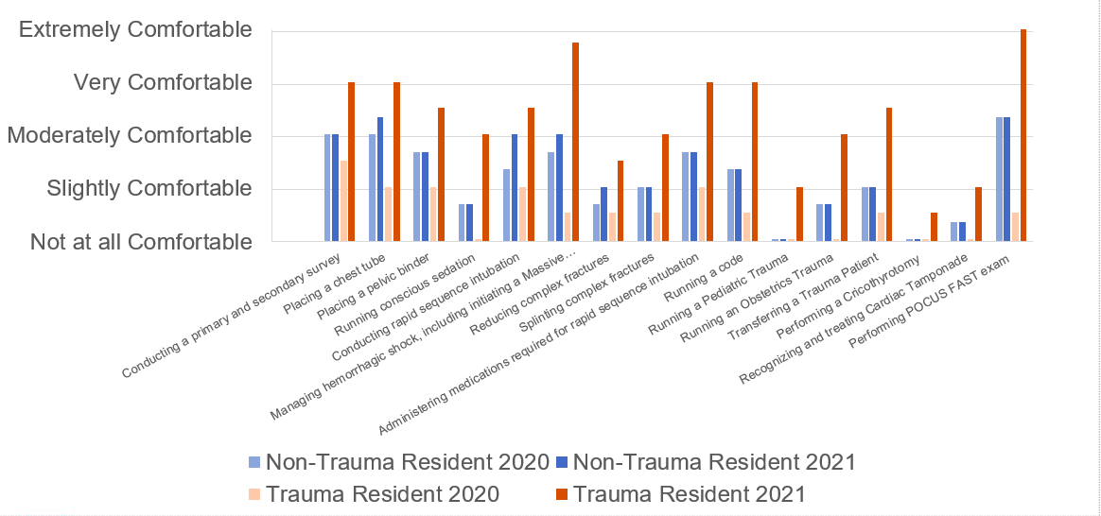
Comfort with Trauma Stabilization Trauma Resident vs Non-trauma Resident

Slide 21
Outcomes
Residents gained regular access to trauma stabilization
Residents were incorporated into leadership positions and performed various procedures during trauma stabilizations
Residents increased their comfort level in acute care and trauma stabilization
The first two classes of trauma residents are or will be working in rural emergency departments
The trauma track reflected positively on Sky Lakes Trauma Committee
During Sky Lakes' level III trauma recertification, the resident trauma track was noted as one of its strengths

Slide 22
Questions?

Slide 23
​ | Confidence Level Prior to Taking the Trauma Training Program​ |  |  |  |  | Confidence Level After Completing the Trauma Training Program​
Please rate your confidence with performing the following skills based on participation in the Trauma Training Program​ | ​ Not at all​ | ​ ​ Slightly​ | ​ ​ Moderately​ | ​ ​ Very​ | ​ ​ Extremely​ | ​ Not at​ all​ | ​ ​ Slightly​ | ​ ​ Moderately​ | ​ ​ Very​ | ​ ​ Extremely​
Conducting a primary and secondary survey​ | 1​ | 2​ | 3​ | 4​ | 5​ | 1​ | 2​ | 3​ | 4​ | 5​
Placing a chest tube​ | 1​ | 2​ | 3​ | 4​ | 5​ | 1​ | 2​ | 3​ | 4​ | 5​
Placing a pelvic binder​ | 1​ | 2​ | 3​ | 4​ | 5​ | 1​ | 2​ | 3​ | 4​ | 5​
Running conscious sedation​ | ​ 1​ | ​ 2​ | 3​ | 4​ | 5​ | 1​ | 2​ | 3​ | 4​ | 5​
Conducting rapid sequence intubation​ | 1​ | 2​ | 3​ | 4​ | 5​ | 1​ | 2​ | 3​ | 4​ | 5​
Managing hemorrhagic shock, including initiating a Massive Transfusion Protocol​ | ​ 1​ | ​ 2​ | ​ 3​ | ​ 4​ | ​ 5​ | 1​ | 2​ | 3​ | 4​ | 5​
Reducing complex fractures​ | 1​ | 2​ | 3​ | 4​ | 5​ | 1​ | 2​ | 3​ | 4​ | 5​
Splinting complex fractures​ | 1​ | 2​ | 3​ | 4​ | 5​ | 1​ | 2​ | 3​ | 4​ | 5​
Administering medications required for rapid sequence intubation​ | 1​ | 2​ | 3​ | 4​ | 5​ | 1​ | 2​ | 3​ | 4​ | 5​
Running a code​ | 1​ | 2​ | 3​ | 4​ | 5​ | 1​ | 2​ | 3​ | 4​ | 5​
Running a Pediatric Trauma​ | 1​ | 2​ | 3​ | 4​ | 5​ | 1​ | 2​ | 3​ | 4​ | 5​
Running an Obstetrics Trauma​ | 1​ | 2​ | 3​ | 4​ | 5​ | 1​ | 2​ | 3​ | 4​ | 5​
Transferring a Trauma Patient​ | 1​ | 2​ | 3​ | 4​ | 5​ | 1​ | 2​ | 3​ | 4​ | 5​
Performing a Cricothyrotomy​ | 1​ | 2​ | 3​ | 4​ | 5​ | 1​ | 2​ | 3​ | 4​ | 5​
Recognizing and treating Cardiac Tamponade​ | 1​ | 2​ | 3​ | 4​ | 5​ | 1​ | 2​ | 3​ | 4​ | 5​
Performing POCUS FAST exam​ | 1​ | 2​ | 3​ | 4​ | 5​ | 1​ | 2​ | 3​ | 4​ | 5​
Retroactive Survey: Assessing Resident Comfort Levels
Notes:
These are the major components and learning tasks of ATLS.

Slide 24
Cascade East Trauma Competency Assessment

