Slide 1
The Power of Podcasts: How Rural Residency Programs Utilize Innovative Technology
Joyce Robert, MD
Jeffrey Hawtof, MD
Cynthia Lamour, DO
Tanya Ray, MS

Slide 2
July 1, 2023
4 Residents Per Year
Full Spectrum Family Medicine
Medical Students from PCOM (Philadelphia College of Osteopathic Medicine)
Family Medicine Residency Program

Slide 3
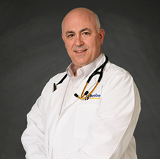
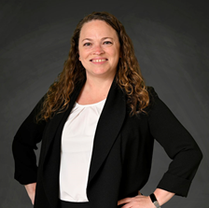
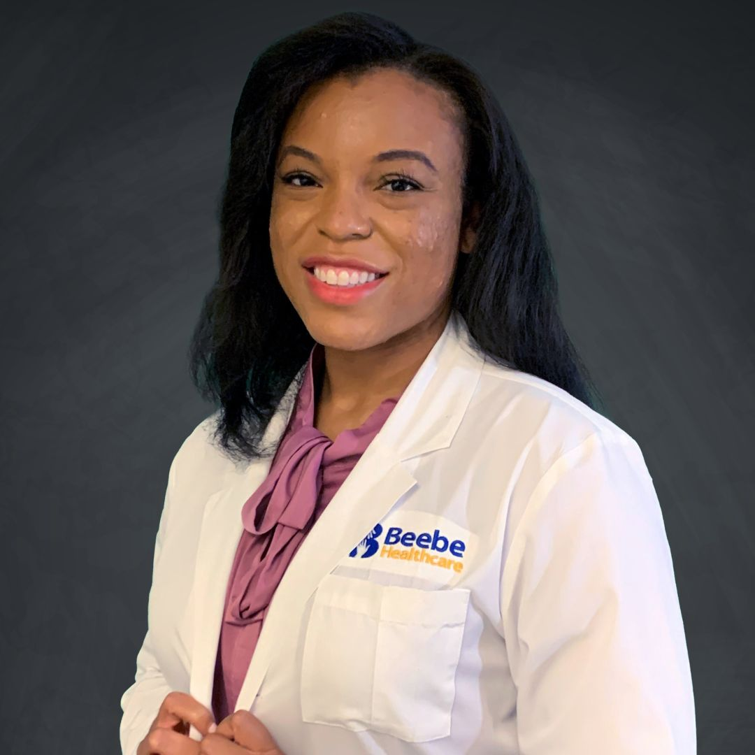
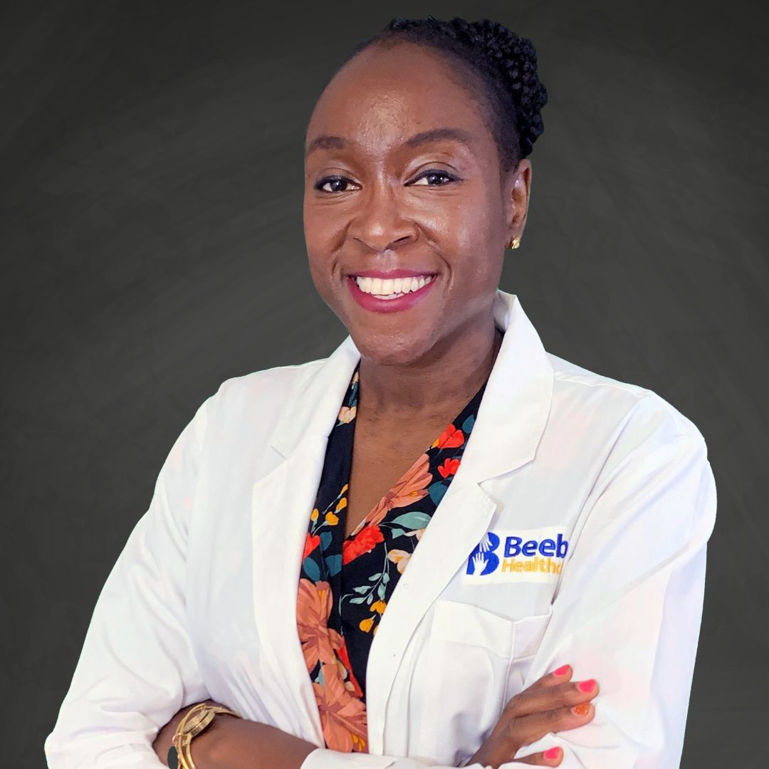
Our Team
Cynthia Lamour, DO
General Faculty
Joyce Robert, MD, FAAFP Program Director

Slide 4
Benefits
Flexibility
Efficiency
Accessibility
Sense of community/shared learning
Edutainment factor
Adjunct to other learning
Possible CME
Notes:
Listen while you commute, work out, engagement on chat feature. Accessibility - FREE
Adjunct to other learning – i.e., faculty development
Some programs can offer CME

Slide 5
Brainstorming: What are we doing?
Determine who is your audience(s)
What is your content per audience?
Involve other key stakeholders (IT, Marketing/Communications,…)
Learn the basics of podcasting, determine the format that will work for you
Lecture, story telling, interview style,…
Standardize things! Look, style, Icons, drop times…
Notes:
Communications team was able to partner with outside vendor who had equipment and knowledge to get podcast up and running. Dr. Podcast
Target Audience: We looked at each of our educational opportunities and would a POD cast help. We ended up determining 4 audiences.
Faculty: Specific content that only faculty members would be interested in
Learners: Specific content for Med students/Residents as learners
General Medical Staff: Specific Content for anyone on medical staff (may overlap with Learners)
Community: Specific Content for our community working with our Marketing/Communications Dpt.
Beebe’s Faculty Forum, Peripheral Brian at Beebe. 4 branches of pods
Once we arrived at our audiences, we decided that we would start internal and learn how to POD cast first with Faculty and Learners and then broaden our scope as we improved the product.
Desired Content: We then split up topics/content into each of the categories. For the Faculty, we chose to take our content that we are doing for the Faculty Development Virtual/Live 1-hour sessions and create POD’s that relate to them. For Learners, we not only developed Clinical content BUT also more of the soft skills and orientation issues that we wanted them to remember.

Slide 6
How Do We Measure?
In order to measure success of retention in learners, an objective method of analysis should be developed
Substitute a portion of in-person learning didactics to podcasts episodes instead.
Pre & post testing for learners to measure retention of material
Comparisons may be drawn between the podcast listeners and traditional didactic listeners.
Notes:
Assign some residents podcast, and some read a traditional article, and then come back to see how the information is obtained.
Measure – people who did only didactics and then those who did didactic AND podcast
Resident satisfaction – in lieu of reading an article, listen to this podcast
Pre- and Post- test analysis
Listeners engagement and satisfaction
Small PI/QI projects

Slide 7
Challenges, The Future & Research
Funding
Time
Wi-Fi capabilities
Technology
Podcast integrated in our student and resident curriculum
How can we assess the power of podcasts on learners
Notes:
Funding – outside resources, lectures and equipment

Slide 8
Favorite Podcasts

Slide 9
Recommended Podcast
Frankly Speaking About Family Medicine
Black Family Doctor
AMA Update
Academic Medicine
Curb Siders – Internal Medicine
JAMA Clinical Reviews
Mayo Clinic Talks
AFP
Hot Topics in MedEd
Key Lime – Canada based

Slide 10
Questions? Keep up to date with Beebe on Social!

Slide 11
Please take a few moments to complete the survey ☺

