Slide 1
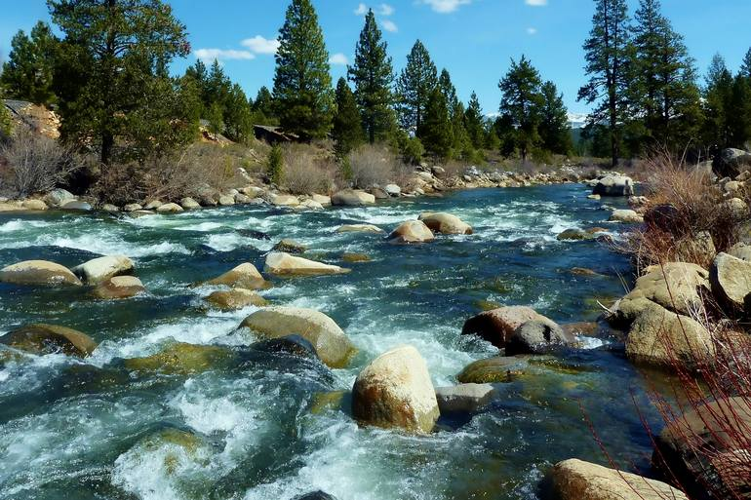
A River Runs Through Us All
RTT Rural Residency Conference
Skamania Lodge, Washington
April 2022
Tina Castañares, MD
tdcastanares@gmail.com

Slide 3
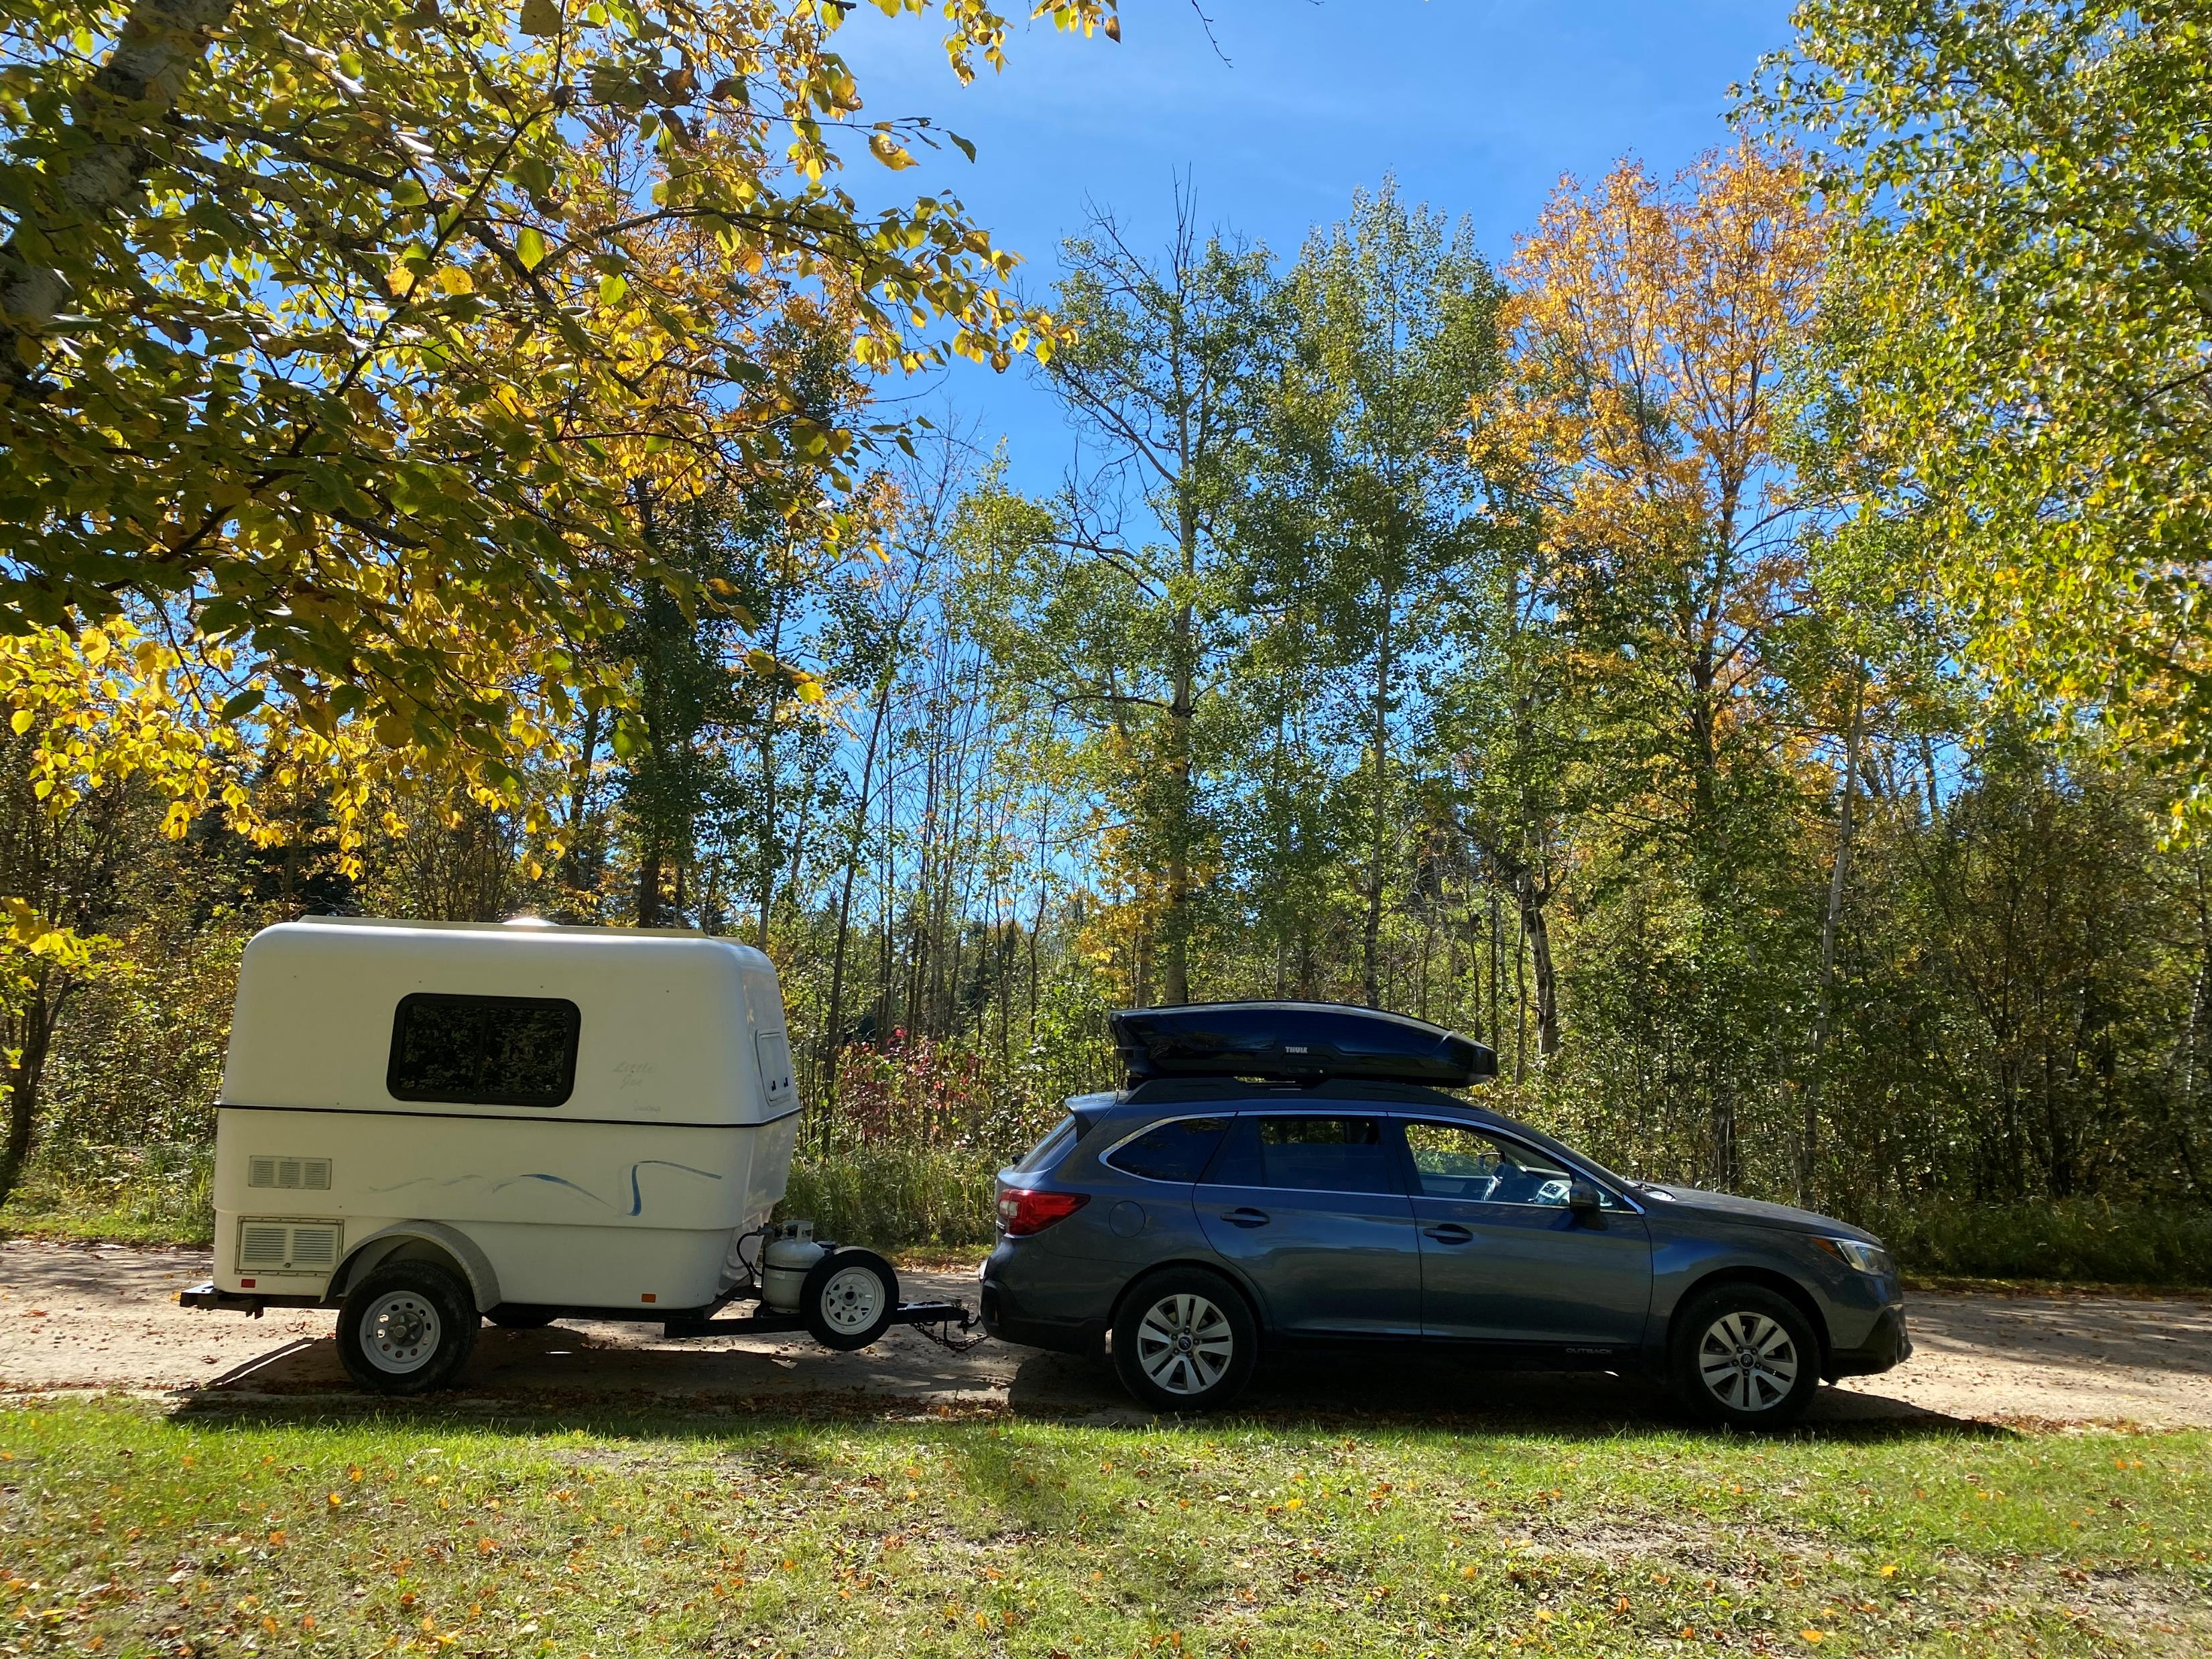

Slide 5
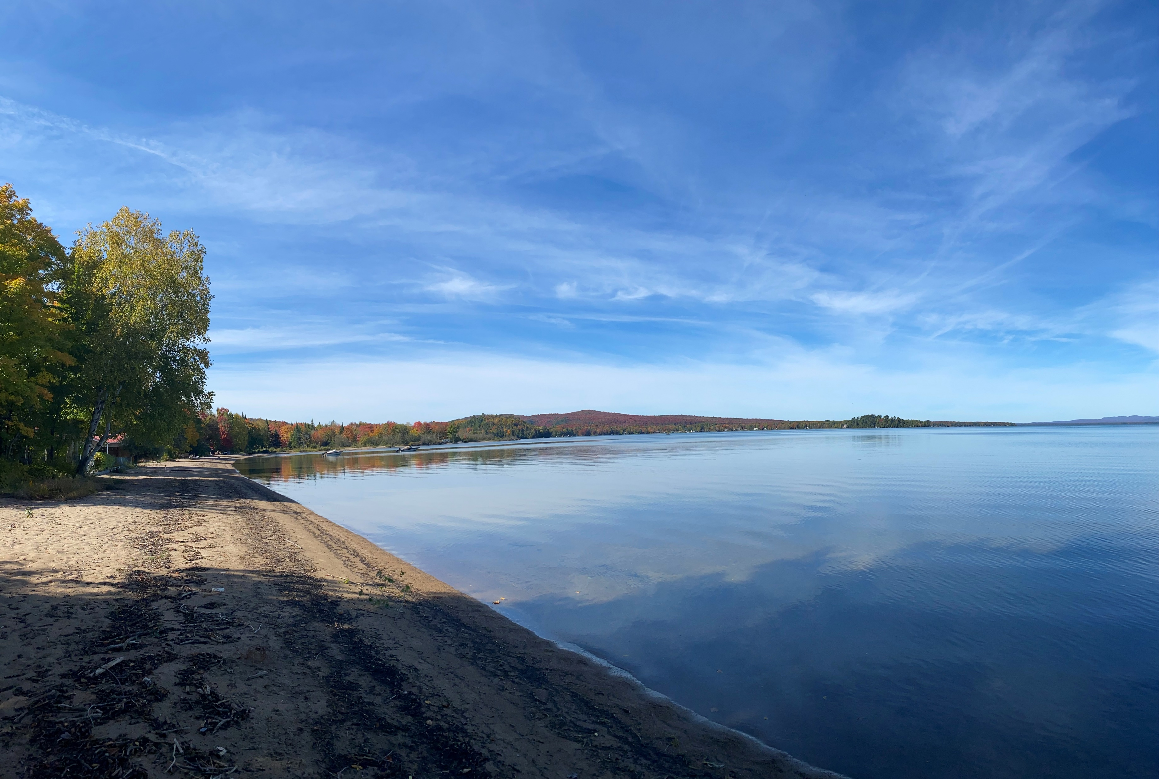

Slide 6
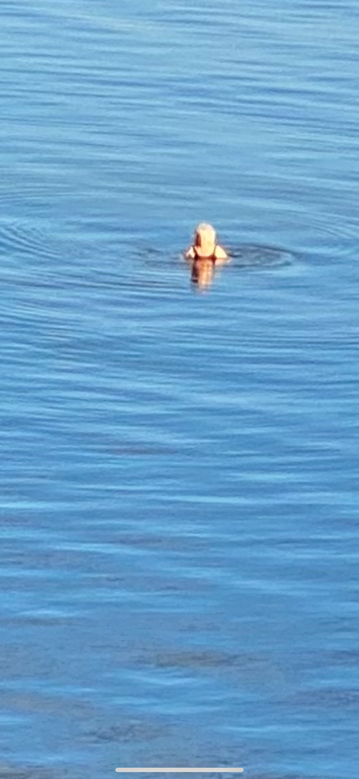
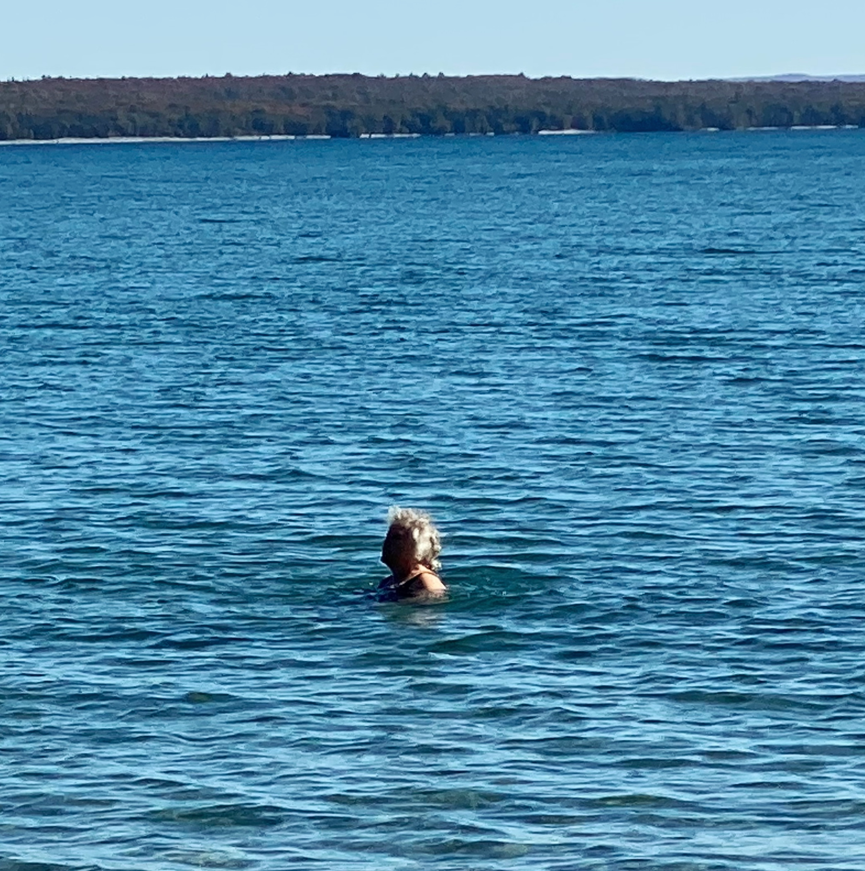

Slide 7
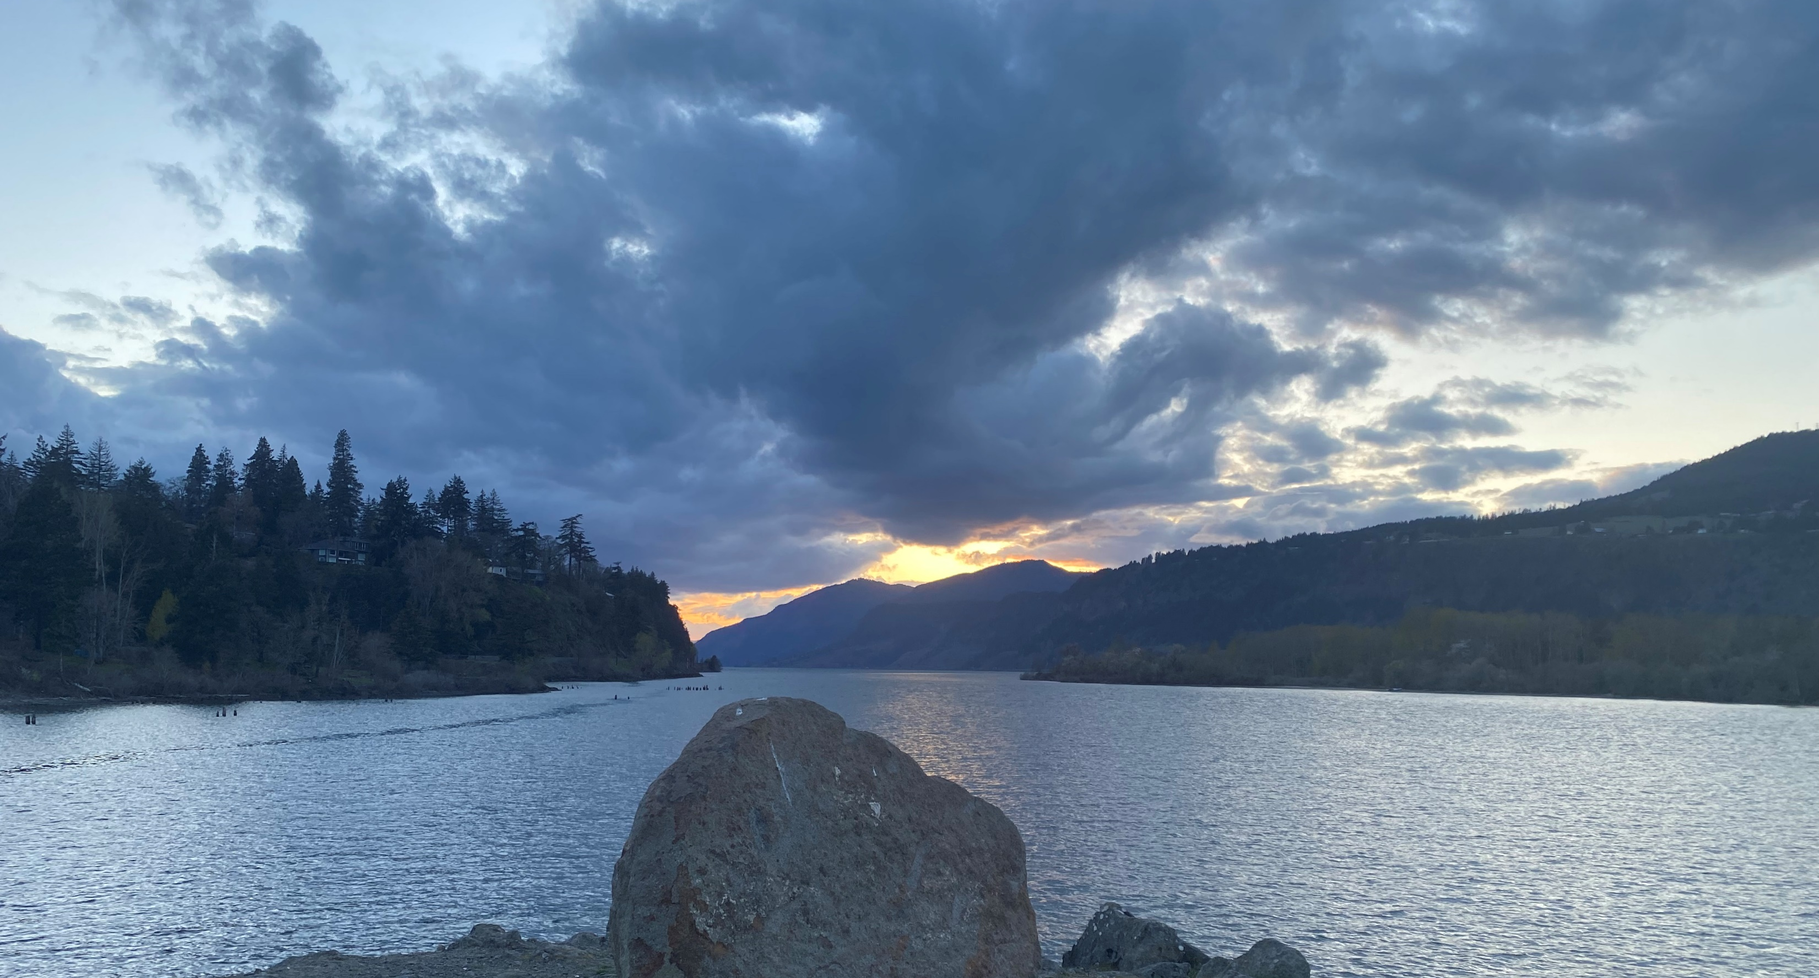

Slide 8
Change: to become different.

Slide 9
Change: to become different.
Agent: something that produces or is capable of producing an effect.
From late 15th century: "one who acts," from Latin agentem "effective, powerful. " agere “…to do”

Slide 10
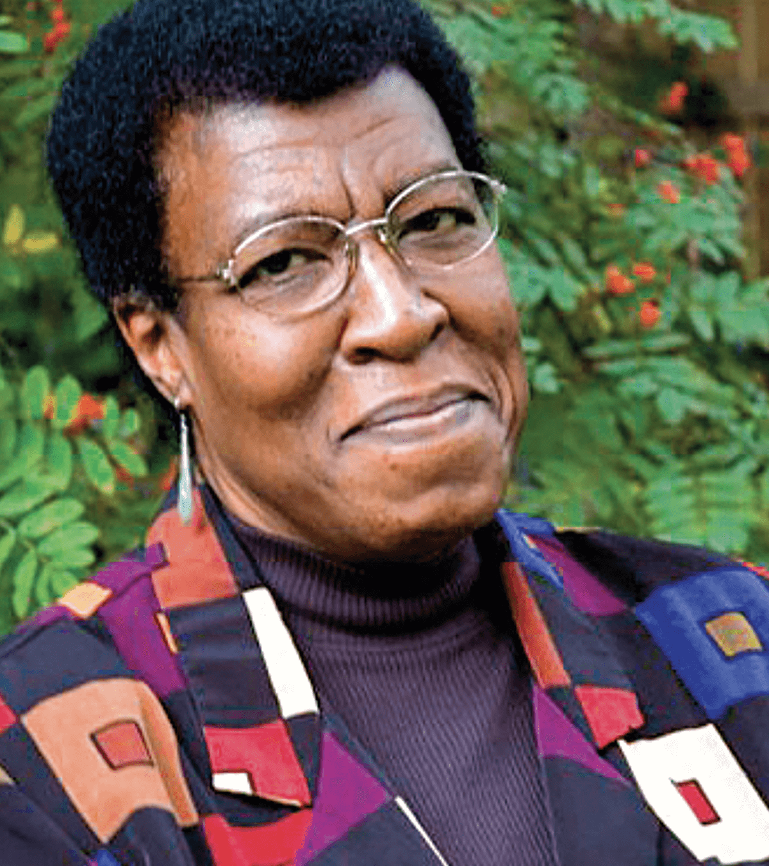
“All that you touch
you change.
All that you change
changes you.
The only lasting truth
is change.”
Octavia E. Butler

Slide 11
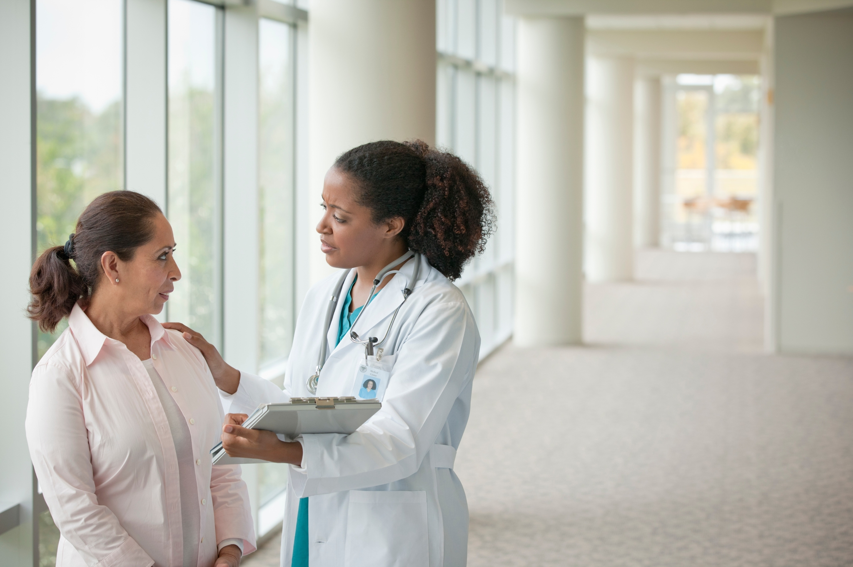
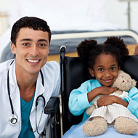
Who and what has uniquely changed you?

Slide 12
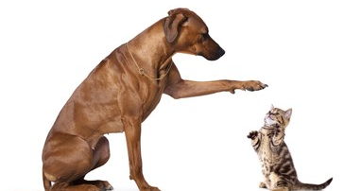

Slide 13
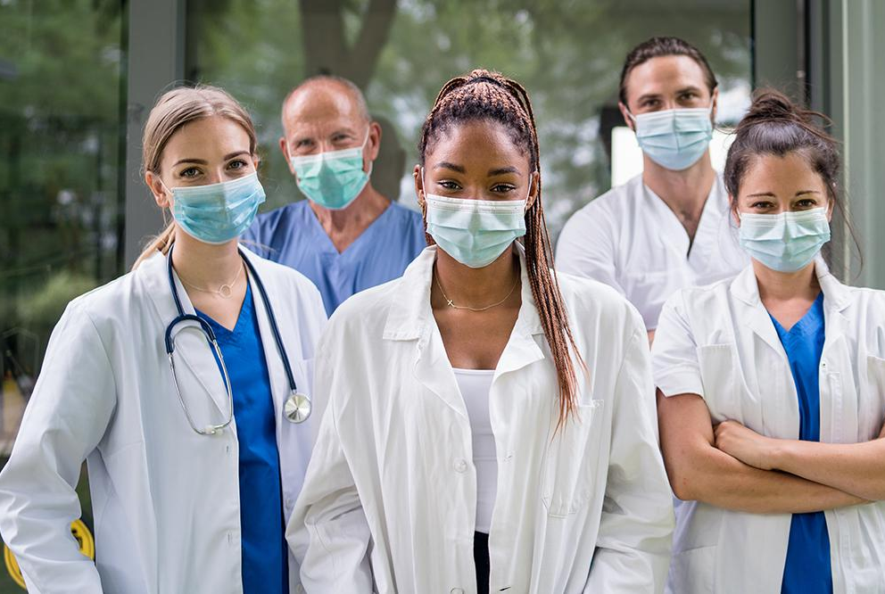
What elements of this work are changing all of you, collectively as well as individually?

Slide 14
Elements changing all of you
your very specialized education

Slide 15
Elements changing all of you
the ever- increasing breadth and sheer volume of medical knowledge

Slide 16
Elements changing all of you
the culture of medicine (rituals, traditions, language, tools)

Slide 17
Elements changing all of you
rules and regulations

Slide 18
Elements changing all of you
practice trends that come and go

Slide 19
Elements changing all of you
the external environment: accelerated change in the world

Slide 20
Elements changing all of you
and much more (pandemic, anyone?)

Slide 21
How do you respond to these forces of change, acting upon you?
How do you change Change?

Slide 22
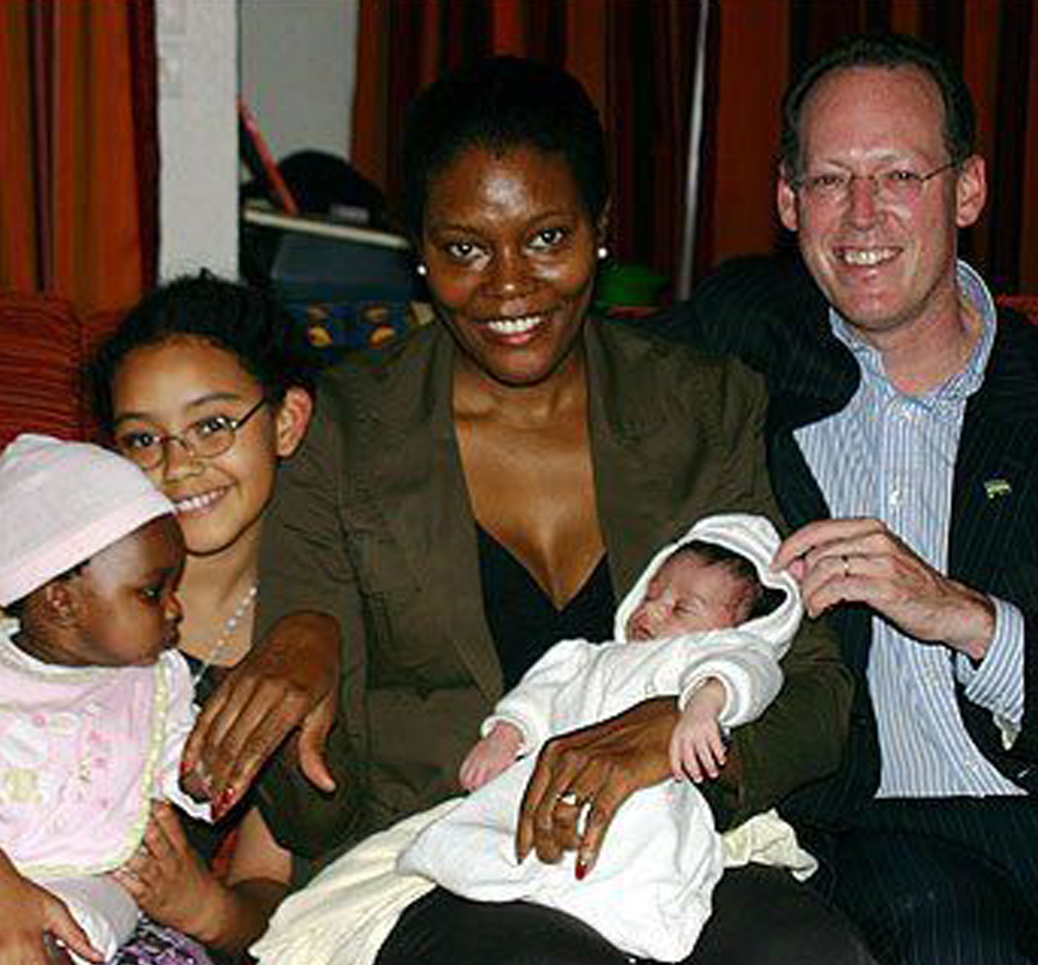
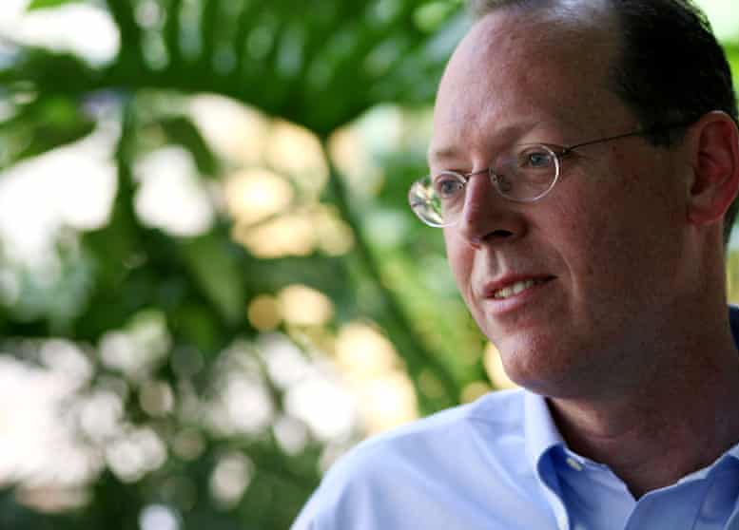
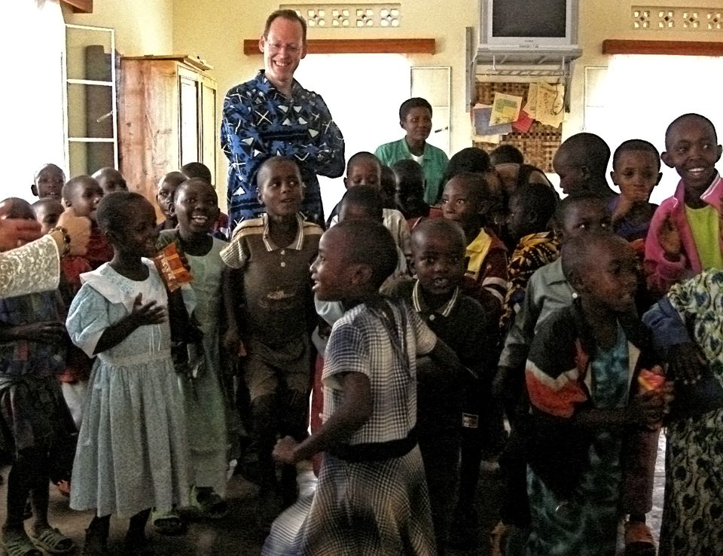

Slide 23
Clark County, Nevada pop. ≈3.1 M
≈8,000 Square miles
Largest city pop. ≈2.4 M

Slide 25
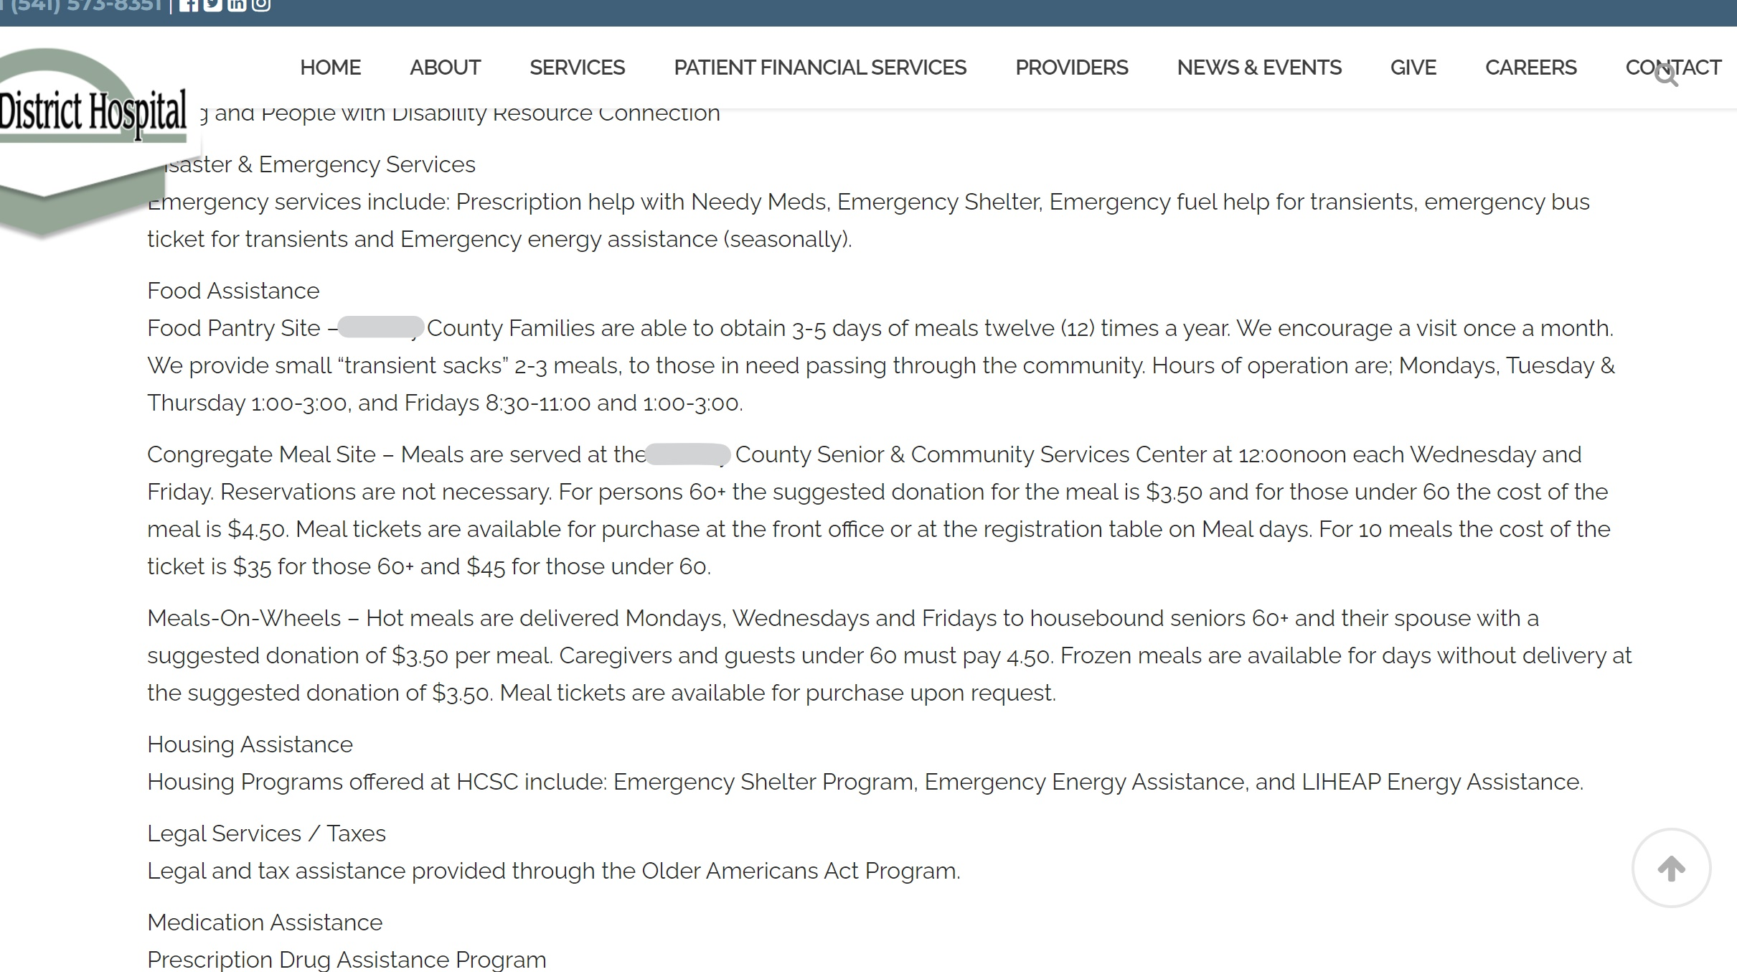
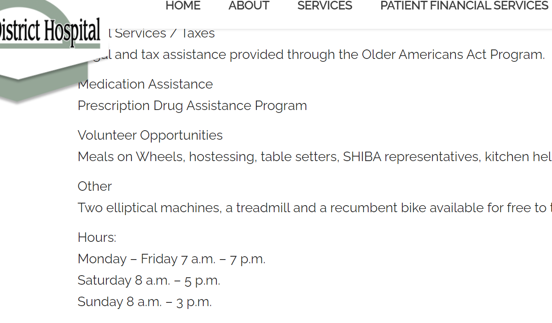
A rural county In the Pacific NW pop. ≈7,500
› 10,200 square miles
Largest city pop. ≈2,700

Slide 26
“stay in your lane”
2018 National Rifle Association →
ER doctors, about gun violence
“stay in their lane” NRA tweet: remarks on gun control did not fall under doctors’ expertise
Doctors → stories of traumatic gun-related injuries and deaths, collected under hashtag #ThisIsOurLane.
From Merriam Webster Dictionary

Slide 27
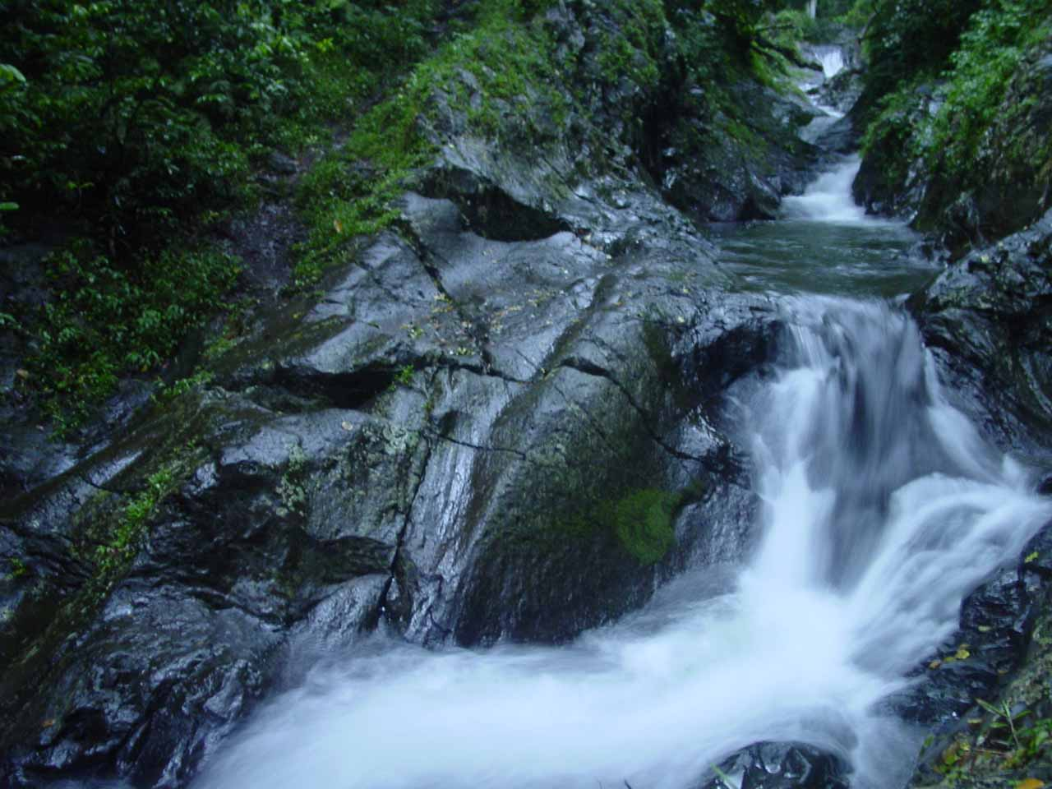
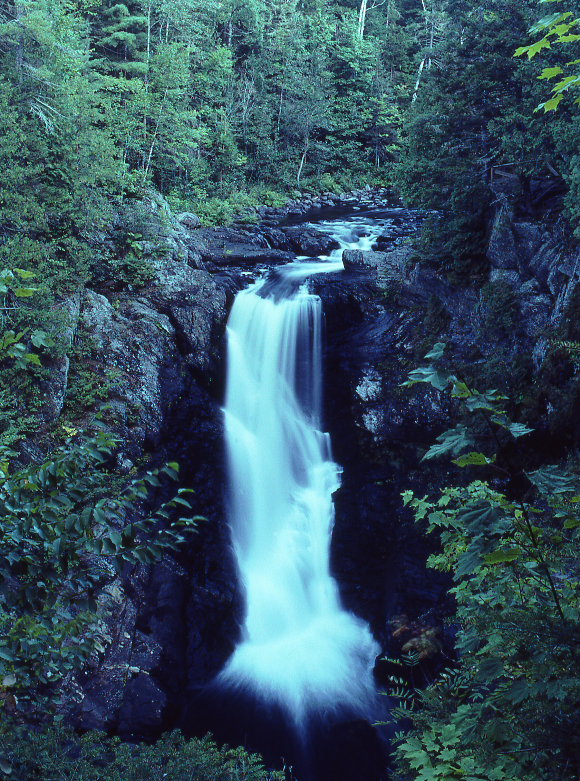

Slide 28
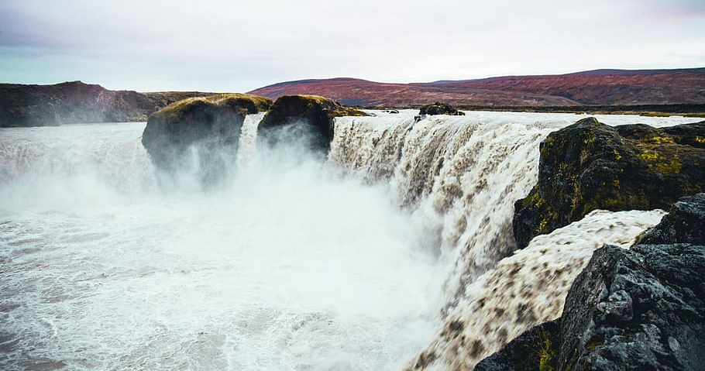
Notes:
Dipti S. Barot is a primary care doctor and freelance writer in the San Francisco Bay Area. You can follow her on Twitter at @diptisbarot.
https://apple.news/ACES_gcw6RSWTHCNnxm21yg
I Was A COVID Doctor. Here's The One Thing I Refuse To Do As We 'Get Back To Normal. March 15, 2022

Slide 29
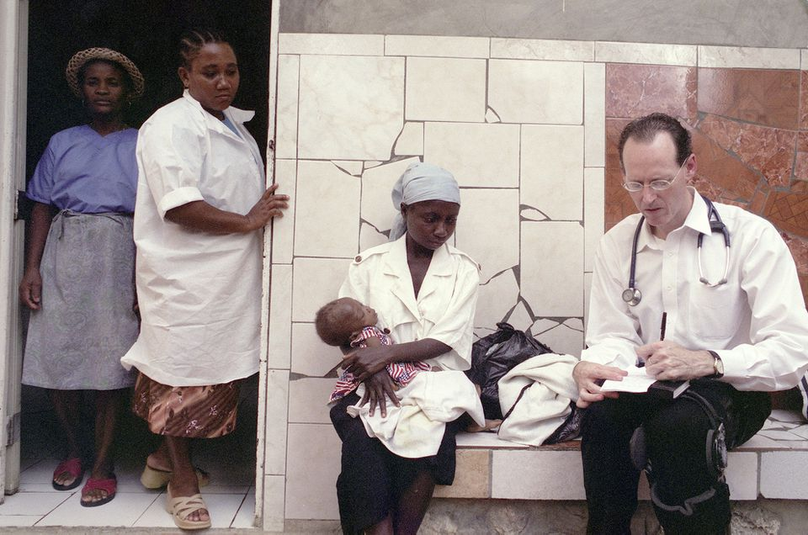
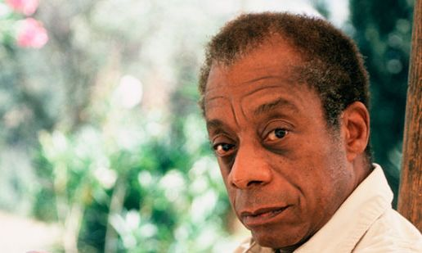
“We made the world we’re living in and we have to make it over.”
James Baldwin
“A social justice approach should be central to medicine and to public health.”
Paul Farmer

Slide 30
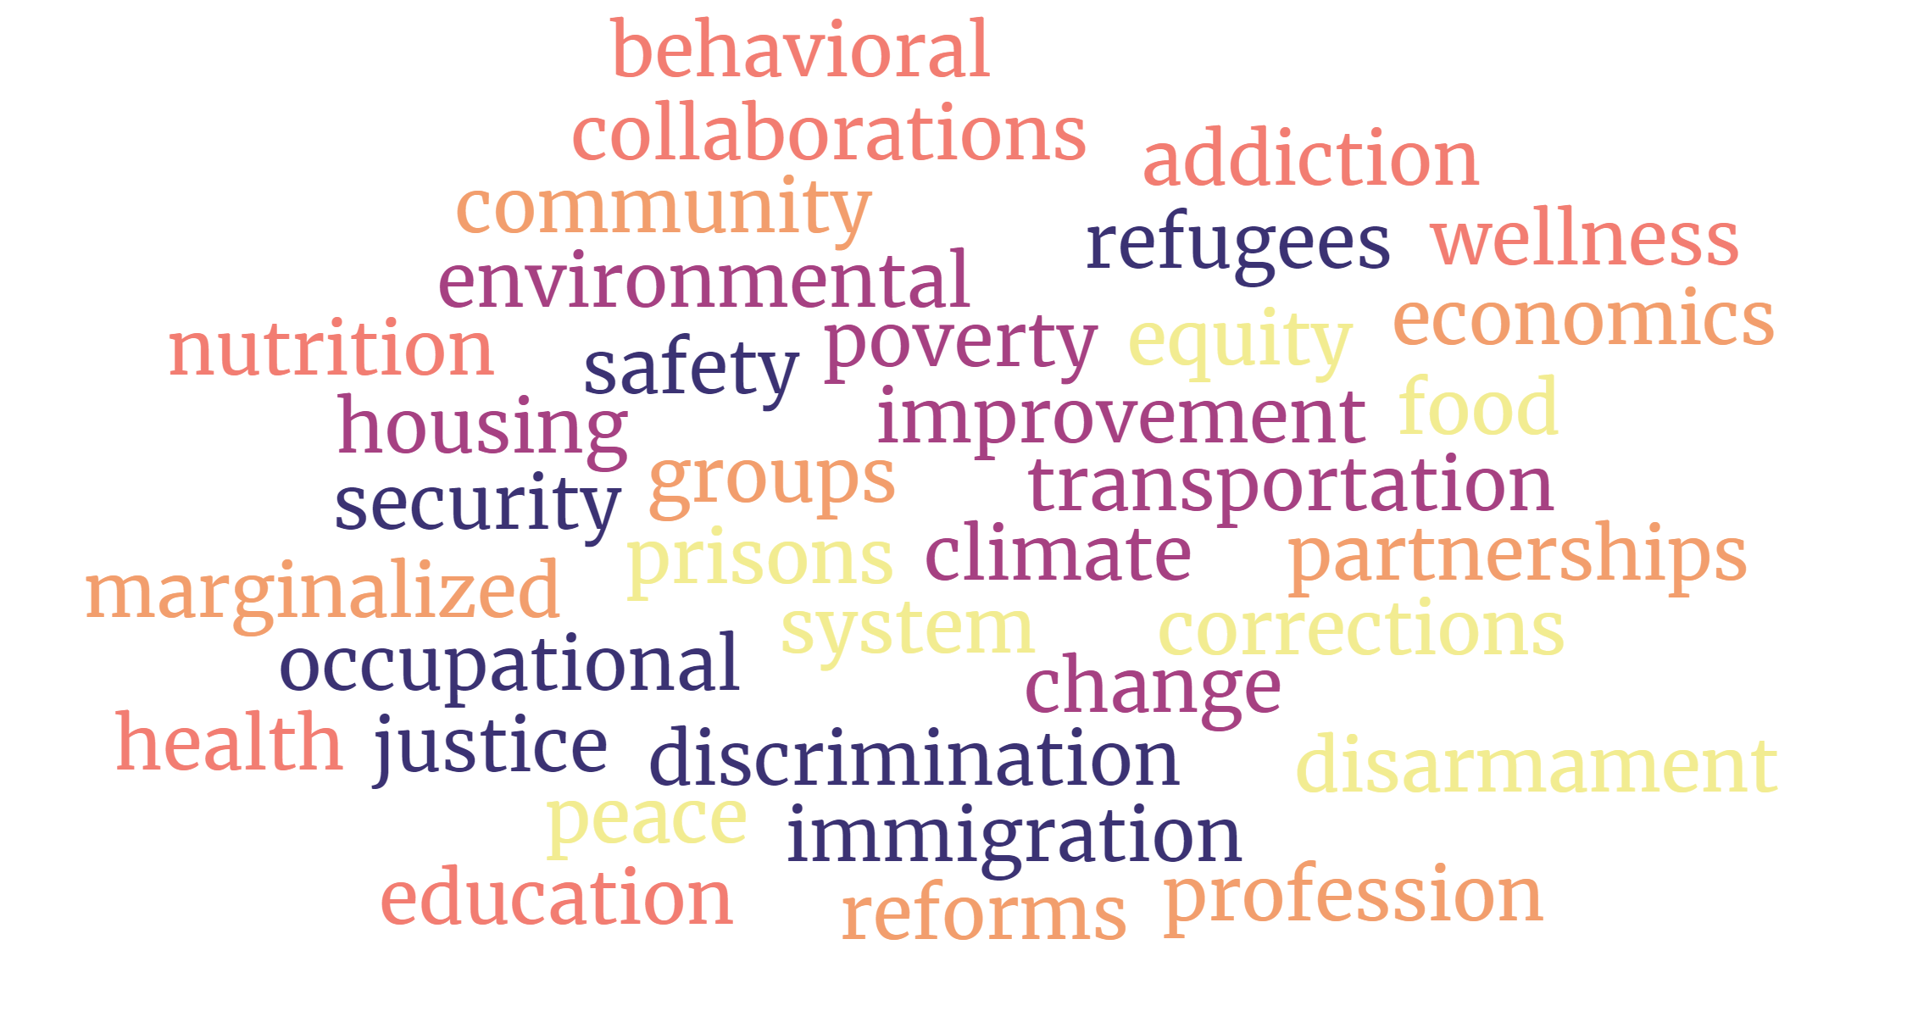

Slide 32
“I would love to live like a river flows, carried by the surprise of its own unfolding.”
- John O'Donohue -

