Slide 1
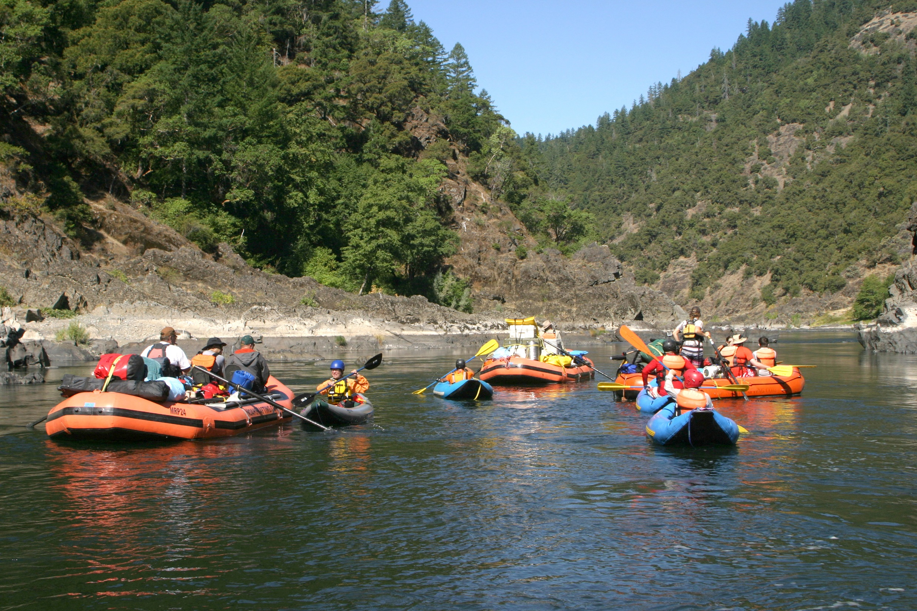
EXPAND THE JOY IN RURAL RESIDENCY TRAINING
Through Unique Curricula

Slide 2
Challenges for Rural Training Programs
Promoting our programs effectively to attract prospective applicants
Broadened full scope needs for rural can seem intimidating
Remoteness issues for FP and their family
Isolation issues
Wellness and Burnout
How do effectively sell my program and make it attractive ???

Slide 3
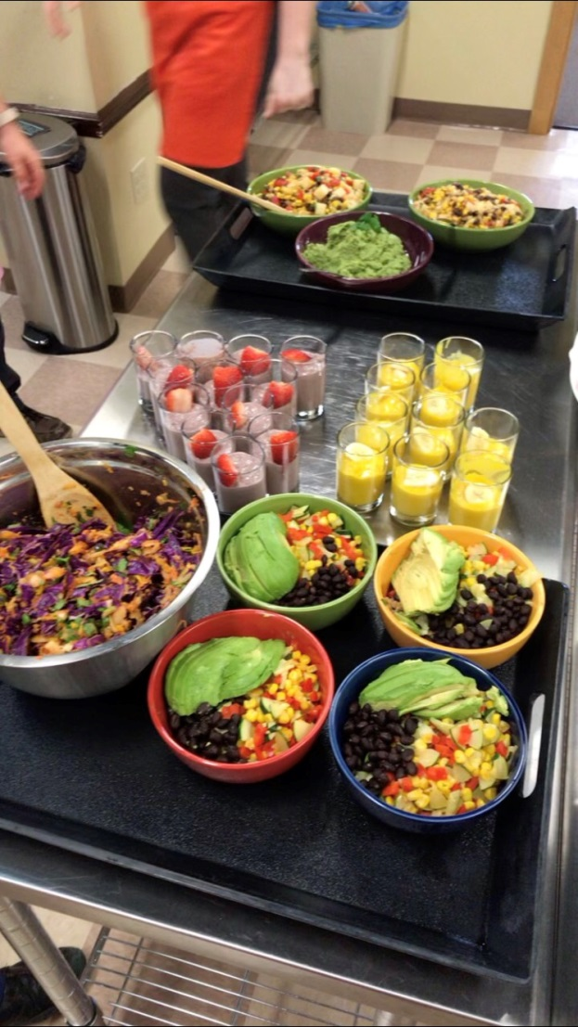
Finding what makes you special??
Curricular strengths of your program
OB/cesarean
Endoscopy
Procedures
Full scope
Advocacy
Finding your program’s passion – what lights your fire?
Wilderness Medicine
Culinary Medicine
POCUS
Community outreach
Special populations/Social Determinants of Health
Wellness or Lifestyle

Slide 4
Wilderness Medicine
Outdoors Passion – how to take medicine to the outdoors?
Especially attractive to the younger physicians
Fits rural family medicine

Slide 5
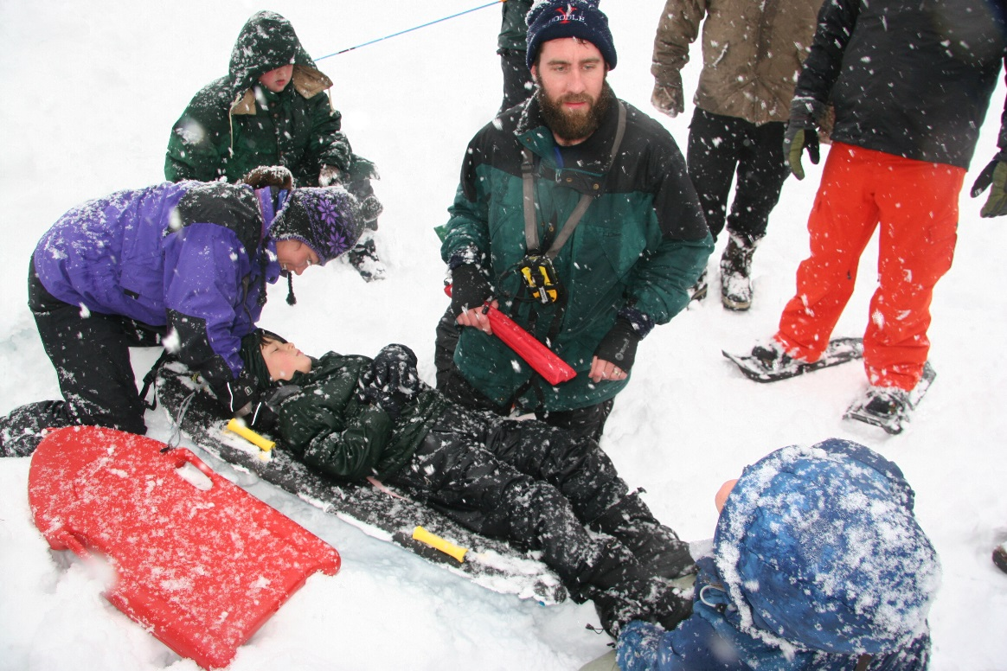
Cascades East Wilderness Medicine
Wilderness Medicine Society Fellowship concurrent with residency
AWLS – Advanced Wilderness Life Support, includes a 4 day whitewater rafting/kayaking trip
Winter Wilderness Medicine Conference
Longitudinal monthly didactic
Resident fellow candidates as teachers
Medical School Student exposure
Interdisciplinary
Medical Student and Nursing scholarships

Slide 6
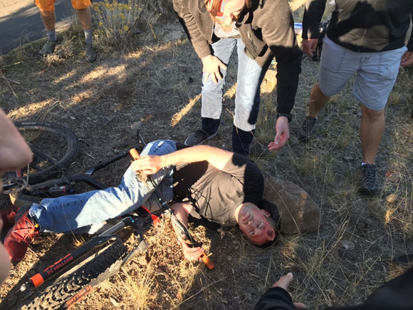
Liability
Use commercial outfitters
Use commercial caterers/restaurant owners for food prep
Use hospital CME coordinator and provides hospital liability coverage
Use WMS Fellows or Fellow candidates as instructors

Slide 7
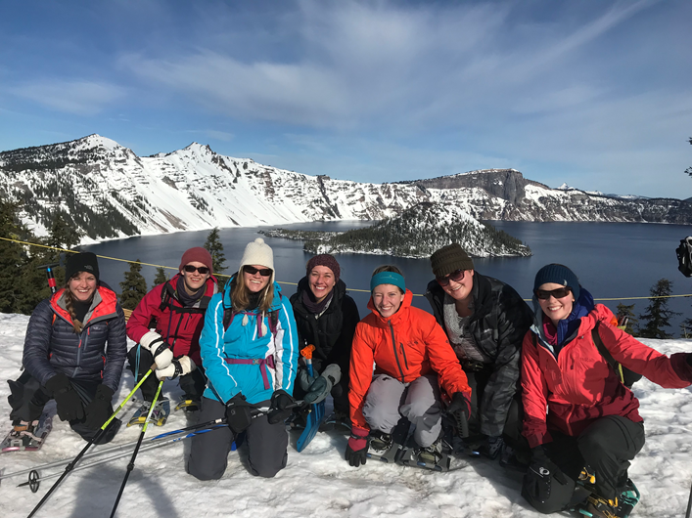
Resident’s Perspective
Motivations for ranking Cascades East FMR high
What made Cascades East more attractive than other excellent residency programs
Fellowship attraction
Effect on resident wellness
Practical lifesaving skill sets
Role of teaching

Slide 8
Resources
WMS.org (fellowship requirements)
AdventureMed – awls.org (AWLS requirements)
AFMRD PD toolkit - afmrd.org (our Wilderness Medicine curriculum)
Dwight Smith MD dsmith@skylakes.org or cell phone 541-891-1831

Slide 9
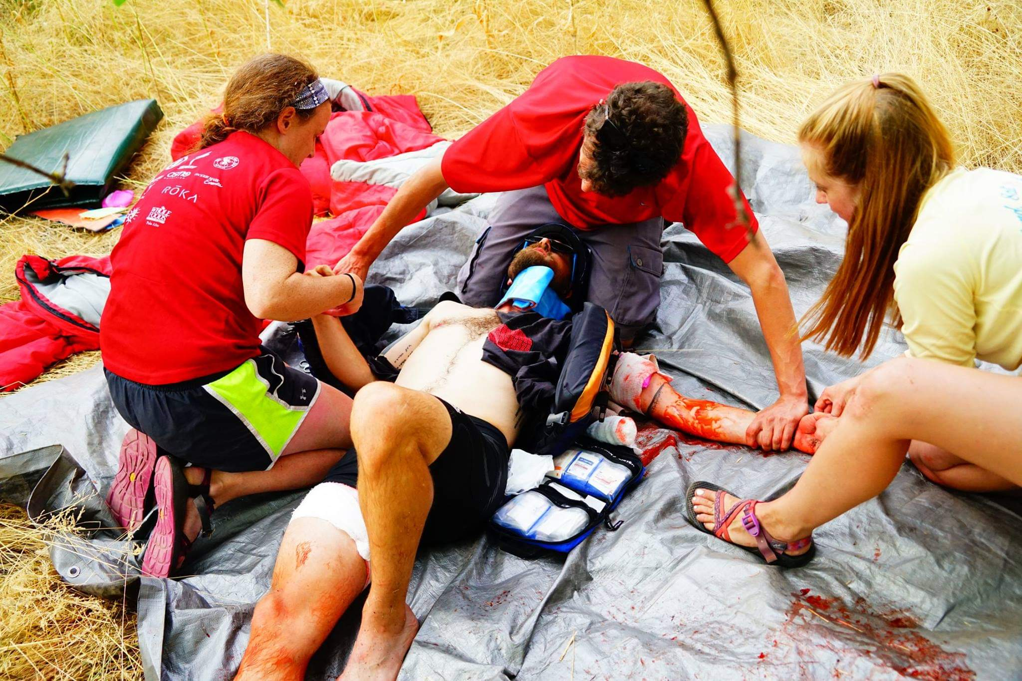
QUESTIONS?
Dwight Smith MD
E-mail questions to me at dsmith@skylakes.org
Call 541-891-1831

