Slide 1
Ready For Rural (R4R): An Innovative Approach to the Transition from Medical Student to Competent and Confident Rural Practitioner
Tina Kenyon, ACSW,
Christopher Heatherton, DO

Slide 2
Presentation Objectives
Describe the draft plan for an innovative non-profit partnership supporting rural preceptors, teams and health systems
Gather strengths, opportunities, aspirations and results related to the implementation of the R4R non-profit partnership
Explore innovative strategies to optimize the strengths and opportunities of developing the R4R non-profit partnership

Slide 3
Session Structure
Introduction of presenters
Review the literature and background that led to the Ready for Rural (R4R) concept
Describe the scope of the R4R non-profit proposal
Invite participants to share their input about strengths, opportunities, aspirations and how to measure results via Survey Monkey
Summarize proposed next steps in the R4R development

Slide 4
Tina Kenyon, ACSW
Background and experience in nursing, social work and education
Educator for interdisciplinary health professionals including Family Medicine residents for 33 years
Raised in and currently living in a rural area
Desire to support learners interested in rural practice after residency

Slide 5
Christopher Heatherton, D.O.
The Road to Rural Practice ~
Training:
University of New England College of Osteopathic Medicine
NH Dartmouth Family Medicine Residency
Practice:
Family Medicine Residency Faculty/Clinical Leader
Locum Tenens practice in rural New Zealand
Inpt/Outpt practice in rural FQHC in New Hampshire
Inpt/Outpt/ER in Critical Access system in rural Idaho

Slide 6
Lessons from the Literature
The patient-to-primary care physician ratio in rural areas is only 39.8 physicians per 100,000 people. (Jaret, AAMC News)¹
Only 11 percent of the physician workforce practices in rural communities.²
By 2017, more than half of rural physicians were at least 50 years old, and more than a quarter were at least 60.³
Growing up in a rural setting is a strong predictor of future rural practice for physicians. There has been a 28% decrease in the number of allopathic medical school matriculants from rural backgrounds over the past 15 years. Rural students represented less than 5 percent of all incoming medical students in 2017. ⁴

Slide 7
Why Change the Model?
Who is joining the ranks of rural health?
Where is the disconnect?
Theory - Providers want to work in rural communities but it may be challenging to live there full time for various reasons (spouse employment, school system, etc.)
Longitudinal practitioners, NOT Locums Tenens

Slide 8
Locums with a Twist
New Zealand Locums model
Collaboration between network of Rural General Practitioners and non-profit Locums provider
Lost River Medical Center
Rotating Physicians with Patient-Centered Medical Home (PCMH) and nurse-run clinic with local APRN
3RNet

Slide 9
Lifelong Learners
Training for our learners
Creating opportunities to encourage all providers to be lifelong learners
Opportunities for providers who want to expand their practice - ATLS, CALS
Expand opportunities for professional growth

Slide 10
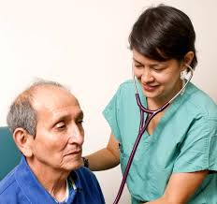
Powerful Questions
How can we attract the current/evolving generations of college, advanced practitioner and medical school students into rural practice?
How can we prepare medical students, advanced practitioner students and residents to provide excellent rural health care?
How can we ensure safe, continuous and sustainable patient care in rural areas with a fluid/rotating work force?

Slide 11
R4R - Something for Everyone
Health professions students
Skills and support for rural practice
Mentoring from experienced, supported practitioners
Patients
Continuous, safe team-based care
Well trained practitioners and teams
Clinical teams/practices
Patient-Centered Medical Home approach
Valued and supported educators for students
Clinician/Preceptors
Resources for support and development as educators
Well prepared and motivated learners

Slide 12
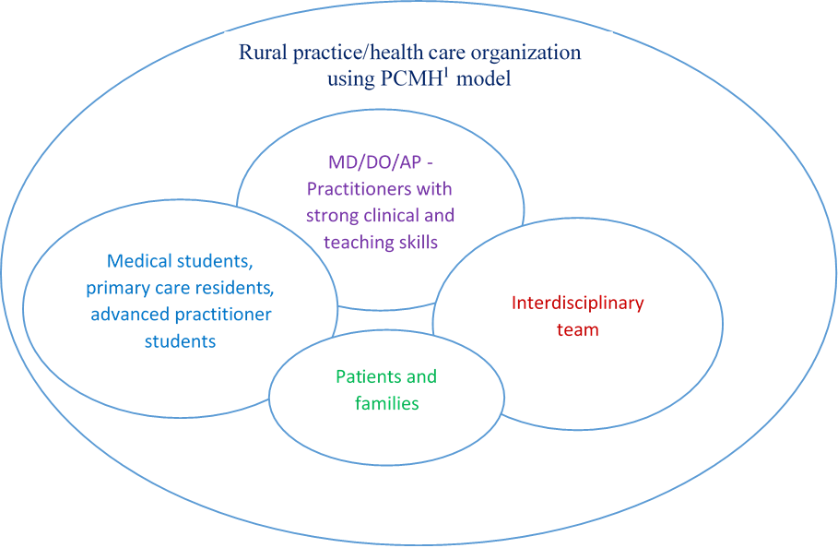
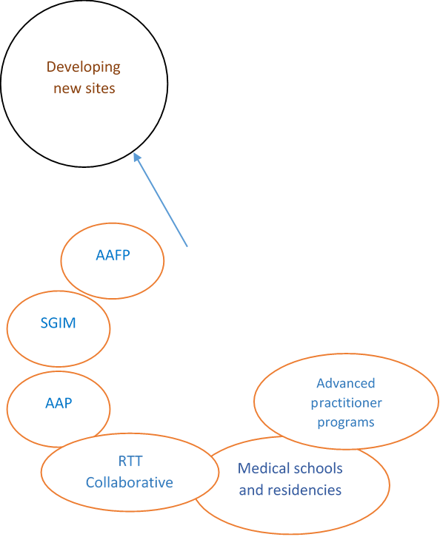
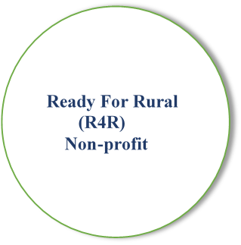
Ready for Rural Partnership
Graphic

Slide 13
Ready for Rural (R4R) Aspirations
The non-profit Ready for Rural (R4R) Partnership aspires to do the following:
a) Establish partnerships with key stakeholders - AAFP, SGIM, AAP, RTT
Collaborative, etc. to leverage and augment existing resources;
Assist interested health care organizations to implement a Patient-Centered
Medical Home (PCMH) care model, where the interdisciplinary team is the
continuity for patients, learners and practitioners;
Assist practitioners/teams to develop advanced clinical, mentoring and teaching skills;
d) Structure electives for medical students, primary care residents and advanced
practitioner students to match them with those skilled practitioners as
preceptors and role models;
e) Reach out to residencies and AP training programs to educate learners about
R4R services, and help them feel prepared and excited about going to a rural
practice post-training, whether temporarily or permanently;
f) Provide support for organizations, teams and practitioners through virtual
connections (e.g. a nurse/medical assistant support group, blogs, etc.)
g) Form teams of rural health care ambassadors (MA, nurse, AP, MD/DO,
business staff, manager, residents, medical students) to help develop new sites

Slide 14
SOAR Analysis
Strengths
Assets, capabilities
Opportunities
Unmet need
Aspirations
Scope of work
Who we want to serve
Where we will focus
Results
How to identify and track progress
Jacqueline Stavros and Gina Hinrichs, Thin Book of SOAR: Building Strengths-Based Strategy. Thin Book Publishing Co, 2009. http://www.thinbook.com/the-thin-book-of-soar.

Slide 15
Please Give Us Your Input
Please paste this link into your browser and add information about R4R from your perspective
https://www.surveymonkey.com/r/XLWPT3N
Strengths
Opportunities
Aspirations
Results

Slide 16
Next Steps for R4R
Gather input from experienced practitioners, residents and students
Assemble an interdisciplinary Advisory Board to guide R4R planning
Establish a timeline and development plan
Explore opportunities for collaboration and partnerships as R4R evolves

Slide 17
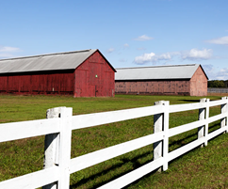
Summary Points
There are concerning trends in the rural practitioner work force
Changes in health care provide an exciting opportunity to explore innovative solutions to sustainable high quality rural health care
Harvesting the wisdom of experienced colleagues in rural health will enhance the effectiveness of the R4R implementation

Slide 18
Contact information
Dr. Christopher Heatherton
cheatherton@msn.com
Tina Kenyon, ACSW
tkenyon@crhc.org

Slide 19
References
1) Attracting the Next Generation of Physicians to Rural Medicine
Peter Jaret, Special to AAMC News, February 3, 2020
2) Fordyce MA, Chen FM, Doescher MP, Hart LG. 2005 physician supply and distribution in rural areas of the United States [Internet]. Seattle (WA): University of Washington Rural Health Research Center; 2007 Nov [cited 2019 Oct 16]. (Final Report No. 116). Available from: https://depts.washington.edu/uwrhrc/uploads/RHRC%20FR116%20Fordyce.pdf Google Scholar
3) Implications of an Aging Rural Physician Workforce
Lucy Skinner, B.A., Douglas O. Staiger, Ph.D., David I. Auerbach, Ph.D., and Peter I. Buerhaus, Ph.D., R.N. N Engl J Med 2019; 381:299-301 DOI: 10.1056/NEJMp1900808
4) The Decline In Rural Medical Students: A Growing Gap In Geographic Diversity Threatens The Rural Physician Workforce
Scott A. Shipman, Andrea Wendling, Karen C. Jones, Iris Kovar-Gough, Janis M. Orlowski, and Julie Phillips - https://www.healthaffairs.org/journal/hlthaff

