Slide 1





Developing, Sustaining, and Replicating a Role for Pharmacists in Rural Primary Care Practice
April 2020
Emily Hawes, PharmD, BCPS, CPP
Clinical Pharmacist Practitioner, Greenway Medical Associates
Associate Professor, UNC Department of Family Medicine
Associate Professor of Clinical Education, UNC Eshelman School of Pharmacy
Bill Hitch, PharmD, BCPS CPP
Director of Pharmacotherapy, Mountain Area Health Education Center
Assistant Professor of Clinical Education, UNC Eshelman School of Pharmacy
Associate Professor, UNC Department of Family Medicine

Slide 2
Objectives
Describe the key strategies for successfully developing and maintaining primary care-based pharmacotherapy clinics in rural North Carolina.
Discuss billing methods, revenue options, and sustainability considerations for pharmacy practice models.
Describe the benefits and challenges of interprofessional health education in rural settings.

Slide 3
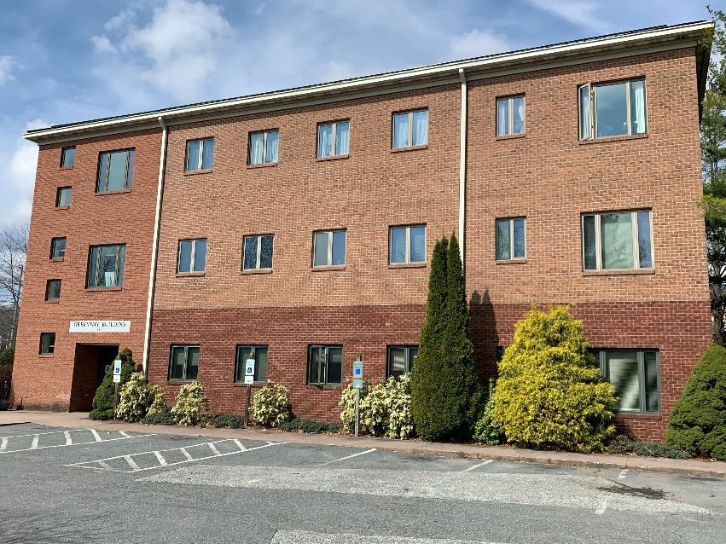
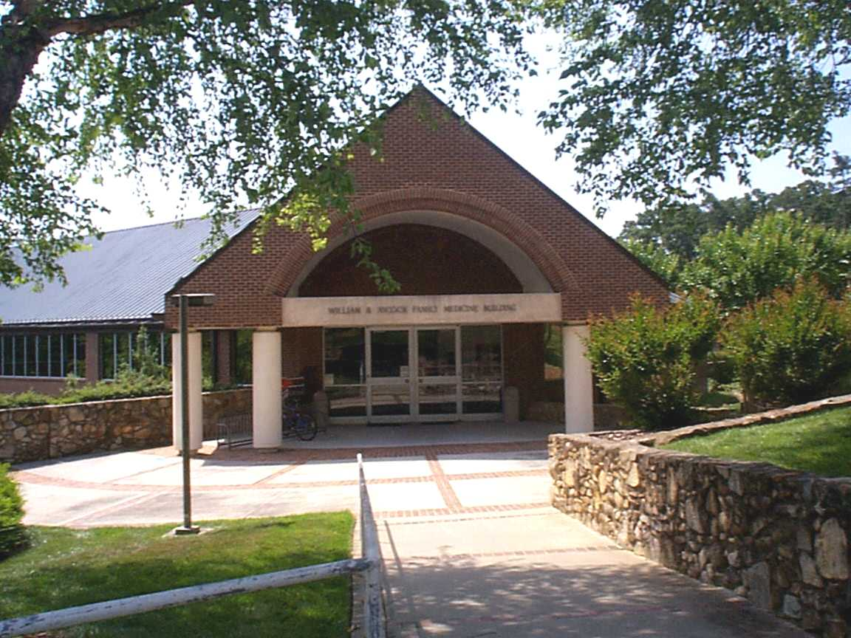
Emily’s Background
Greenway Medical Associates
  Located in Boone, NC
  3 PCPs (2 NPs and 1 MD)
  PCMH Level 3
  1 LPA and 1 CPP
UNC Family Medicine Center
  Located in Chapel Hill, NC
  64 PCPs (~ 10 FTE)
  PCMH Level 3
  4 LCSW and 2 CPP

Slide 4
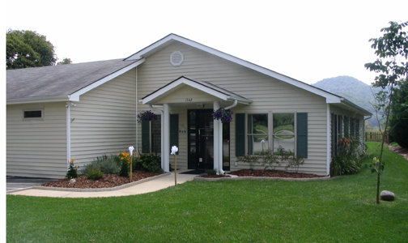
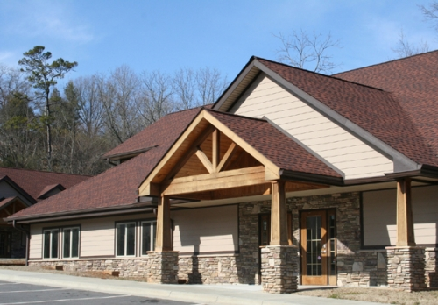
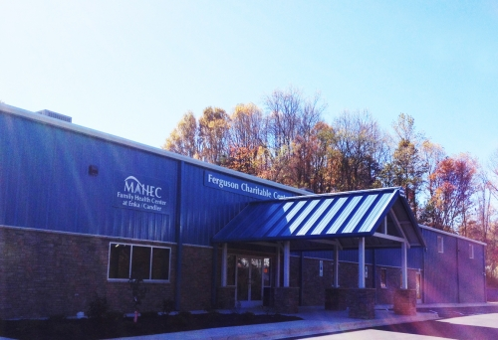
Bill’s Background
Mountain Area Health Education Center
Locations in Asheville, Cane Creek, and Candler, North Carolina
Multisite Family Medicine organization containing 4 Family Health Centers, one OB/GYN office, and 2 Continuing Care Retirement Community (CCRC) clinics
30 PCPs (26 MDs, 3 PAs + 1 FNP)
Level 3 PCMH
7 CPPs, 4 BH, 1 Dietician

Slide 5
Pharmacy Scope of Practice
Direct Patient Care
  Pharmacotherapy Visits
- Collaborative Practice Agreements
  Multidisciplinary Visits
Drug Information Services/Consultation
Evidence-based care algorithms
Population-based efforts
Continuous quality improvement
Education
Accreditation/Certifications

Slide 6
Clinical Pharmacist Practitioner
Atrial Fibrillation
DVT/PE
Chronic Pain
Diabetes
Hyperlipidemia
Hypertension
Osteoporosis
Depression
Asthma/COPD
Hypothyroidism/Hyperthyroidism
Gout
Hepatitis C
Prescribe pharmacotherapy
Order & interpret labs
Monitor for efficacy and side effects
Bill for services
Hawes EM, Misita C, Burkhart JI, McKnight L, Deyo ZM, Lee RA, Howard C, Eckel SF. Prescribing pharmacists in the ambulatory care setting: Experience at the University of North Carolina Medical Center. Am J Health Syst Pharm. 2016 Sep 15;73(18):1425-33.

Slide 7
Billing
  “Incident to” Billing by Pharmacist
    99211-99214
    Medicare Wellness Visit codes G0438, G0439
    E-visits 99444
  Indirect Billing
    Transitional Care Management codes 99495- 99496
    Co-visit model supporting physician billing level 99211-99215
Scott MA, Hitch WJ, Wilson CG, Lugo AM. Billing for pharmacists' cognitive services in physicians' offices: multiple methods of reimbursement. J Am Pharm Assoc (2003). 2012 Mar-Apr;52(2):175-80.
Notes:
)

Slide 8
Medicare Annual Wellness Visits
Annual visit focused around preventative health
  Health risk assessment
  Updating family, medical, social histories and providers
  Assessment of memory, depression, falls
  Schedule for routine screenings
Benefits of pharmacists conducting annual wellness visits:
  Annual review and assessment of the medication regimen
  Increased % of completed annual wellness visit in the practice
  Challenging for physician to complete if acute health concerns
  Frees physicians up to see other patients
  Revenue generated from 1070 AWVs supports 1 clinic pharmacist
Park I, Sutherland S, Ray L, Wilson CG. Financial implications of pharmacist-led Medicare annual wellness visits. JAPhA 2014 Aug-Sept; 54(4): 435-40

Slide 9
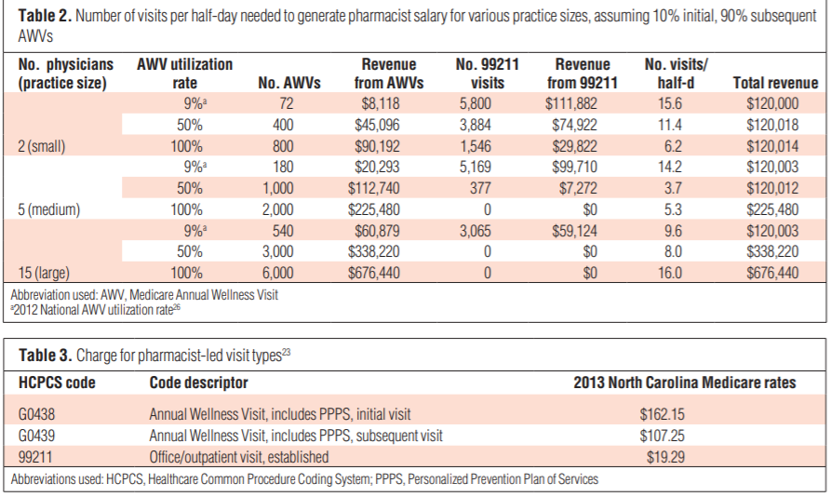
Annual Wellness Billing
Park I, Sutherland S, Ray L, Wilson CG. Financial implications of pharmacist-led Medicare annual wellness visits. JAPhA 2014 Aug-Sept; 54(4): 435-40

Slide 10
Co-Visits
Model
  Model of care where pharmacist and physician patient panels are merged and patients are seen by both providers
  14 patient visits are available on co-visit half days (usual MD panel 10, usual PharmD 7)
  Prior to clinic, pharmacist and physician which patients need co-visits
  Pharmacists usually sees patient while they are waiting to see physician
  Pharmacist and physician share the documentation
  Physician bills for services provided by the pharmacist and physician
Ulrich IP, Patel S, Gilmer B. Evaluation of a pharmacist-physician co-visit model in a family medicine practice. J Am Pharm Assoc 2019 Jan-Feb; 59(1):129-135

Slide 11
Co-Visit Benefits
Revenue increased with this model by $800 in charges, $400 in reimbursement per half day of clinic
Works well in rural space in a smaller clinic
Convenience for patients receiving all care in one visit
Team based care collaboration and education
Clinicians reported increased satisfaction with clinic workday and less documentation to complete after clinic
Ulrich IP, Patel S, Gilmer B. Evaluation of a pharmacist-physician co-visit model in a family medicine practice. J Am Pharm Assoc 2019 Jan-Feb; 59(1):129-135

Slide 12
Utilizing PGY2 Residents to Build Pharmacy Services
MAHEC PGY2 Ambulatory Care Residency Program
  MAHEC partners with one Primary Care office (per resident) annually
  Pharmacy resident’s role is to build and implement pharmacy services at this new site
  Position is funded 50% by UNC, 25% by MAHEC, and 25% by the practice site
  Resident starts with 2 half days per week at practice site which increases to 7 over the year
  Goal is for the resident to build sustainable services which could create their job post residency
Benefits of this model
  In the last 4 years, our 8 pharmacy residents have sustained 5.7 positions
  Year one is often the hardest year financially as a pharmacist builds their patient panel
  Practice site pays 25% of a resident’s salary in year one while building
  Relationship building between resident and practice site during the building year
  Practice site has a low cost trial period of pharmacy services before committing more significant funds to a position
Wilson C, Ulrich IP, Scott MA. Factors demonstrating readiness for clinical pharmacy services. Am J Health Syst Pharm Nov 2019; 76(21):1717–1718

Slide 13
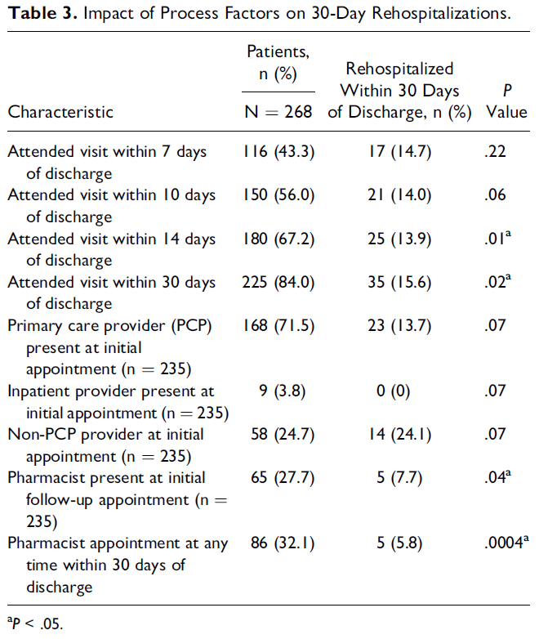
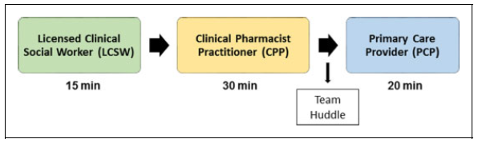
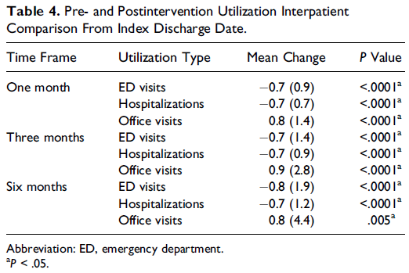
Transitions of Care
Moderate-to High- Risk patients seen by Multidisciplinary team
Hawes EM, et al. Accountable Care in Transitions (ACTion): A Team-Based Approach to Reducing Hospital Utilization in a Patient-Centered Medical Home. J Pharm Pract. 2018 Apr;31(2):175-182.

Slide 14
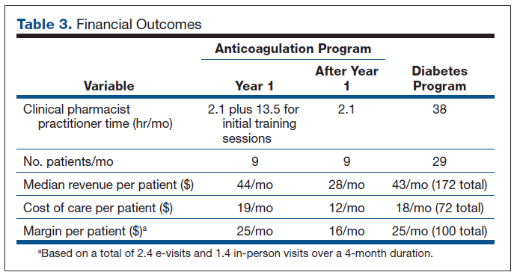
E-Visits
Diabetes Follow Up
Decrease in A1C by 3.4% observed at 5.7 months after enrollment (p < 0.001)
Significant improvements in statin use, aspirin use, and BP control
Warfarin Patient Self Testing
Hawes EM, Lambert E, Reid A, Tong G, Gwynne M. Implementation and evaluation of a pharmacist-led electronic visit program for diabetes and anticoagulation care in a patient-centered medical home. Am J Health Syst Pharm. 2018 Jun 15;75(12):901-910.

Slide 15
Considerations for Implementation
  Practice readiness for team-based care
  Presence of a physician champion
  Full EHR Access for pharmacists
  Private space to see patients
  Buy in from administrative staff
  Funding and sustainability
Carrington A, Pokallus A, Ulrich IP, Scott MA, Fay AE, Drake ES, Wilson CG. Essential factors demonstrating readiness of primary care practices for clinical pharmacy services. Am J Health Syst Pharm. 2018 Nov 1; 75(21):1708-1713.

Slide 16
Strategies for Sustainability
  Priority alignment
  Community engagement
  Strong pharmacist-physician relationships
  Interprofessional collegiality
  Teamwork for Population Based Efforts
  Outcome tracking (clinical, educational, financial)
Hawes EM, Misita C, Burkhart JI, McKnight L, Deyo ZM, Lee RA, Howard C, Eckel SF. Prescribing pharmacists in the ambulatory care setting: Experience at the University of North Carolina Medical Center. Am J Health Syst Pharm. 2016 Sep 15;73(18):1425-33.

Slide 17
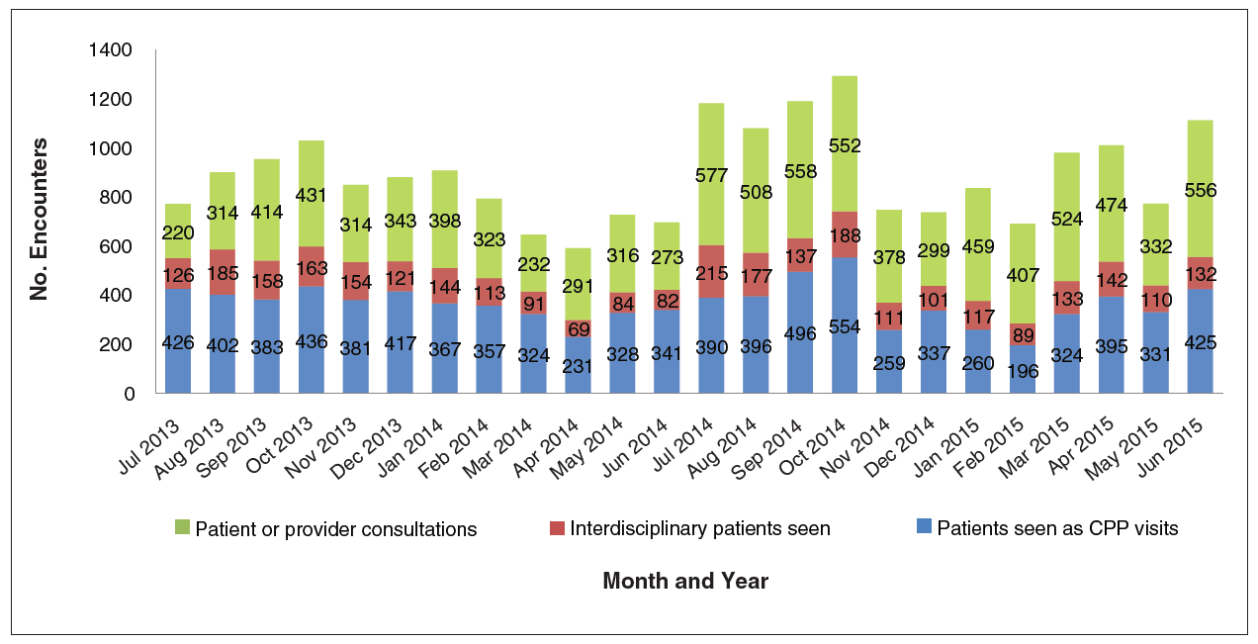
Outcome Tracking – Financial/Productivity
Hawes EM, Misita C, Burkhart JI, McKnight L, Deyo ZM, Lee RA, Howard C, Eckel SF. Prescribing pharmacists in the ambulatory care setting: Experience at the University of North Carolina Medical Center. Am J Health Syst Pharm. 2016 Sep 15;73(18):1425-33.

Slide 18
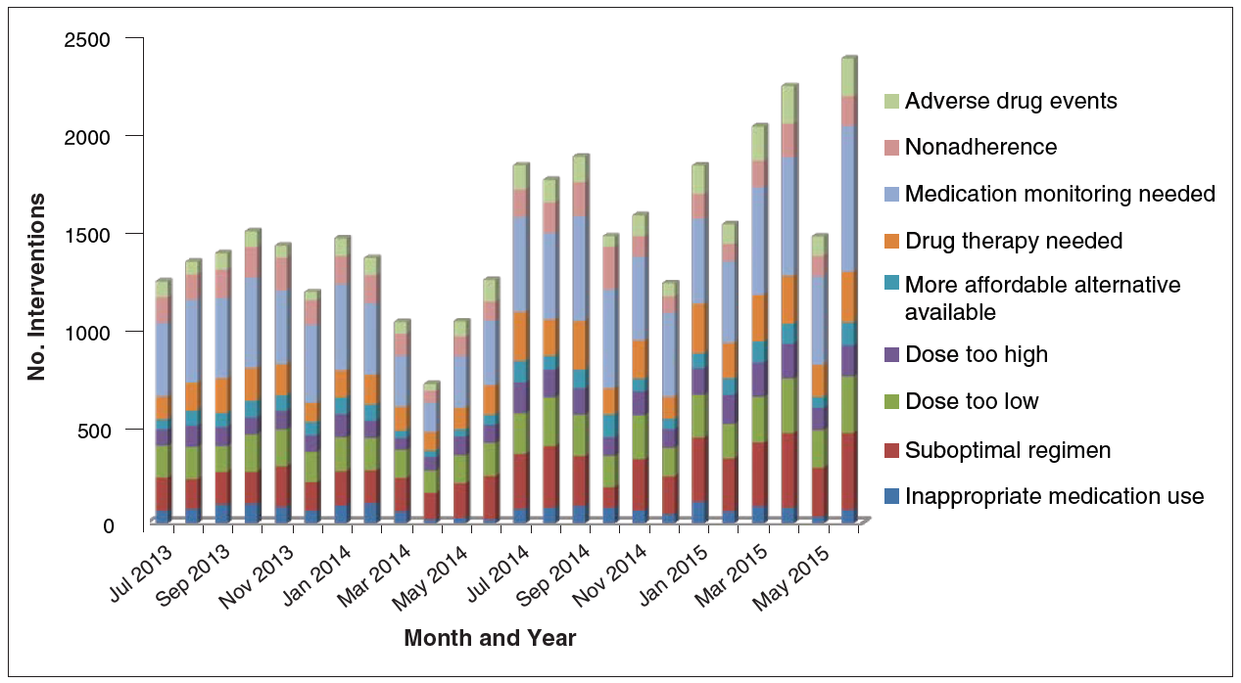
Outcome Tracking - Clinical
Hawes EM, Misita C, Burkhart JI, McKnight L, Deyo ZM, Lee RA, Howard C, Eckel SF. Prescribing pharmacists in the ambulatory care setting: Experience at the University of North Carolina Medical Center. Am J Health Syst Pharm. 2016 Sep 15;73(18):1425-33.

Slide 19
Take Home Points
Pharmacists can provide a variety of services to rural primary care offices including patient education, anticoagulation services, chronic disease management, polypharmacy assessment, transitions of care, annual wellness, and medication access
Collaborative practice agreements between pharmacists and physicians allow pharmacists to work at the top of their license and can save physicians time
Pharmacists can enhance patient care, improve practice quality measures, and decrease 30 day hospital readmission rates
Interprofessional teams provide rich opportunities for pharmacy and medical education
Several financial models exist that can sustain pharmacy services in rural settings

Slide 20
QUESTIONS?
Emily Hawes
emily_hawes@med.unc.edu
Bill Hitch
Bill.Hitch@mahec.net

