Slide 1
NIPDD Fellowship Project
Opioid Use Disorder Education and Medication Assisted Treatment (MAT) Training and the Likelihood of Family Medicine Residents Incorporating MAT into Their Future Practice
Craig Burrows, MD
Program Director
University of Kentucky Rural Morehead Family Medicine Residency

Slide 2
Question
Does Opioid use Disorder(OUD) Education and Medication Assisted Treatment (MAT) training for OUD increase the likelihood of residents in a Family Practice residency program deciding to consider incorporating MAT into their future practice?

Slide 3
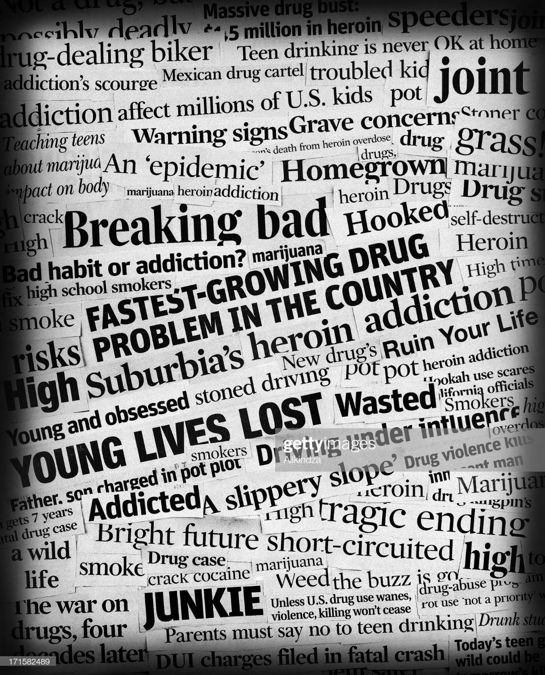

Slide 4
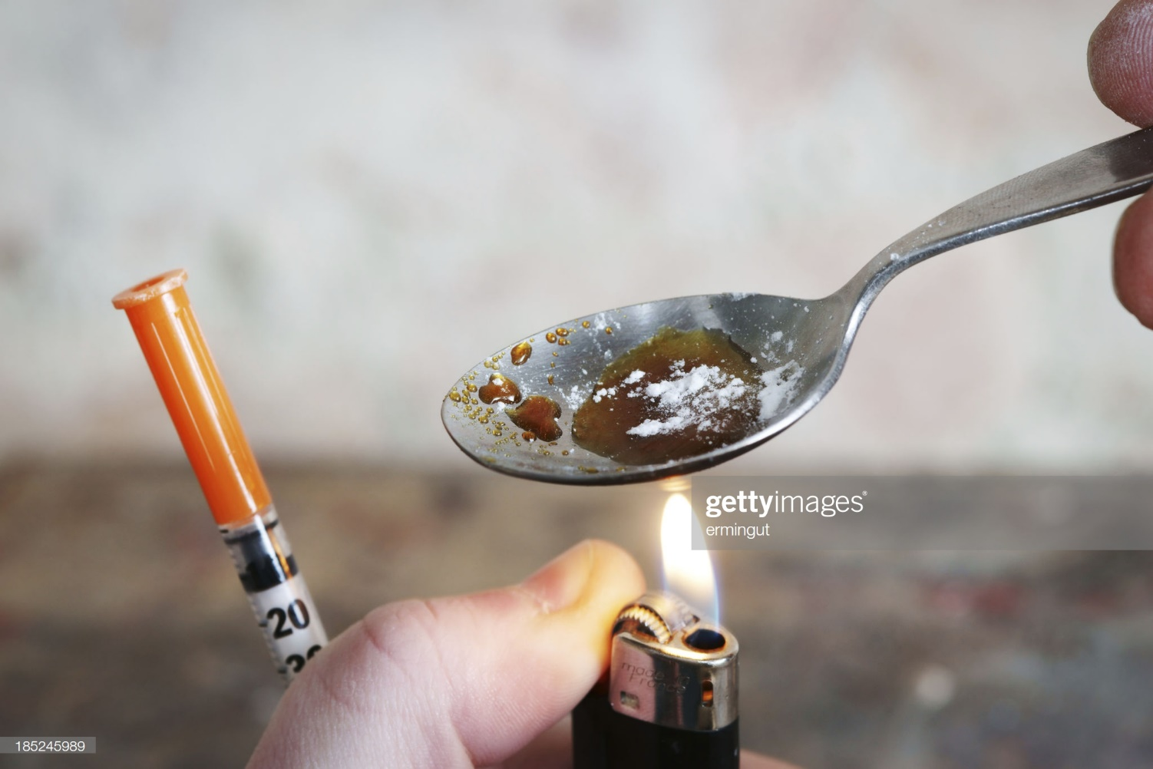

Slide 7
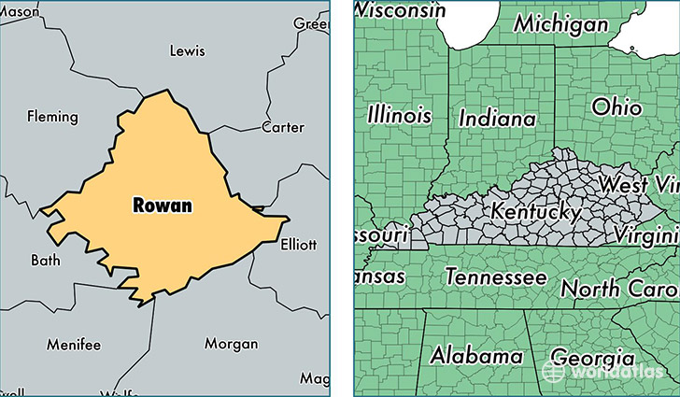

Slide 8
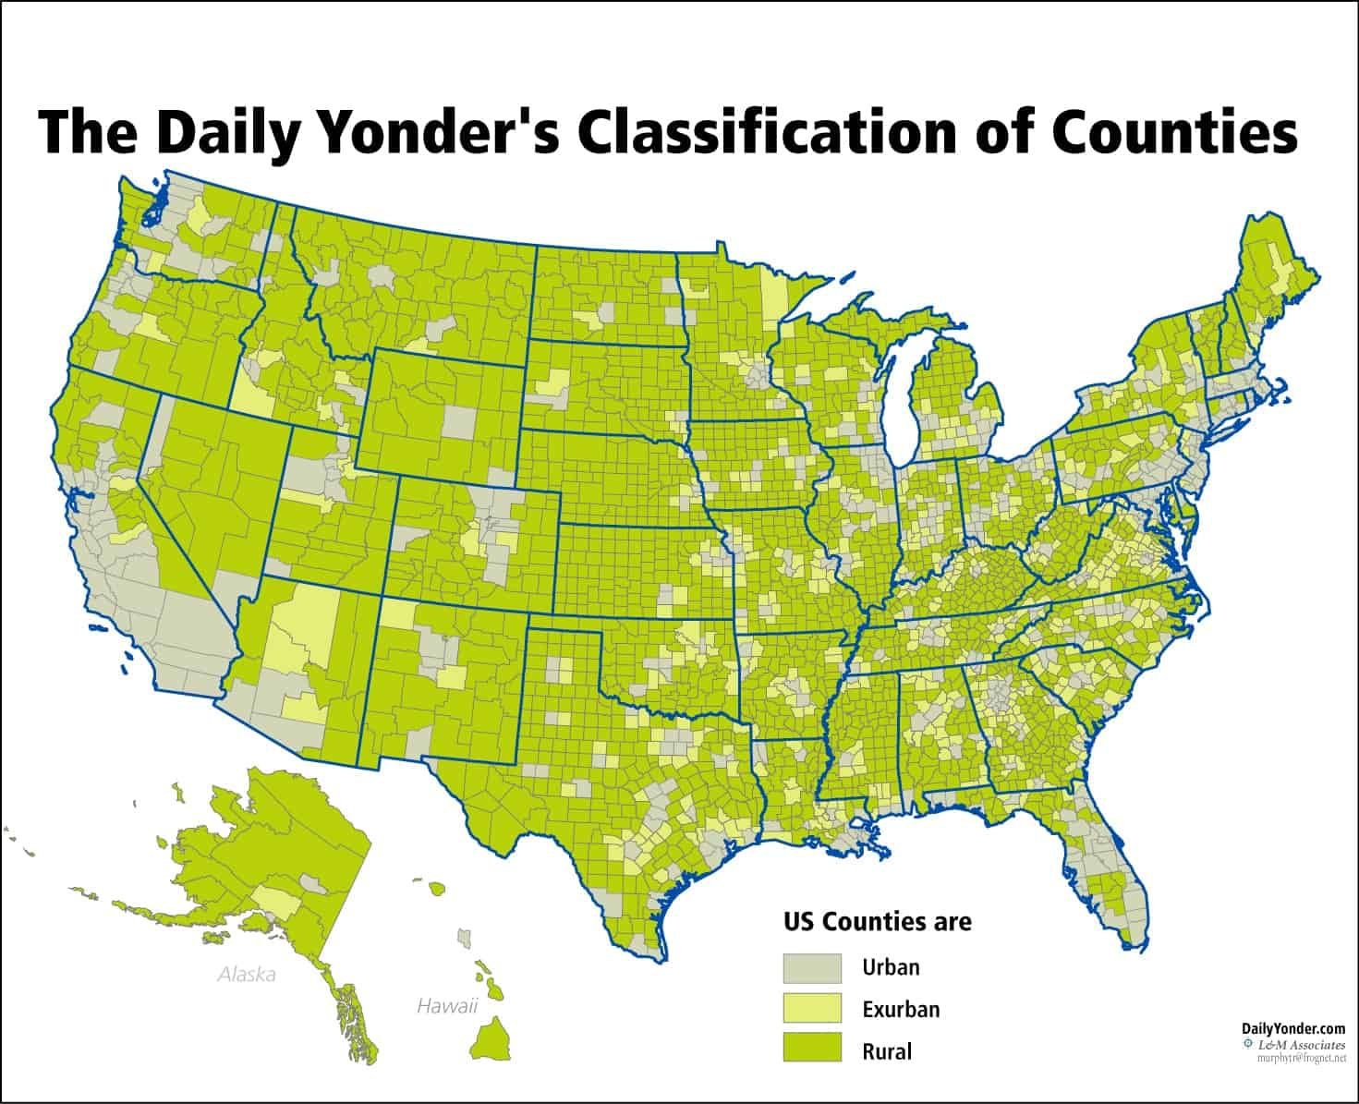

Slide 9
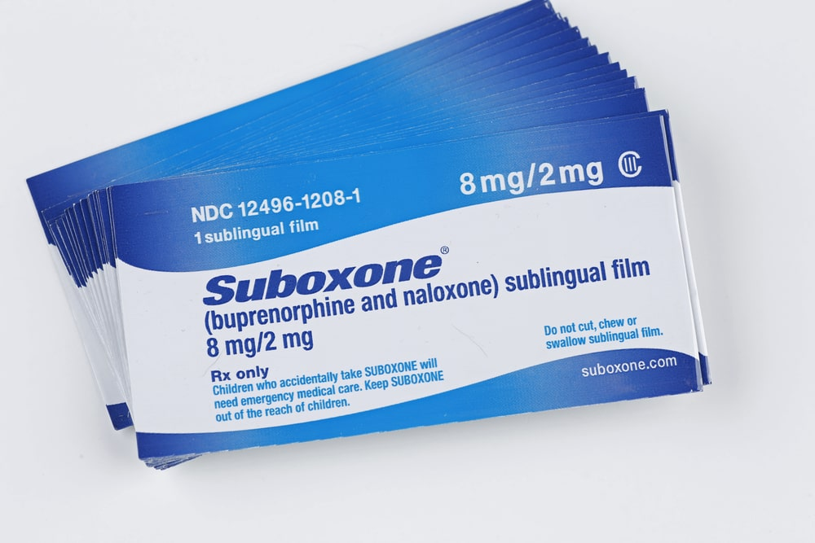

Slide 10
MAT of OUD
Safe
Effective – reduces OUD and mortality from overdose
Can be implemented in Primary Care
Yet, in a study from 2018, only 10% of 2016 Family Medicine graduates reported preparedness to provide MAT

Slide 11
The hypothesis is that OUD education and MAT training will have a positive impact on their decision to incorporate MAT into their future practice.
Family Practice residents were surveyed on their confidence level in knowledge of substance use disorder and medication assisted treatment and their likelihood to consider incorporating MAT into their future practice.
They were then exposed them to the curriculum elements outlined by the Betty Ford consensus and they received the MAT Training to obtain a waiver.
They were then resurveyed to see if the curriculum elements and the MAT training had impact on their likelihood to consider incorporating MAT into their future practice.

Slide 12
Survey Questions
Demographics
Exposure to OUD teaching or MAT in the past?
Following Questions on a Lykert scale:
Strongly agree, Agree, disagree or strongly disagree
Very confident, confident, somewhat confident, not confident at all

Slide 13
Do you agree that MAT is an appropriate treatment regimen for Opioid Use disorder?
Do you agree that MAT is an effective treatment for Opioid Use Disorder?
Do you agree MAT should be performed by primary care physicians?
Do you agree that MAT should be delivered in:
Addiction Medicine Clinic with addiction specialists
Addiction Medicine Clinic with coverage of by primary care physicians
Primary care Physician run separate Addiction Medicine Clinic based in the primary care office
Provided by Primary care Physician in the office integrated into the schedule.

Slide 14
How confident are you in your knowledge of OUD detection and evaluation?
How confident are you in your knowledge of OUD treatment including MAT?
How likely are you to incorporate MAT into your future practice?
What are the issues that are impacting your likelihood to incorporate MAT into your practice?

Slide 15
Curricular elements

Slide 16
Appropriate opioid prescription in primary care
Interventional options for pain
Psychological interventions for pain
Opioid tapering while managing pain
MAT Law and program guidance
MAT medications use
Treating OUD and other comorbid conditions
Withdrawal management

Slide 17
The incorporated elements described include didactic information, role play and workshops to develop techniques such as SBIRT, case presentations and discussions, legal and practice management considerations.
They were then required to receive MAT-waiver training which incorporates 4 hours in person and a 4 hour online course.

Slide 18
The respondents were 12 Family Medicine Residents in a Rural Family Medicine Residency in Eastern Kentucky, located at a 150 Bed Community Medical Center.
There was equal representation between PGY 1, 2 and 3 with an age range of 26 to 48 years of age.
The majority of the respondents, about 92%, reported that they had received 8 hours or less of Didactic/workshop exposure to MAT for OUD with most of those reporting 3 hours or less.
Half of the respondents reported some clinical exposure in their training up to this point varying from ½ day or less to 1 full month.

Slide 19
66% of them reported they were somewhat to very confident in evaluation and detection of OUD and the same percentage were somewhat or very confident in their ability to provide MAT for OUD.
All responded that MAT was an appropriate and effective means of treating OUD and 83% agreed or strongly agree that MAT should be provided by Primary care physicians in a variety of settings.
Finally, the majority 83% stated they were somewhat to very likely to incorporate MAT into their future practice.

Slide 20
Results of the Post Survey after the Educational Exposure:
All respondents continued to somewhat or strongly agree that MAT is an appropriate and effective treatment for OUD.
The percentage of residents reporting somewhat to very confident in knowledge and detection of OUD increased from 66% to 83% and confidence in their ability to provide MAT increased a similar amount.
After the intervention, all agreed that MAT could and should be performed by Primary Care Physicians.
There was no movement in the number of residents who considered it likely they would incorporate MAT into their practice in the future.

Slide 21
Limitations
Small Sample size
Previous Exposure to Community Efforts
Clinical experience just ramping up
Resident bias pre-residency

Slide 22
Why is this question important?
.
Early Career and new Graduates are driving the increases in MAT providers
Study in JABFM in Jan 2020 edition

Slide 23
Why is this question important
What curricular elements are more likely to influence FM Residents to provide MAT in future practice

Slide 24
Robust Training Environment
Mature Addiction Medicine Curriculum
Robust Community of MAT prescribing Preceptors
MAT DEA-X Waiver a requirement for Graduation
Louis and Weida in accompanying Commentary on the Article in JABFM advocated for a national mandate through the ACGME for MAT Waiver training for IM, PEDS, FM residents

Slide 25
What Drives Residents to provide MAT?
Personal experience with OUD in family, friends, community, self
National trends – reduction in stigmatization of OUD and MAT
Media emphasis on OUD and its implications
Hospital systems setting up comprehensive strategies to deal with OUD from identification in ED, clinic or Hospital, to detox, to connection to MAT provider/clinic to Psych and social services to Vocational services, to community education.

Slide 26
References
National Institute on Drug Abuse Overdose Death Rates. www.drugabuse.gov/related-topics/trends-statistics/overdose-death-rate. Published 2017
Wide Ranging Online Data for Epidemiologic Research (WONDER). Centers for Disease Control and Prevention (CDC). Web site. http:// wonder.cdc.gov Accessed Jan 2, 2018.
National Institute on Drug Abuse: Opioid Summaries by State. www.drugabuse.gov/drugs-abuse/opioids-summaries-by-state/kentucky. Revised Feb 2018. Accessed December 27, 2018.
2017 Overdose Fatality Report: Kentucky Office of Drug Control Policy. Commonwealth of Kentucky Justice and Public Safety Cabinet. Accessed Dec 2018.
Zoorob R, Kowalchuk A, de Grubb MM. Buprenorphine Therapy for Opioid Use Disorder. American Family Physician. 2018 Mar 1;97(5):313-320.
Rosenblatt RA, Andrilla DHA, Catlin M, Larson EH. Geographic and Specialty Distribution of US Physicians Trained to Treat Opioid Disorder. Ann of Fam Med. 2015:Jan/Feb 13(1):23-26.
Pani PP, MAremmani I, Pirastu R, Tagliamonte A, Gessa GL. Buprenorphine: a controlled clinical trial in the treatment of opioid dependence. Drug Alcohol Depend. 2000;60(1):35-50.

Slide 27
References
Johnson RE, Jaffe JH, Fudala PJ. A controlled trial of buprenorphine treatment for opioid Dependence. JAMA 1992;267(20):2750-55.
Fudala PJ, Bridge TP, Herbert S, et al. Office Based treatment of opiate addiction with a sublingual-tablet formulation of buprenorphine and naloxone. N Engl J Med. 2003;349(10):949-958.
Schwartz RP, Gryczynski J, O’Grady KE, et al. Opioid Agonist Treatments and Heroin verdose Deaths in Baltimore, Maryland, 1995- 2009. AMJ Pub Health. 2013 May;103(5):917-922.
Mauger S, Fraser R, Gill, K. Utilizing Buprenorphine-Naloxone to Treat Illicit and Prescription-opioid Dependence. Neuropsychiatric Disease and Treatment.2014:10: 587-598.
Minizer IL, Eisenberg M, Terra M, et al. Treating Opioid Addiction With Buprenorphine-Naloxone in Community Based Primary Care Settings. Ann of Fam Med.2007 Mar/Apr;3(2):146-150.
Tong ST, Hochheimer CJ, Peterson LE, Krist AH. Buprenorphine Provision by Early Career Family Physicians. Ann of Fam Med. 2018 Sept/Oct; 16(5): 443-447.

Slide 28
References
Tong ST, Sabo R, Aycock R, etal. Assessment of Addition Medicine Training in Family Medicine Residency Programs: A CERA Study. Fam Med. 2017;49(7):537-43.
Tesema L, Marshall J, Hathaway R. et al. Training in Office-based Opioid Treatment With Buprenorphine in US Residency Programs: A National Survey of Residency Program Directors. Substance Abuse. Published online 14 May 2018.
Seale JP, Shelenberger S, Clark DC. Providing Competency Based Family Medicine Residency Training in Substance Abuse in the New Millennium : A Model Curriculum. BMC Medical Education. 2010:10(33).
James JR, Gordon, LM, Klein, JW et al. Interest in Prescribing Buprenorphine among Resident and Attending Physicians at an Urban Teaching Clinic. Substance Abuse. Published online 26 Apr 2018.

Slide 29
References
Peterson, LE, Morgan, ZJ and Eden, AR. Early-Career and Graduating Physicians More Likely to Prescribe Buprennorphine. JABFM. Jan 2020, 33(1) 7-8.
Louis, J and Weida, N. Why are Early Career Family Physicians Driving Increases in Buprenorphine Prescribing. JABFM. Jan 2020, 33(1) 4-6.

