Slide 1
A Roadmap for Rural Residency Program Development
Steven Crane, MD
Amanda Weidner, MPH
Emily Hawes, PharmD

Slide 2
Rural Residency Planning and Development – Technical Assistance Center (RRPD-TAC)

Slide 3
Disclosures
RRPD-TAC is supported by the Health Resources and Services Administration (HRSA) of the U.S. Department of Health and Human Services (HHS) under cooperative agreement #UK6RH32513. The content are those of the presenters and do not necessarily represent the official views of, nor an endorsement, by HRSA, HHS, or the U.S. Government.

Slide 4
Background
In 2019, HRSA funded 27 Rural Residency Planning and Development (RRPD) Programs
4 in psychiatry, 1 in internal medicine, 22 in family medicine
HRSA also funded a Technical Assistance Center to help support the development of new rural primary care residency programs (and other communities interested in starting programs)

Slide 5
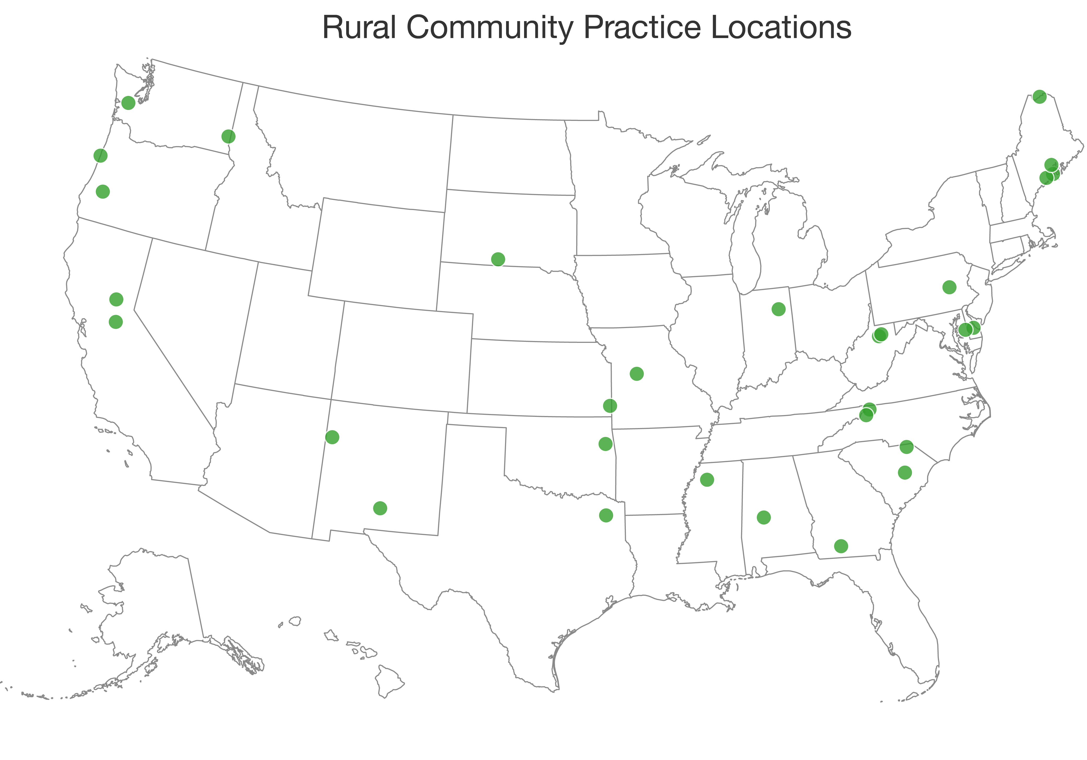
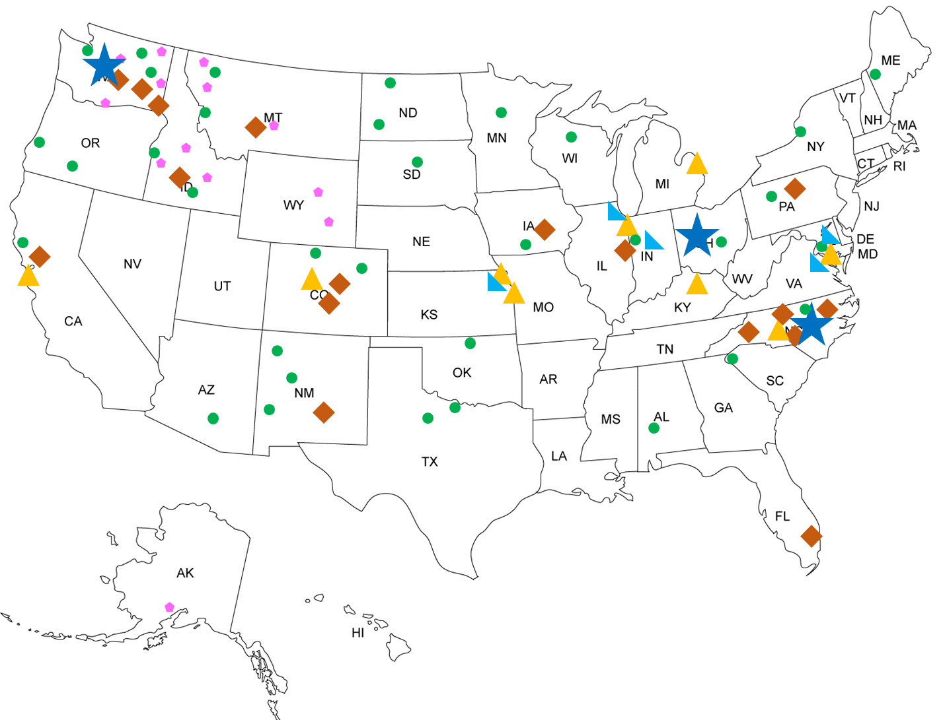
RRPD Program and TA Center Maps
RRPD-TAC Leadership
Content Experts
External Partners
Other Key Stakeholders
RTTC Programs
WWAMI Programs

Slide 6
Developing the “Roadmap for Rural Residency Program Development” model
No previous descriptions of a semi-standardized pathway for residency development exist
Used existing literature and iterative consensus process with 21 content experts
Framework describing steps needed in each of five key stages in program development: 1) exploration, 2) design, 3) development, 4) start-up and 5) maintenance.
Each stage ends with a “hard stop” that must be met to move from one stage to the next

Slide 7
Application of the model
For communities and institutions creating new residency programs, especially in rural areas, the model provides:
Order of steps to maximize chances of success
Awareness of pitfalls that may not be apparent from the get-go
Pre-emptive identification of barriers and challenges that may lie ahead
Pre-emptive identification of future steps for advance planning

Slide 8
The “Roadmap for Rural Residency Program Development” model
Each stage includes several goals and each goal includes multiple objectives
Goals and objectives demonstrate specific, measurable milestones need to be accomplished to move toward an accredited and sustainable program
Program development is iterative - may be meeting some goals in future stages before having moved to that stage of development based on these “hard stops”

Slide 9
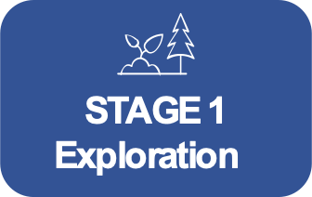
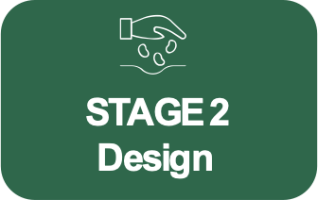
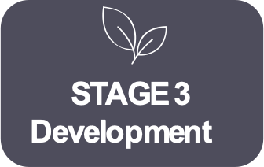
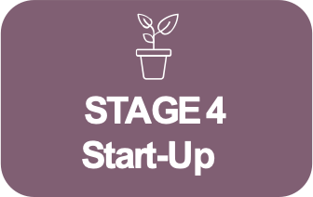
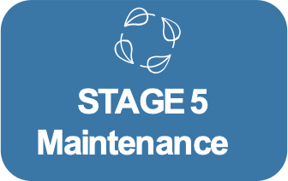
Community
Assets
Initial Educational & Programmatic Design
Program Personnel
Marketing & Resident Recruitment
Identify community assets and interested parties.
Identify Program Director (permanent or in development). Consider community assets, educational vision, resources, and accreditation timeline.
Appoint residency coordinator. Identify core faculty and other program staff.
Create a website. Register with required systems. Market locally and nationally.
Leadership
Program Planning & Accreditation
Program Infrastructure & Resources
Financial Planning
Assemble local leadership and determine program mission.
Develop curricular plans, goals and objectives; evaluation system and tools; policies and procedures; program letters of agreement; faculty roster. Complete ACGME application and site visit.
Hire core faculty and other program staff. Ensure faculty development. Complete any construction and start-up purchases. Establish annual budget.
Develop a budget and secure funding. Consider development
and sustainability with revenues and expenses.
Ongoing Efforts
Report annually to ACGME and the Sponsoring Institution. Maintain accreditation and financial solvency. Recruit and retain faculty. Track program educational and clinical outcomes. Ensure ongoing performance improvement.
Sponsorship
Identify an institutional affiliation or sponsorship. Begin to consider financial options and governance structure.
Sponsoring Institution Application
Matriculate
Find a Designated Institutional Official and organize the GME Committee. Complete application.
Welcome and orient new residents.
To advance to the next stage:
Make an organizational decision to proceed with investing significant resources in program development.
To advance to the next stage:
Finalize a draft budget. Complete program design to include curriculum outline and site mapping. Submit
a Sponsoring Institution (SI) application & receive initial accreditation.
To advance to the next stage:
Achieve initial program accreditation – requires successful site visit and
letter of accreditation
from the ACGME.
To advance to the next stage:
Complete contracts and
orient first class of residents. Hire all required faculty.

Slide 10
Complete community asset and capacity inventory.
Assemble a local leadership team.
Engage potential financial stakeholders and identify a preliminary governance structure.
Make an organizational decision to proceed with investing significant resources in program development.

Slide 11
Appoint a Program Director (PD) or a PD in development.
Complete initial program design.
Develop Sponsoring Institutional (SI) Application (if the SI is not already accredited).
Using initial program design, complete a detailed pro forma for all phases of program development and sustainability with revenues and expenses.
In light of the detailed pro forma, refine program design to include final curriculum outline and site mapping.
Submit SI application (if the SI is not already accredited).
Notes:
Steve

Slide 12
Identify key staff support and core faculty members.
Complete specific program planning.
Submit ACGME Application.
Complete ACGME site visit.
Finalize financial plan for the program.
Obtain ACGME accreditation.
Notes:
Steve

Slide 13
Develop plan for resident marketing and recruitment.
Complete program infrastructure.
Establish annual budget (based on earlier pro forma).
Fill program positions through the NRMP Match.
Matriculate and orient initial class of residents.
Notes:
STeve

Slide 14
Annually recruit excellent residents.
Maintain accreditation.
Maintain financial solvency; budget and reconcile budget annually.
Recruit and retain faculty.
Track program educational and clinical outcomes and ensure ongoing performance improvement, adaptability, and resilience.
Contribute to the community of practice in rural GME through dissemination of innovations and peer consultation.
Notes:
STeve

Slide 15
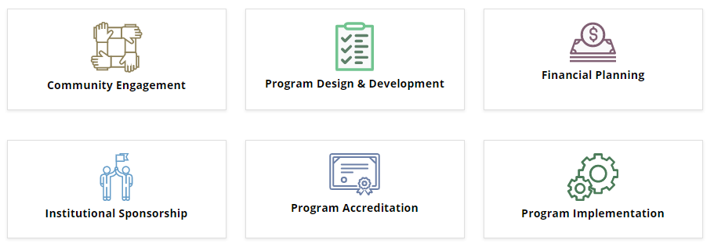
Domains

Slide 17
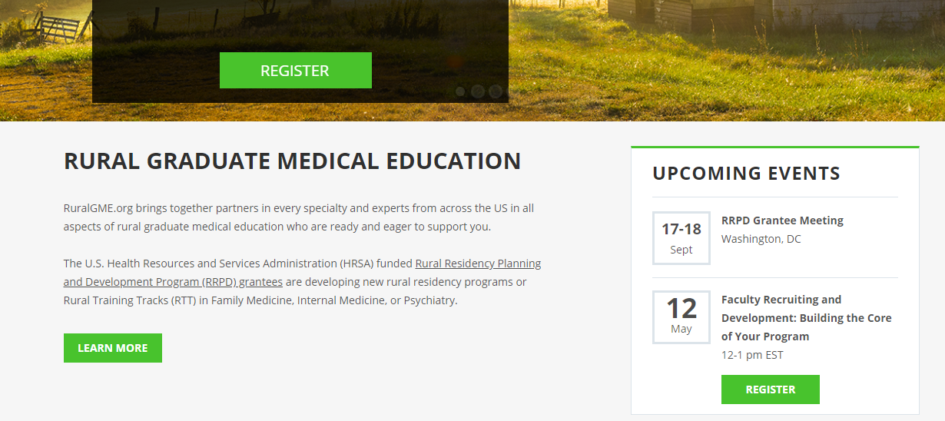

Slide 18
Community
Assets
Initial Educational & Programmatic Design
Program Personnel
Marketing & Resident Recruitment
Identify community assets and interested parties.
Identify Program Director (permanent or in development). Consider community assets, educational vision, resources, and accreditation timeline.
Appoint residency coordinator. Identify core faculty and other program staff.
Create a website. Register with required systems. Market locally and nationally.
Leadership
Program Planning & Accreditation
Program Infrastructure & Resources
Financial Planning
Assemble local leadership and determine program mission.
Develop curricular plans, goals and objectives; evaluation system and tools; policies and procedures; program letters of agreement; faculty roster. Complete ACGME application and site visit.
Hire core faculty and other program staff. Ensure faculty development. Complete any construction and start-up purchases. Establish annual budget.
Develop a budget and secure funding. Consider development
and sustainability with revenues and expenses.
Ongoing Efforts
Report annually to ACGME and the Sponsoring Institution. Maintain accreditation and financial solvency. Recruit and retain faculty. Track program educational and clinical outcomes. Ensure ongoing performance improvement.
Sponsorship
Identify an institutional affiliation or sponsorship. Begin to consider financial options and governance structure.
Sponsoring Institution Application
Matriculate
Find a Designated Institutional Official and organize the GME Committee. Complete application.
Welcome and orient new residents.
To advance to the next stage:
Make an organizational decision to proceed with investing significant resources in program development.
To advance to the next stage:
Finalize a draft budget. Complete program design to include curriculum outline and site mapping. Submit
a Sponsoring Institution (SI) application & receive initial accreditation.
To advance to the next stage:
Achieve initial program accreditation – requires successful site visit and
letter of accreditation
from the ACGME.
To advance to the next stage:
Complete contracts and
orient first class of residents. Hire all required faculty.
Notes:
Steve

Slide 19
Contact
For questions:
Email info@ruralgme.org

