Slide 1
Evaluation of Current Practices for Distance Learning Didactics Curricula in Rural Family Medicine Residency Programs
Ying Zhang, MD MPH; Assistant Professor; University of Washington (UW) Family Medicine Residency (FMR)
David Evans, MD; Professor & Residency Program Director; UW FMR
Keri Bergeson, MD; RTT Program Director (Chelan); UW FMR, Chelan RTT
Tessa Moore; Medical Student; UW School of Medicine
Viet Nguyen, MD; Resident Physician, UW FMR
Amanda Weidner, MPH; Research Consultant, WWAMI Family Medicine Residency Network
Notes:
Ying

Slide 2
Objectives
Describe the current landscape for didactic & distance learning curriculum practices in rural family medicine residency education.
Review common barriers and facilitators to implementing distance learning for family medicine residency didactics curricula at rural training sites.
Discuss & identify key components of bi-directional distance learning models that can be used to enhance family medicine residency education across various clinic sites or learning sites within each participant’s residency program
Notes:
Ying
ACGME accreditation in last 2 years; this year is first year with RTT interns at urban site
Chelan is in Eastern WA about 180 miles from Seattle
mention Chelan RTT as case example -- one of our priorities is maintaining connection (might not be true for all RTTs)
We started this project to figure out how to integrate and effectively delivery didactics between our urban and rural site. As we started thinking about this, we wanted to know more about what current rural family medicine resident training programs are doing with their didactic practices.

Slide 3
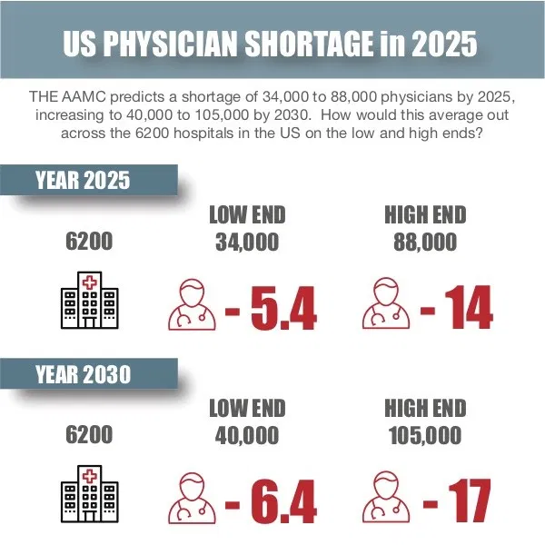
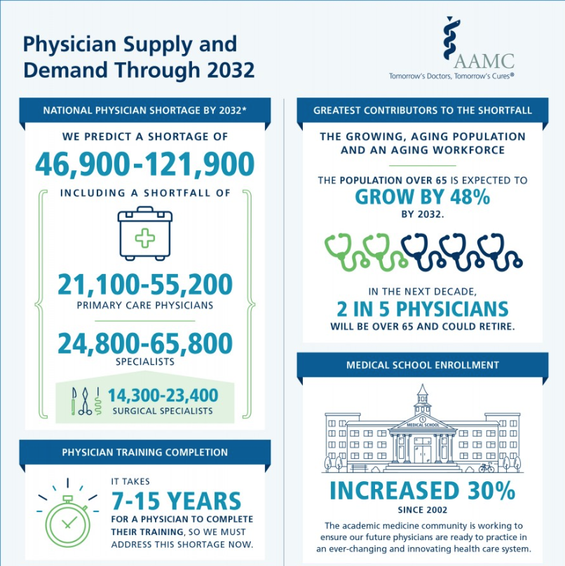
Physician Shortage
Notes:
Tessa
Physicians are in short supply. There is a discrepancy between physician density in rural and urban setting.
Identifying ways to improve education for our health care workforce is an evolving area, without robust data/clear objectives.

Slide 4
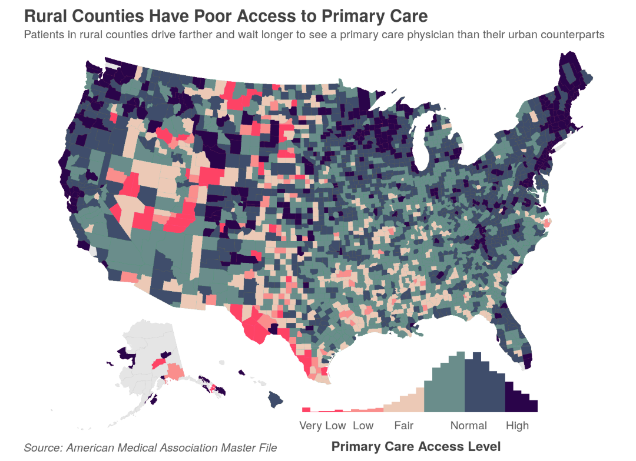
Rural Access
Reduced access to primary care
Fewer primary care doctors per patient
Many rural hospitals have had to close
Rural areas have a higher prevalence of various chronic conditions including diabetes and heart disease
American Academy of Family Physicians. (2015). Rural Practice, Keeping Physicians In. Retrieved October 7, 2015, from AAFP.org.
Notes:
Tessa
Acknowledge the issue of rural access here
https://www.ruralhealthweb.org/about-nrha/about-rural-health-care
https://www.aafp.org/about/policies/all/rural-practice-paper.html
Touching on rural/urban disparitiy is good but don’t need to say to much about thiat to this audience. They live it.
https://www.sciencedirect.com/science/article/abs/pii/S0033350612002016

Slide 5
Synchronous and Asynchronous Distance Learning
Instructors and learners are in different locations and interact using technology.
Synchronous: Instructors and learners are interacting in different locations but in real time.
Asynchronous: Material is available and learners are able to choose when, for how long, and at what speed they want to learn.
Notes:
Synchronous:
Instructors and learners are interacting in different locations but in real time.
Synchronous learning is any type of learning that takes place in real-time, where a group of people are engaging in learning at the same time. Although learning occurs at the same time, learners don’t have to be there in person. Or even in the same location!
Synchronous learning enables learners to ask questions and receive answers straight away.
Asynchronous:
Material is available and learners are able to identify when/for how long/in what space/what speed they learn. They are able to start/stop at their leisure.
Examples: Khan academy videos, podcasts, lecture slides. Eg: Email, Blogs, Pre-recorded video lessons or webinars, Online discussion boards
Talk about the Effectiveness of Online Blended curriculum
The terms blended learning and hybrid learning are used interchangeably and without a broadly accepted precise definition. Bonk and Graham (2005) described blended learning systems as a combination of face-to- face instruction and computer-mediated instruction. The 2003 Sloan Survey of Online Learning (Allen & Seaman, 2003) provided somewhat more detail, defining blended learning as a “course that is a blend of the online and face-to-face course. Substantial proportion of the content is delivered online, typically uses online discussions, typically has some face-to-face meetings” (p. 6). Horn and Staker (2010) defined blended learning as “any time a student learns at least in part in a supervised brick-and-mortar location away from home and at least in part through online delivery with some element of student control over time, place, path and/or pace” (p. 3).

Slide 6
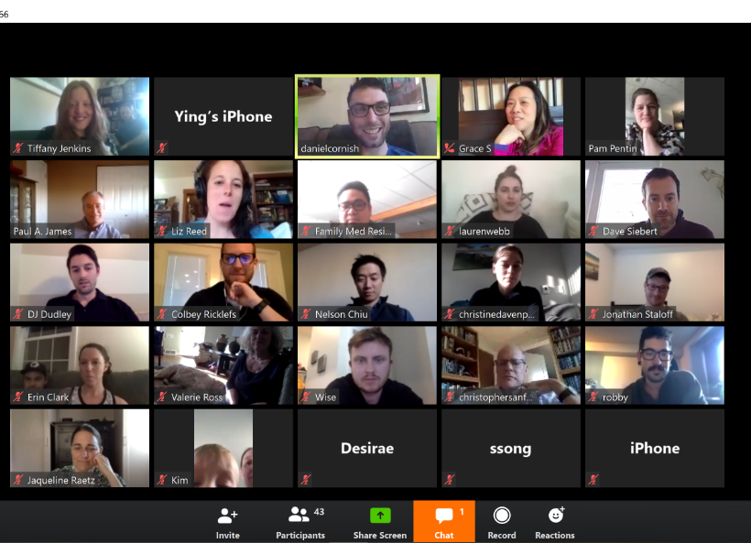
Distance Learning
Uni-directional Learning: A learning model in which information flows in one direction from teacher to learner.
Bi-directional Learning: An interactive learning model where participants at each site engage in both teaching and learning.
Notes:
Mention that learners/teachers can take advantage of the bi-directional learning when they are doing remote-learning/teaching in a synchronous way (real time with each other). Any evidence that bi-directional learning is more effective in certain situations?
Distance Learning: Instructors and learners are in different locations and interact using technology.

Slide 7
Success of Distance Learning
Background:
2005 study of 36 Wayne State University family medicine residents for one year of didactics (17 sessions).
Evaluating the effectiveness of an interactive, synchronous distance learning model compared to face-to-face instruction.
Methods:
Established two sites (24 miles apart) that the residents and instructors transitioned between.
Created a live audio/video connection between the two sites, that allowed for all residents to participate in live didactics.
For each session, depending on the location of the instructor, one site was deemed the traditional face-to-face classroom and the other was the distance learning site.
Sessions consisted of a 30-min pretest, three 45-min lectures with 15-min discussion after each lecture, and a 30-min posttest and evaluation.
Residents evaluated their satisfaction of the content and learning experience, and then pre and post tests were compared across learning models.
Key Findings:
Didactic sessions were rated highly by both groups (in-person and distance learning), with no significant difference in resident satisfaction.
Residents in both groups scored higher on posttests than pretests, and there was no significant difference in knowledge gain between the in-person and distance learning groups.
Synchronous distance learning is an effective way to deliver family medicine residency didactics across multiple sites.
Markova T, Roth L, Monsur J. Synchronous Distance Learning as an Effective and Feasible Method for Delivering Residency Didactics. Family Medicine. 2005;37(8):570-575.

Slide 8
Success of Distance Learning
Background:
2012 study of US orthodontic residency programs.
Evaluating distance learning as a way to combat the lack of full-time faculty at the residency sites.
Methods:
Developed a blended distance learning curriculum that utilized both pre-recorded seminars, and live post-seminar discussions.
Residents were supposed to complete pre-seminar reading, watch the 1.5 hour recorded seminar, and then participate in a 30-min live (in-person or via videoconference) discussion.
52% (33) of US orthodontic programs participated.
Key Findings:
Overall, despite some need for technology improvements, most residents and faculty reported they would like to use this distance learning model again.
The blended approach was determined to be effective and enjoyable.
Residents who completed the pre-seminar work reported a greater ability to learn from the curriculum.
This model allows residents to access various experts and eases the strain of faculty shortages.
Klein KP, Hannum WM, Koroluk LD, Proffit WR. Interactive distance learning for orthodontic residents: utilization and acceptability. Am J Orthod Dentofacial Orthop. 2012;141:378–385.
Notes:
Interactive distance learning for orthodontic residents: Utilization and acceptability
Various distance learning formats and technological platforms exist, with varied levels of success and satisfaction
Among the 214 programs with PDs who responded, 85 (39.7%) use synchronous e-learning at least sometimes, somewhat often, or very often (Fig. ​
(Fig.1).
1). In contrast to synchronous e-learning, more programs (153; 71.5%) use asynchronous e-learning at least sometimes, somewhat often, or very often. The most commonly reported e-learning approaches were locally developed PowerPoint slide shows with narration (147; 68.7%) and online modules from professional organizations (144; 67.3%).
Asynchronous elearning allows for residents to learn on their own schedules and to adhere to duty-hour restrictions.
Portaility/accessiility are helpful. Over time, developed e-learning content may reduce cost.
Internet based curriculua in the health professions outperformed no intervention for teaching knowledge/ehaviors/patient care outcomes. VIirtual patient interventions positively affected knowledge/clinical reasoning, and skill outcomes.
*Wittich, C (2017): E-learning in graduate medical education: survey of residency program directors
*Tomlinson, J (2013): How does tele-learning compare with other forms of education delivery? A systematic review of tele-learning educational outcomes for health professionals
Poirier, JN (2014): Evaluation of three different methods of distance learning for postgraduate diagnostic imaging education: A pilot study
Klein, K (2012): Interactive distance learning for orthodontic residents: Utilization and acceptability
Miller, K (2011): Recorded interactive seminars and follow-up discussions as an effective method for distance learning

Slide 9
Methods
Key Informant Telephone Interviews with 5 RTT programs to aid survey development
Electronic survey (RedCap) to RTT Collaborative programs – program directors and site directors
Analysis: descriptive analysis, planned bivariate analysis
UW IRB approval as exempt
Notes:
NOTE:
Need effective ways to teach learners in rural residency sites.
Despite increasing demand for rural primary care providers, little research has been done into the best ways to provide distance learning at rural residency sites.
Survey contacts : supplemented by outreach to those with RTT models missing site director email addresses

Slide 10
Survey Response for RTTs
69 individuals contacted as RTT program representatives for sample; 36 respondents at 31 sites = 52% response
43 IRTT or IRTT-like programs in sample so response represents 72% of RTT sites
Notes:
meaningful that we have 72% of RTT sites represented
but individual response rate was less (52% for RTTs) since surveyed more than one person per program for most RTTs

Slide 11
Survey Respondent Demographics: RTTs
Primary practice site location of respondent
rural | 12 (52%)
urban | 11 (48%)
Distance between urban and rural training sites*
<30 miles | 0 (0%)
31-60 miles | 6 (26%)
61-100 miles | 8 (35%)
>100 miles | 8 (35%)
Size of Rural Community for RTT*
<5,000 | 9 (39%)
5,001-10,000 | 6 (26%)
>10,000 | 11 (47%)
*Adds to >100% as respondents were encouraged to select more than one option if their program had more than one rural site
Notes:
data on rurally located programs, rural training pathways, and rural-centric programs not included
some percentages don’t add to 100% because of missingness
some of the categories have > 100% because participants could select more than one response (if more than one RTT site)
Key Points summary for RTT programs:
Respondents for RTTs were a mix of urban and rural site program directors, associate program directors, and core faculty.
Most respondents are from university based/university affiliated
Most respondents reported distance from urban to rural site is >60 miles (difficult to go in person to didactics)
Most respondents report size of rural community for RTT programs is </= 10,000 people
All RTT sites are ACGME accredited

Slide 12
Shared Didactics for RTTs
39% of RTTs share >50% of didactics remotely (phone/internet) between rural and urban site
Though 26% also share none
The majority (52%) of RTTs have a little (1-25%) of didactics shared in person with rural and urban sites
17% share no in person didactics
75% of RTTs with any shared didactics (N=20/23) have shared didactics delivered multiple times per month
This includes 25% who have them more than once per week
Most shared didactic sessions are ≥2 hours (60%)
45% are bi-directional >50% of the time
Another 30% are never bi-directional
Notes:
Key Points Summary from RTT programs
26% of respondents reported NONE for shared audio/visual remote didactics; everyone else reported some (39% share >50% of their didactics remotely through audio/visual)--> and actually 35% share more than 75%
17% of respondents reported NONE for shared in person didactics; everyone else reported some with 52% of respondents having </=25% of didactics shared in person
The majority of respondents report shared didactics happen between once per week and once per month (70%)
The majority of respondents reported that shared didactics last >/= 2 hours (similar to duration of non-shared didactics that are separately give at urban and rural sites)
30% of respondents have NO bidirectional didactics while 60% have bidirectional didactics > 25% of the time
Residents at both urban and rural sites are frequently/always relieved of clinical responsibilities during didactics
100% of didactics are given synchronously

Slide 13
Didactics at Rural & Urban Sites
Similar length of separate didactics at rural and urban sites
Residents at both rural and urban sites are frequently or always excused from clinical responsibilities for didactics
Who teaches?
urban site faculty tend to lead didactics 20-80% of the time
rural site faculty tend to lead less than 20% of the time
residents are leading didactics less than 20% of the time at most sites, with similar amounts of resident teaching at both urban and rural sites
some teaching from non-residency faculty (1-20%) with urban site non-residency faculty teaching more often (21-40%)
Notes:
*MENTION THAT THESE WERE ALL MULTIPLE CHOICE...

Slide 14
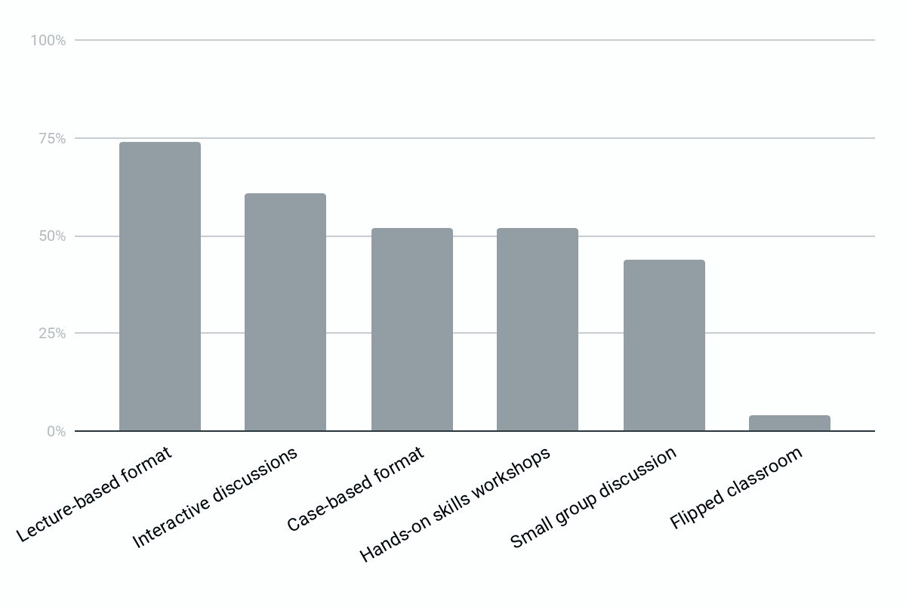
Most Commonly Used Didactic Formats
Notes:
Amanda
Thanks, Ying. This is Amanda and I’m going to talk a bit more about the didactic formats and shared remote didactics.
We asked respondents to indicate their top 3 didactic formats for any of their didactic offerings.
As this graph shows, the standard lecture-based format remains the most popular, but interactive discussions, and both case-based and hands-on workshops were also very common
choose top 3
Key Points:
lecture based/Interactive discussion/hands on skills workshop & case based are the top three formats for didactics (#3 was tied)
Zoom & other (??) is most frequently used platform for remote technology

Slide 15
Remote Didactics
100% report most didactics sessions are synchronous
Most sites are using in person (70%) AND remote audio & video (61%) for most didactic sessions
93% (13/14) report having issues with remote connection or technology some of the time
but 71% report less that they have issues less than 25% of the time
85% have someone on site to help with technology
Notes:
Amanda
Once we knew a little about the shared and separate didactic structures at rural and urban sites, we wanted to dive into more about the structures for those using shared remote didactics.
For sites doing any remote didactics, all reported that they are mostly offered in real time and most reported using both in person and audio/video options
Technology disruptions happen to everyone, but thankfully appear to be fairly minor, with most sites reporting issues less than a quarter of the time.
Almost all programs have someone on site to help with the technology aspects of remote didactics, and Zoom was the most commonly used platform with a wide range of other alternatives

Slide 16
Barriers to Remote Didactics
Top barriers for those without shared remote didactics | Top challenges for those with shared remote didactics
Scheduling challenges Lack of faculty champions | Lack of training for faculty/residents in giving remote didactics Lack of time to develop curriculum Tie between: Lack of appropriate technology; Lack of staff to help with remote connection; Lack of faculty availability; and no on-site IT person
Notes:
Amanda
One important component of our survey purpose was to learn more about barriers and challenges with conducting didactics remotely
Those without any shared remote didactics reported scheduling challenges and a lack of faculty champions as top barriers
Those WITH shared remote didactics had slightly different barriers, reporting a lack of training for faculty and residents in giving remote didactics and a lack of time to develop the curriculum as the top barriers.
They also reported lack of appropriate technology, faculty and staff – including an on-site IT person, as major challenges.

Slide 17
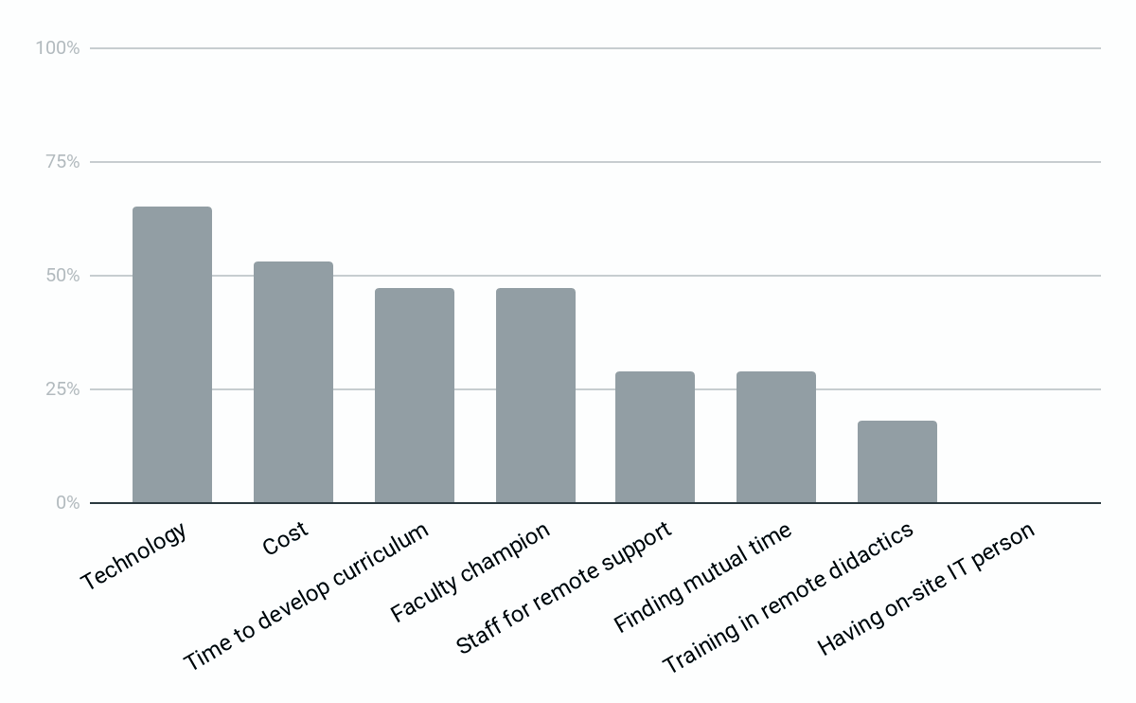
Top Facilitators of Shared Remote Didactics
Notes:
Amanda
Additionally, we were interested in learning more about facilitators of shared remote didactics and asked respondents to choose their top 3 facilitators.
Unsurprisingly, the things that make shared remote didactics work well are the opposite of the top barriers – good technology and the financial resources to purchase it, having designated time to develop the curriculum – as well as faculty and staff support and leadership.

Slide 18
Room for improvement!
Satisfied or very satisfied with the delivery and structure of didactics at your rural site | 14 (61%)
Satisfied or very satisfied with the technology available to provide distance learning/remote didactics at your rural site | 7 (30%)
Interested or very interested in improving ability to have shared remote didactics between your rural and urban program sites | 16 (70%)
Notes:
Amanda
Lastly, our results showed that there is room for improvement in this space
Although 61% of respondents reported being satisfied or very satisfied with the delivery and structure of didactics at their rural site, only 30% were satisfied with the technology available to make remote didactics happen and 70% were interested in finding ways to improve their shared didactics.

Slide 19
Key messages from our preliminary results
Multiple and remote sites require curricular innovation and connection for didactic learning
70% of respondents reported distance from urban to rural site >60 miles
About three quarters of respondents have some shared didactics over phone/internet and 83% of respondents have some shared didactics in-person (less frequent) between urban and rural sites’
Higher percentage of urban site faculty are leading most didactic sessions compared with rural site faculty
100% of participants said that most of their didactic sessions are synchronous
Top challenges to holding shared remote didactic sessions: lack of training & lack of time to develop
Top facilitators to holding shared remote didactic sessions: having technology, financial resources for technology, time for curricular development, & faculty champion
Notes:
YING
also 70% said some didactics are bi-directional

Slide 20
Acknolwedgements
All of you!
RTT Collaborative
Dr. Randy Longnecker
Dr. David Schmitz
Notes:
Thank you for participating in the survey

Slide 21
Discussion
Planned to be over Zoom on 4/16
Discuss & identify key components of bi-directional distance learning models that can be used to enhance family medicine residency education across various clinic sites or learning sites within each participant’s residency program

